Slide 1
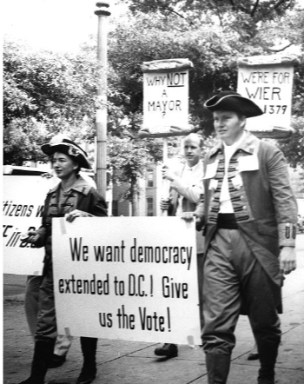
Timeline of D.C. Home Rule History
Home Rule: Grade 12, Lesson 4
Notes:
About this lesson
This lesson focuses on a timeline of Home Rule events from the establishment of the Nation’s Capital in 1790 through the District of Columbia Home Rule Act of 1973. The events summarize Washington, D.C.’s journey to Home Rule.
Students . . .
track the events discussed in the lesson on a timeline handout.
summarize the history of Home Rule in Washington, D.C.
Materials:
Entrance Ticket (blank)
Entrance Ticket (completed)
Timeline of D.C. Home Rule History (blank)
Timeline of D.C. Home Rule History (completed)
Exit Ticket (blank)
Exit Ticket (completed)
ELA Standards:
SL.11-12.1: Initiate and participate effectively in a range of collaborative discussions (one-on-one, in groups, and teacher-led) with diverse partners on grades 11-12 topics, texts, and issues, building on others' ideas and expressing their own clearly and persuasively.
W.11-12.4: Produce clear and coherent writing in which the development, organization, and style are appropriate to task, purpose, and audience. (Grade-specific expectations for writing types are defined in standards 1-3 above.)
W.11-12.2: Write informative/explanatory texts to examine and convey complex ideas, concepts, and information clearly and accurately through the effective selection, organization, and analysis of content.
RI.11-12.7: Integrate and evaluate multiple sources of information presented in different media or formats (e.g., visually, quantitatively) as well as in words in order to address a question or solve a problem.
DC Content Power Standards:
12.DC.22.6: Review the reasons why Washington, D.C. residents do not have voting representation in Congress, and assess the prospects for current efforts to get congressional representation for the District.
12.DC.16: Students identify key milestones and efforts that led to greater self-government and suffrage for Washington, D.C. residents.
C3 Framework Indicators and Common Core Standards for Literacy in History/Social Studies:
D2.Civ.12.9-12. Analyze how people use and challenge local, state, national, and international laws to address a variety of public issues.
D2.Civ.14.9-12. Analyze historical, contemporary, and emerging means of changing societies, promoting the common good, and protecting rights.

Slide 2
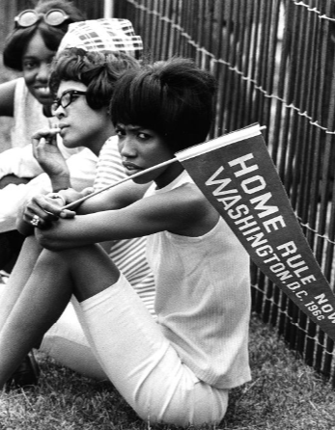
Let's Review!
What is Home Rule, and why was Home Rule so important to residents of Washington?
Notes:
Teaching notes
Suggested Pacing: 4 minutes
Directions:
Use an established classroom routine to pair students or use elbow partners.
Hand out the Entrance Ticket.
Say, “What is Home Rule, and why was Home Rule so important to residents of Washington?”
Students should record their answers on the Entrance Ticket.
Prompt students to turn and talk to their partners about the question.
Conduct a whole class discussion calling on a few students to share their thinking.
Student Look-Fors:
Student responses will vary.
See completed example.
Attribution:
Supporters at the Home Rule Day rally. Evening Star (Washington, D.C.). Washington Star Photograph Collection. DC Public Library.

Slide 3
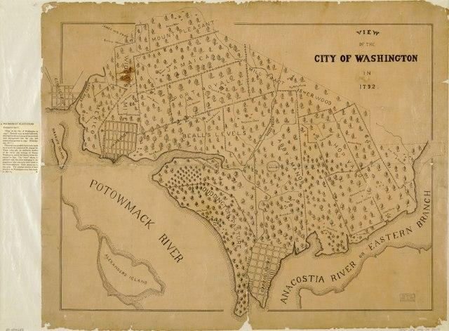
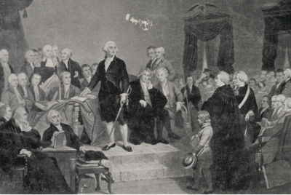
Timeline of Home Rule History: 1790
City of Washington and the Territory of Columbia established
City had a modern design
Territory formed from land that came from Maryland and Virginia
Three commissioners governed the city
Notes:
Teaching notes
Suggested Pacing: 3 minutes
Directions:
Hand out the Timeline of Home Rule History handout.
Refer to Timeline of Home Rule History completed handout as needed.
Show students where they will keep track of the different events that occurred in Home Rule History.
Say, “The City of Washington and the Territory of Columbia were established in the year 1790. President George Washington chose the city’s site along the Potomac and Anacostia Rivers.
The city was to be distinct and distinguished from the rest of the states.
Washington appointed Pierre Charles L’Enfant to design the city with a modern grid system that included boulevards and ceremonial spaces. The style of the city was similar to that of L'Enfant's home in Paris, France.
The Territory was formed from land that came from Maryland and Virginia, and the residents voted in these two states. President George Washington assigned three commissioners, or government officials, to govern the city.”
Ask students to record the following date on the Timeline of Home Rule History handout:
1790
Attributions:
Library of Congress Geography and Map Division, Washington, D.C.
George Washington takes his oath of office during his inauguration. Historic Image Collection. DC Public Library.

Slide 4
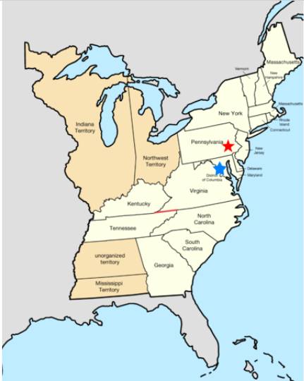
Timeline of Home Rule History: 1800
Capital of the United States moved from Philadelphia to the City of Washington
Why do you think the capital was moved from Philadelphia to the City of Washington?
Notes:
Teaching notes
Suggested Pacing: 4 minutes
Directions:
Say, “In 1800, the Capital of the United States moved from Philadelphia to the City of Washington.
From this point, the City of Washington was officially the Nation’s Capital. The Capitol building was not completely constructed at this time.”
Ask students to record the following date on the Timeline of Home Rule History handout:
1800
Say, "Let’s think about this event for a minute. Why do you think the capital was moved from Philadelphia to the City of Washington?
Look at the map to guide your thinking. The red star on the map represents the City of Philadelphia. The blue star represents the City of Washington.
Turn to your partner and discuss your thinking.”
Conduct a whole class discussion calling on a few students to share their thinking.
Student Look-Fors:
Student responses will vary.
The capital moved south to the City of Washington so that it was closer to the middle of the United States.
Attribution:
Golbez / CC BY-SA

Slide 5
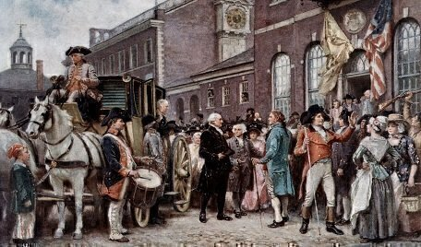
Timeline of Home Rule History: 1800
Moving the Capital from Philadelphia to Washington, D.C.
Yellow fever epidemic in Philadelphia
Geographical center of the country
Residence Act of July 16, 1790
Notes:
Teaching notes
Suggested Pacing: 2 minutes
Directions:
Say, “The Nation’s Capital was moved from Philadelphia to Washington, D.C. for several reasons.
In 1793, a yellow fever epidemic hit Philadelphia. The area was not thought to be safe.
George Washington, James Madison, and Thomas Jefferson were originally from Virginia, and they saw this as an opportunity for the capital to move closer to their home state.
Another reason for the move was based on geography. Moving the capital to Washington, D.C. placed it closer to the middle of what was then the United States.
An additional reason for the move was political. The Residence Act of July 16, 1790 moved the Nation's Capital to Washington, D.C. as part of a plan to appease the states who supported slavery because they feared that a capital in the north would support pro-abolitionists.”
Attribution:
How Philadelphia lost the nation’s capital to Washington

Slide 6
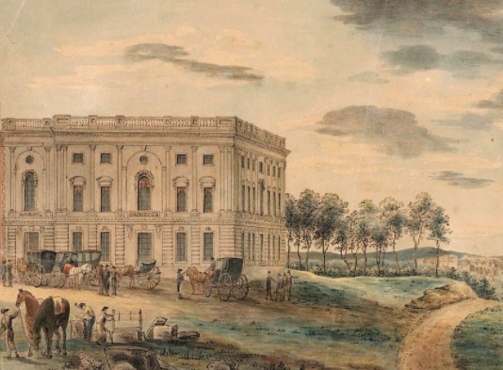
Timeline of Home Rule History: 1802
Citizens protested for self-government
Congress gave the City of Washington a charter and a Council
Voters elected Council
Council passed local laws and determined some taxes
President gave the City of Washington a mayor
Notes:
Teaching notes
Suggested Pacing: 2 minutes
Directions:
Say, “In 1802, the citizens of the City of Washington started protesting for self-government. They wanted the opportunity to govern themselves.
Congress gave the City of Washington a charter, which is a document issued by a government that gives rights to a person or group.
Congress also gave them a Council, which is a group of people appointed or elected to make laws. Voters elected the members of Council and then the Council was able to pass laws and determine some taxes.
Congress also allowed the City of Washington to have a mayor; that mayor needed to be appointed by the President.”
Ask students to record the following date on the Timeline of Home Rule History handout:
1802
Attribution:
Washington D.C. 1800

Slide 7
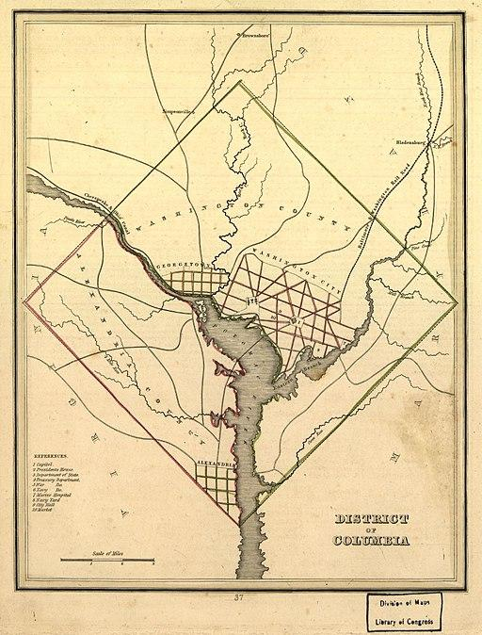
The Organic Act of 1871
Combined Alexandria, Georgetown, and the City of Washington
Became District of Columbia
District was 10 miles square
Three commissioners governed
Notes:
Teaching notes
Suggested Pacing: 3 minutes
Directions:
Say, “After the Civil War, the City of Washington’s population grew very quickly. Even though so many people were living there, the City was not in good shape.
It still had dirt roads and problems keeping the city clean.
Congress needed to make a change, especially because the City of Washington was the Nation’s Capital. Congress passed the Organic Act of 1871.
The Organic Act combined Alexandria, Georgetown, and the City of Washington. The area became the District of Columbia. Alexandria was formerly in Virginia. Georgetown was formerly in Maryland.
According to the Constitution, the District was 10 miles square. President Ulysses S. Grant assigned three commissioners, or government officials, to govern the district. This was similar to President George Washington assigning three commissioners to govern the City of Washington in 1790.”
Ask students to record the following event on the Timeline of Home Rule History handout:
1871
Attribution:
Unknown author / Public domain

Slide 8
Turn and Talk
Why did the citizens of Washington, D.C. push for self-government?
Consider your prior learning, and make connections between the costumes worn by the protestors, the issue they are protesting, and the Boston Tea Party.
Notes:
Teaching notes
Suggested Pacing: 4 minutes
Directions:
Say, ”From 1948 until 1966, the citizens of Washington, D.C. pushed for self-government. Why do you think the citizens would push for self-government?
Consider your prior learning, and make connections between the costumes worn by the protestors, the issue they are protesting, and the Boston Tea Party.
Turn to your partner and discuss your thinking.”
Prompt students to turn and talk to their partners about the question.
Conduct a whole class discussion calling on a few students to share their thinking.
Student Look-Fors:
Student responses will vary.
The citizens would want the freedom to make their own laws and choices rather than have Congress and the President make those decisions for them.
In this picture, the protestors are dressed as colonists.
In 1773, frustration over being taxed without a voice in British Parliament drove the colonists to protest. American colonists dumped 342 chests of tea into Griffin’s Wharf in Boston, Massachusetts.
This event became known as the Boston Tea Party. The tea had been imported by the British East India Company. The colonists were protesting taxation without representation.
Attribution:
D.C. residents march for home rule in colonial costumes. Evening Star (Washington, D.C.). Washington Star Photograph Collection. DC Public Library.

Slide 9
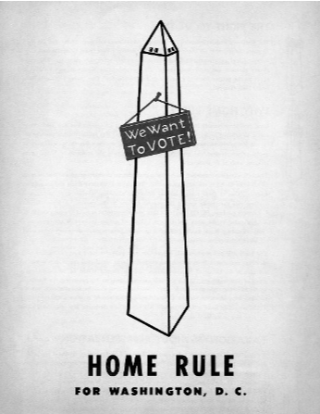
Timeline of Home Rule History: 1948 to 1966
Home Rule bills introduced in Congress
None of the bills passed
Struggle for D.C. Home Rule continued
Notes:
Teaching notes
Suggested Pacing: 2 minutes
Directions:
Say, “When people in the United States have ideas about laws they would like to see created in our country, they send those ideas to members of the House of Representatives or to the Senate. These are the two parts of the U.S. Congress.
Any member of Congress who has an idea for a law can draft a bill. A bill is a written description of a new law, and all laws in the United States begin as bills.
After they are introduced to Congress, bills are voted on. If Congress passes a bill, it goes to the President to be signed into law.
Between 1948 to 1966, six bills were introduced in Congress to provide some form of home rule for the District. They never became laws, and the struggle for D.C. Home Rule continued.”
Ask students to record the following dates and details to the Timeline of Home Rule History handout:
1948 to 1966
Attribution:
Home rule for Washington, D.C. poster. Washingtoniana Ephemera Collection. DC Public Library.

Slide 10
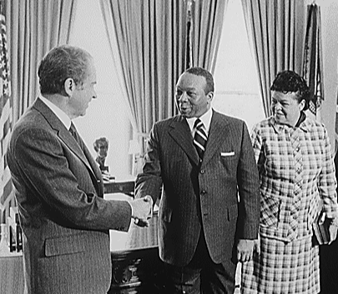
Timeline of Home Rule History: 1967
Congress removed the three-commissioner government
Walter Washington became Mayor-Commissioner
Notes:
Teaching notes
Suggested Pacing: 2 minutes
Directions:
Say, “In 1967, President Johnson convinced Congress to remove the three-commissioner government to provide Washington D.C. with more opportunity for self-government.
With this change, Washington, D.C. now had a presidentially appointed Mayor-Commissioner, Walter Washington. Unlike all other mayors, Washington had the title of mayor but was not elected by the people.
This change moved the District a step closer to home rule.”
Ask students to record the following date on the Timeline of Home Rule History handout:
1967
Attribution:
Jack E. Kightlinger, White House Photographer / Public domain

Slide 11
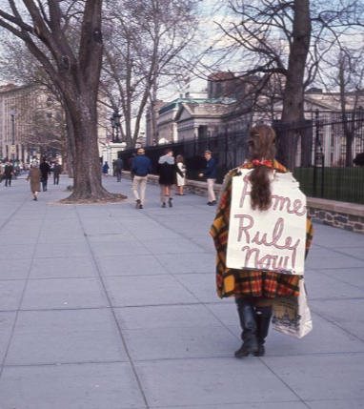
Timeline of Home Rule History: 1970
D.C. citizens earned the right to elect a representative to Congress
Representative could not vote
First time in 100 years that Washingtonians had the chance to elect a representative to Congress
Notes:
Teaching notes
Suggested Pacing: 2 minutes
Directions:
Say, “In 1970, citizens of Washington D.C. were given the right to elect a representative to Congress for the first time in 100 years.
This representative did not have full voting privileges in the House of Representatives but acted as a voting member in the U.S. Congressional committees.
This representative could also lobby for their congressional colleagues regarding the District's interests.”
Ask students to record the following date on the Timeline of Home Rule History handout:
1970
Attribution:
Woman protesting for Home Rule outside of White House. Crain, Darrell C., 1910-1995. Darrell C. Crain, Jr. Photograph Collection. DC Public Library.

Slide 12
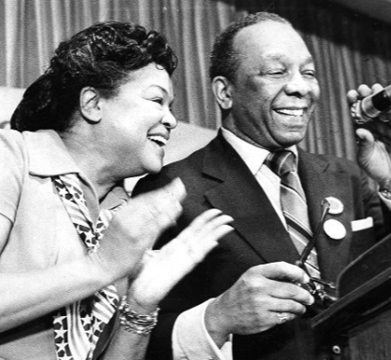
Timeline of Home Rule History: 1973
The District of Columbia Home Rule Act became a United States federal law
Walter Washington became the first Home Rule Mayor of Washington, D.C.
Notes:
Teaching notes
Suggested Pacing: 2 minutes
Directions:
Say, “With the Home Rule Act of 1973, the citizens of Washington, D.C. gained certain powers.
Walter Washington became the first elected Home Rule Mayor of Washington, D.C.
After almost 200 years, Washington, D.C. had the right to elect a mayor.
The citizens also had the right to elect a district council. A council is a group of people elected to manage a city or district. This council had the ability to pass laws.”
Ask students to record the following date on the Timeline of Home Rule History handout:
1973
Attribution:
Walter and Bennetta Washington celebrate on election night. Evening Star (Washington, D.C.). Washington Star Photograph Collection. DC Public Library.

Slide 13
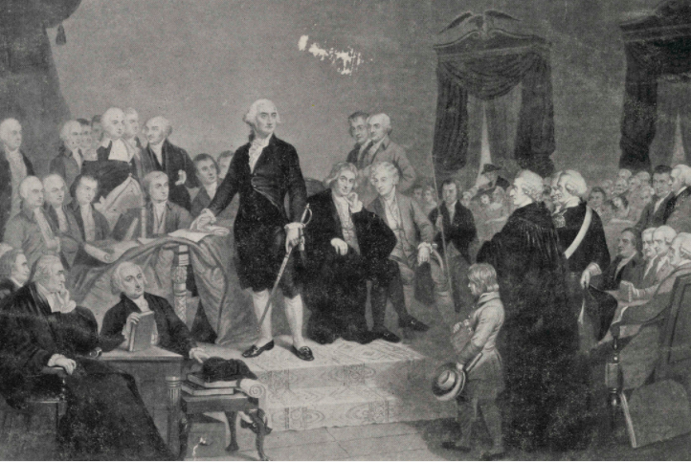
Express Your Understanding!
Summarize the history of Home Rule in Washington, D.C.
Notes:
Teaching notes
Suggested Pacing: 5 minutes
Directions:
Hand out a copy of the exit ticket.
As a formative assessment, students are asked to complete a quick-write to the following prompt: “In a few sentences, summarize the history of Home Rule in Washington, D.C.”
Collect exit tickets as a formative assessment.
Student Look-Fors:
Student responses will vary.
See completed example.
Attribution:
George Washington takes his oath of office during his inauguration. Historic Image Collection. DC Public Library.

