Slide 1
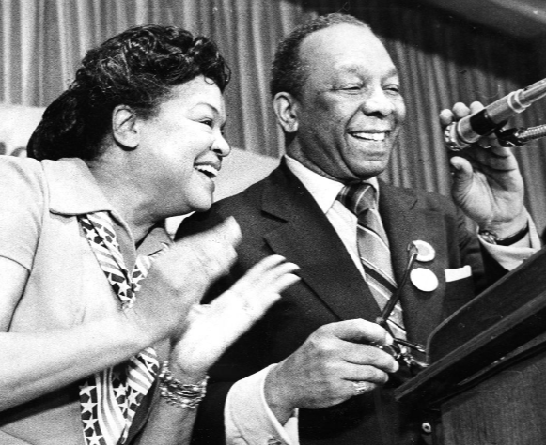
Early Leaders for D.C. Independence
Home Rule: Grade 12, Lesson 7
Notes:
About this lesson
This lesson focuses on early advocates for Washington, D.C. Home Rule.
Students . . .
identify specific leaders who supported Washington, D.C.'s independence including Dr. Martin Luther King, Jr., President Lyndon Baines Johnson, and Walter Washington.
express their understanding with an exit ticket.
Materials:
Entrance Ticket (blank)
Entrance Ticket (completed)
Support for Washington, D.C. Independence (blank)
Support for Washington, D.C. Independence (completed)
Exit Ticket (blank)
Exit Ticket (completed)
Capital Takes Dr. King to its Heart
ELA Standards:
SL.11-12.1: Initiate and participate effectively in a range of collaborative discussions (one-on-one, in groups, and teacher-led) with diverse partners on grades 11-12 topics, texts, and issues, building on others' ideas and expressing their own clearly and persuasively.
W.11-12.4: Produce clear and coherent writing in which the development, organization, and style are appropriate to task, purpose, and audience. (Grade-specific expectations for writing types are defined in standards 1-3 above.)
W.11-12.2: Write informative/explanatory texts to examine and convey complex ideas, concepts, and information clearly and accurately through the effective selection, organization, and analysis of content.
RI.11-12.7: Integrate and evaluate multiple sources of information presented in different media or formats (e.g., visually, quantitatively) as well as in words in order to address a question or solve a problem.
DC Content Power Standards:
12.DC.16: Students identify key milestones 1 and efforts that led greater self-government and suffrage for Washington, D.C. residents.
12.DC.17: Students identify key people 2 who were civic and political leaders in Washington, D.C. during the second half of the 20th century.
12.DC.22.6: Review the reasons why Washington, D.C. residents do not have voting representation in Congress, and assess the prospects for current efforts to get congressional representation for the District.
C3 Framework Indicators and Common Core Standards for Literacy in History/Social Studies:
D2.Civ.3.9-12. Analyze the impact of constitutions, laws, treaties, and international agreements on the maintenance of national and international order.
D2.Civ.4.9-12. Explain how the U.S. Constitution establishes a system of government that has powers, responsibilities, and limits that have changed over time and that are still contested.
D2.Civ.12.9-12. Analyze how people use and challenge local, state, national, and international laws to address a variety of public issues.
D2.Civ.14.9-12. Analyze historical, contemporary, and emerging means of changing societies, promoting the common good, and protecting rights.

Slide 2
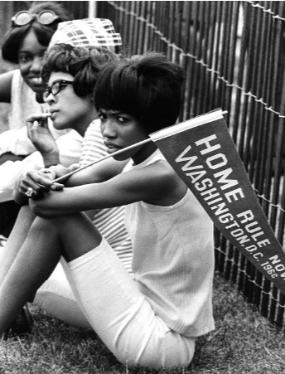
Let's Write
Think of a leader or an activist who was involved in Washington, D.C. Home Rule.
How did this person contribute to the fight for D.C.’s representation in Congress?
Notes:
Teaching notes
Suggested Pacing: 5 minutes
Directions:
Hand out copies of Entrance Ticket.
Say, “Think of a leader or activist who was involved in Washington, D.C.’s fight for Home Rule.
How did this person contribute to the fight for DC representation in Congress?”
Students should record their answers on the Entrance Ticket.
Prompt students to turn and talk to their partners about the question.
Conduct a whole class discussion calling on a few students to share their thinking."
Student Look-Fors:
Student responses will vary.
Refer to completed Entrance Ticket.
Attribution:
Supporters at the Home Rule Day rally. Evening Star (Washington, D.C.). Washington Star Photograph Collection. DC Public Library.

Slide 3
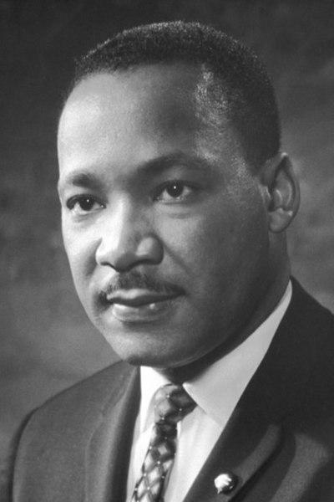
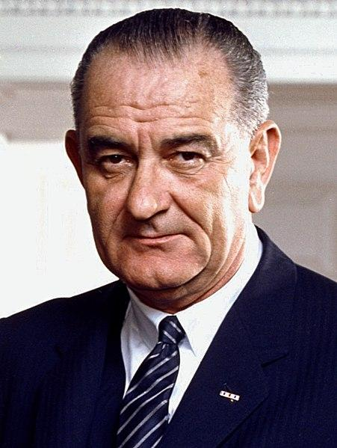
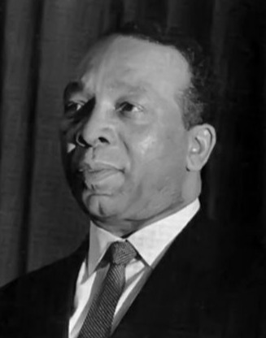
Early Leaders for D.C. Independence
Dr. Martin Luther King, Jr.
President Lyndon Baines Johnson
Walter Washington
Notes:
Teaching notes
Suggested Pacing: 1 minute
Directions:
Say, “Hundreds of activists shaped Washington, D.C. during the fight for Home Rule.
This lesson will focus on three early leaders who supported D.C. independence: Dr. Martin Luther King, Jr., President Lyndon Baines Johnson and Walter Washington."
Hand out copies of Supporters of Washington, D.C. Independence (blank).
Refer to completed Supporters of Washington, D.C. Independence as needed.
Attributions:
Nobel Foundation / Public domain
Arnold Newman, White House Press Office (WHPO) / Public domain
Not specified / Public domain

Slide 4
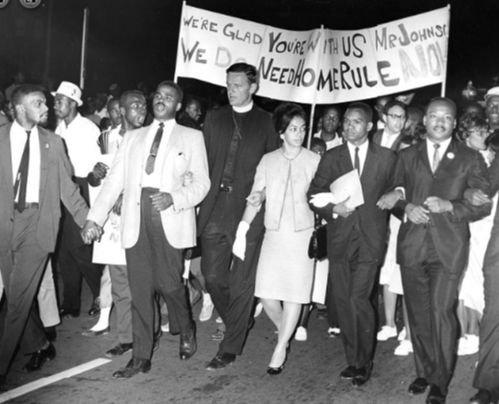
Dr. Martin Luther King and D.C. Home Rule
Supporter of D.C. Home Rule
Believed D.C. should have full voting representation in Congress
Worked with D.C residents to gain their right to self-governance
Notes:
Teaching notes
Suggested Pacing: 2 minutes
Directions:
Say, "Dr. Martin Luther King, a civil rights leader in the 1950s and 1960s, fought for the equal rights of all American people.
Dr. King wanted to change America so that race or income would not impact a person's civil rights.
He wanted America to become a country where all people had equal access to opportunities.
Dr. King saw that the citizens of Washington, D.C. were treated differently than other citizens in the United States and he knew this was unfair.
Dr. King was a strong supporter of D.C. Home Rule. By protesting alongside the residents of Washington, D.C., King joined their struggle to gain the right to self-governance."
Students should add the following information to their Supporters of Washington, D.C. Independence (blank) handout:
Supporter of D.C. Home Rule
Believed D.C. should have full voting representation in Congress
Worked with D.C residents to gain their right to self-governance
Attribution:
Reverend Martin Luther King Jr., Reverend Walter Fauntroy, Right Reverend Paul Moore Jr., Reverend Ralph David Abernathy, and Reverend Andrew Young at the March for Home Rule. Evening Star (Washington, D.C.). Washington Star Photograph Collection. DC Public Library.

Slide 5
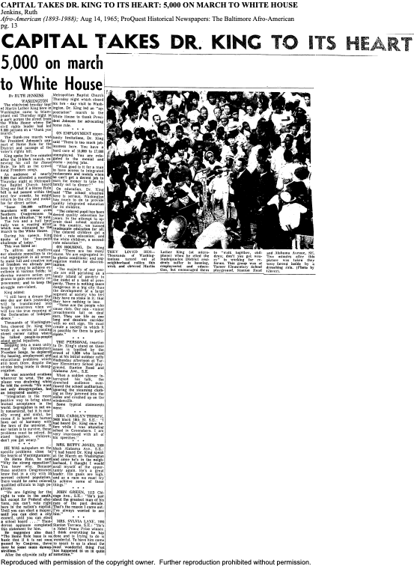
Dr. King and D.C. Home Rule
Dr. King's Thank-You March to the White House
Marched to thank President Johnson for support of Home Rule and Voter's Rights Bill
Believed that the opposition to D.C. home rule was fueled by racism
Addressed the issues of home rule, employment, and housing
Notes:
Teaching notes
Suggested Pacing: 3 minutes
Directions:
Say, “After a two-day tour of Washington, D.C, Dr. King marched to the White House with supporters and spoke to the crowd on Thursday, August 12, 1965.
Dr. King thanked President Johnson for his support of Home Rule and the Voter's Rights Bill.
Making connections to the struggle for voting rights across the country, Dr. King addressed his beliefs about the opposition to D.C. home rule .
King explained that the majority of D.C.'s population was African American. If D.C. gained home rule, many officials in high positions would be African American.
Dr. King believed that members of Congress did not want to see African Americans in these positions, and that racism fueled their opposition to home rule.
During his address, Dr. King also addressed the issues of home rule, employment, and housing."
Additional Note:
Consider assigning the article Capital Takes King to Heart: 5,000 on March to White House" by Ruth Jenkins for homework.
Attribution:
"Capital Takes King to Heart: 5,000 on March to White House" by Ruth Jenkins. Baltimore Afro-American, Aug 14, 1965. Accessible via ProQuest Historic Black Newspapers

Slide 6
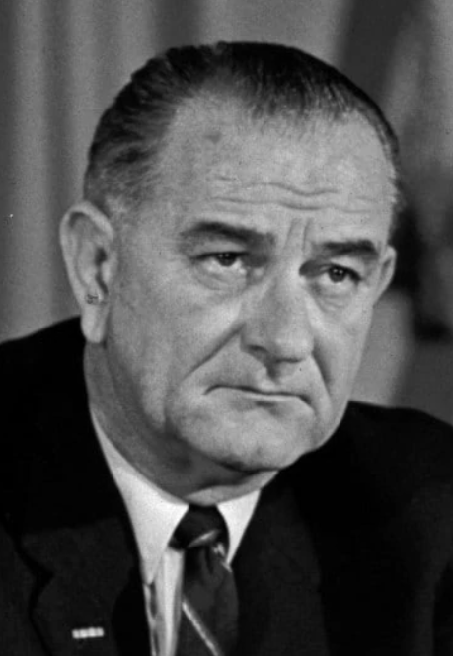
President Lyndon Baines Johnson
President from 1963 to 1969
Vice President from 1961 to 1963
Congressman from 1949 to 1961
Senator from 1937 to 1949
Notes:
Teaching notes
Suggested Pacing: 2 minutes
Directions:
Say, “President Lyndon Baines Johnson was the 36th president of the United States. His term ran from 1963 until 1969.
Prior to his presidential term, Johnson served as the vice president to John F. Kennedy.
President Johnson spent 32 years of his career on Capital Hill, and he felt a strong sense of commitment and connection to Washington, D.C."
Attribution:
The Flight LBJ could not win D.C. home rule

Slide 7
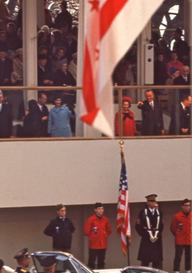
The Great Society
Purpose was to expand aid to social institutions such as education, medical care, and employment
Goal was to eliminate poverty and racial injustice
Led to the signing of the The United States Voting Rights Act of 1965
Notes:
Teaching notes
Suggested Pacing: 2 minutes
Directions:
Say, “During his presidency, Johnson created a domestic policy called the ‘Great Society.’ The purpose of this legislation was to expand aid to social institutions such as education, medical care, and employment.
The ultimate goal of the Great Society policy was to eliminate poverty and racial injustice.”
The Great Society policy led to the signing of the The United States Voting Rights Act of 1965.
This act overcame the legal barriers that prevented African Americans from having their right. Historically, the Voting Rights Act is considered one of the most significant pieces of civil rights legislation in the United States.”
Attribution:
Presidential box at the Inaugural Parade. Crain, Darrell C., 1910-1995. Darrell C. Crain, Jr. Photograph Collection. DC Public Library.

Slide 8
Turn and Talk
"By the time Lyndon Johnson became President, he had lived in Washington, D.C., almost all his adult life; he was as much a Washingtonian as any resident of the nation's capital. While the press caricatured him as a big-handed, big-nosed, larger-than-life, tall Texan —and he had indeed loved the state of his birth and youth — it was Washington where he and Lady Bird lived day to day," Califano recalled. "Lady Bird would leave a stunning legacy of floral beautification along the Potomac, the Mall, and throughout the parks. LBJ's legacy to the District of Columbia, as might be expected, was political."
The fight LBJ could not win: D.C. home rule by Karen Tumulty
Notes:
Teaching notes
Suggested Pacing: 4 minutes
Directions:
Say, "Read the quote from Johnson's domestic policy chief, Joseph A. Califano Jr.
How does this quote illustrate President Johnson’s dedication to the residents of Washington D.C.?"
Prompt students to turn and talk to their partners about the question.
Conduct a whole class discussion calling on a few students to share their thinking.
Student Look-fors:
Student answers will vary.
In his role as President, President Johnson had considerable influence in Washington, D.C.’s Home Rule efforts.
President Johnson’s commitment to Home Rule for Washington, D.C. was reflected in his personal connection to the city.
Supports for Differentiation
Lady Bird Johnson was the wife of President Johnson, 36th president of the United States. She was an environmentalist. She was named Claudia Alta Taylor, but her family gave her the nickname of Lady Bird.
Attribution:
Arnold Newman, White House Press Office (WHPO) / Public domain

Slide 9
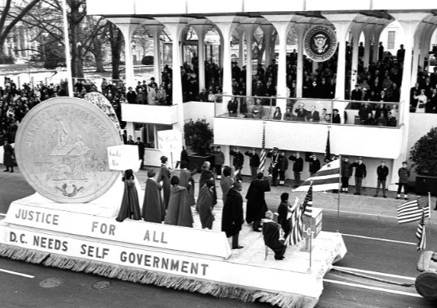
President Johnson and D.C. Home Rule
Sought self-government for Washington, D.C.
Worked toward D.C. Home Rule legislation
Created the position of mayor-commissioner in 1967
Notes:
Teaching notes
Suggested Pacing: 2 minutes
Directions:
Say, “President Johnson sought self-government for Washington, D.C. from the moment he became elected. He worked tirelessly for D.C. Home Rule legislation.
Johnson had been well-respected as a congressman prior to being elected and had already been working for Home Rule in the House of Representatives.
These efforts grew stronger in his role as President. The float in this picture, from the parade that took place on Johnson’s inauguration day, illustrates his commitment to self-rule for the District.
In 1967, Johnson created a more independent government for Washington, D.C. Johnson’s idea was to have a single commissioner who he hoped would be called mayor.
A commissioner is an individual who has been given an official charge or authority to do something.”
Students should add the following information to their Supporters of Washington, D.C. Independence (blank) handout:
Sought self-government for Washington, D.C.
Worked toward D.C. Home Rule legislation
Created the position of mayor-commissioner in 1967
Attribution:
D.C. float in the inauguration parade for President Lyndon B. Johnson. Evening Star (Washington, D.C.), Washington Star Photograph Collection. DC Public Library.

Slide 10
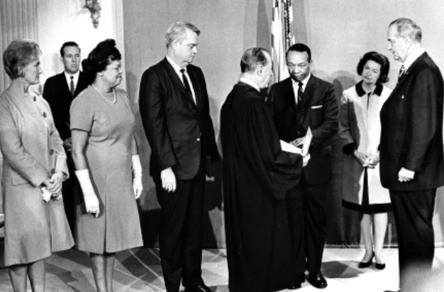
President Johnson and D.C. Home Rule
Creating the position of mayor-commissioner was a significant step toward Home Rule
Notes:
Teaching notes
Suggested Pacing: 3 minutes
Directions:
Say, “As a result of President Johnson’s efforts, Congress named Walter Washington the mayor-commissioner of Washington, D.C. in 1967.
Even though Congress was still ultimately responsible for Washington D.C.’s budget and had the ability to veto laws, President Johnson believed that the position of mayor-commissioner would represent a move toward genuine home rule.
Despite Washington being appointed mayor-commissioner by the President rather than voted in by the people, Washington, D.C. had achieved a form of self-governance.
This was a significant step toward Home Rule. Unfortunately, President Johnson did not live to see the passing of the District of Columbia Home Rule Act of 1973.”
Students should add the following information to their Supporters of Washington, D.C. Independence (blank) handout:
Sought self-government for Washington, D.C.
Worked toward D.C. Home Rule legislation
Created the position of mayor-commissioner in 1967
Attribution:
Community Archives, DC Public Library.

Slide 11
Walter Washington
American politician
1967: Mayor-Commissioner of D.C.
1975: Home Rule Mayor of D.C.
Notes:
Teaching notes
Suggested Pacing: 2 minutes
Directions:
Say, “Walter Washington was an American politician who played several important roles in the history of Washington, D.C. Home Rule.
President Johnson appointed him Mayor-Commissioner in 1967. In 1975, after the passing of the District of Columbia Home Rule Act, Walter Washington became the first elected Home Rule Mayor of Washington, D.C.”
Attribution:
Walter and Bennetta Washington celebrate on election night. Evening Star (Washington, D.C.). Washington Star Photograph Collection. DC Public Library.

Slide 12
Walter Washington and D.C. Home Rule
Shaped the position of mayor
Created home rule governance
Paved the way for future leaders of D.C.
Notes:
Teaching notes
Suggested Pacing: 1 minute
Directions:
Say, “As the very first mayor of Washington, D.C., Washington had to make decisions and choices without the ability to use previous leadership as a guide, and that would later impact future mayors.
Because of his strong leadership and his service to the residents of Washington, D.C., he paved the way for future leaders of D.C.”
Students should add the following information to their Supporters of Washington, D.C. Independence (blank) handout:
Shaped the position of mayor
Created home rule governance
Paved the way for future leaders of D.C.
Attribution:
Community Archives, DC Public Library.

Slide 13
Express Your Understanding!
Choose one of the three leaders discussed in this lesson.
Dr. Martin Luther King, Jr.
President Lyndon Baines Johnson
Walter Washington
What was the significance of their leadership for Home Rule in Washington, D.C.?
Notes:
Teaching notes
Suggested Pacing: 5 minutes
Directions:
Hand out a copy of the Exit Ticket.
As a formative assessment, students are asked to respond to the following question:
Choose one of the three leaders discussed in this lesson.
Dr. Martin Luther King, Jr.
Walter Washington
President Lyndon Baines Johnson
What was the significance of their leadership for Home Rule in Washington, D.C.?
Collect exit tickets as a formative assessment.
Student Look-fors:
Student answers will vary.
See completed example.
Attributions:
Nobel Foundation / Public domain
Arnold Newman, White House Press Office (WHPO) / Public domain
Not specified / Public domain

