Slide 1
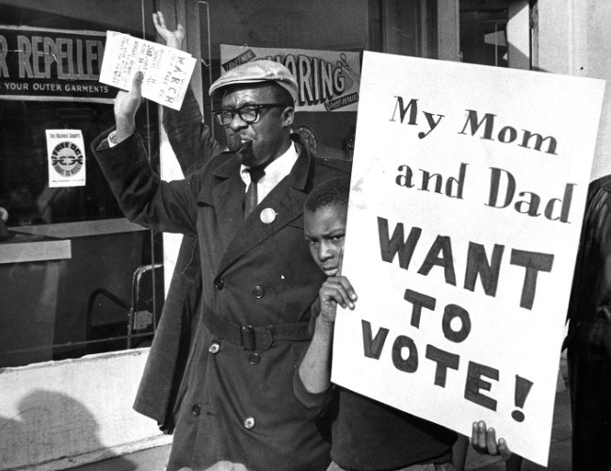
The Impact of Statehood on Washington, D.C.
Home Rule: Grade 12, Lesson 8
Notes:
About this lesson
This lesson focuses on efforts to make Washington, D.C. a state and the impact statehood would have on Washington, D.C.
Students . . .
review the Home Rule Act of 1973 and H.R. 51: The D.C. Statehood Bill.
compare and contrast statehood and D.C. Home Rule.
analyze the impact of the D.C Statehood Bill.
summarize the changes that would take place if Washington, D.C. becomes a state.
Materials:
Statehood and Home Rule Venn Diagram (blank)
Exit Ticket (blank)
Exit Ticket (completed)
ELA Standards:
SL.11-12.1: Initiate and participate effectively in a range of collaborative discussions (one-on-one, in groups, and teacher-led) with diverse partners on grades 11-12 topics, texts, and issues, building on others' ideas and expressing their own clearly and persuasively.
W.11-12.4: Produce clear and coherent writing in which the development, organization, and style are appropriate to task, purpose, and audience. (Grade-specific expectations for writing types are defined in standards 1-3 above.)
W.11-12.2: Write informative/explanatory texts to examine and convey complex ideas, concepts, and information clearly and accurately through the effective selection, organization, and analysis of content.
RI.11-12.7: Integrate and evaluate multiple sources of information presented in different media or formats (e.g., visually, quantitatively) as well as in words in order to address a question or solve a problem.
DC Content Power Standards:
12.DC.22.6: Review the reasons why Washington, D.C. residents do not have voting representation in Congress, and assess the prospects for current efforts to get congressional representation for the District.
C3 Framework Indicators and Common Core Standards for Literacy in History/Social Studies:
D2.Civ.3.9-12. Analyze the impact of constitutions, laws, treaties, and international agreements on the maintenance of national and international order.
D2.Civ.4.9-12. Explain how the U.S. Constitution establishes a system of government that has powers, responsibilities, and limits that have changed over time and that are still contested.
D2.Civ.12.9-12. Analyze how people use and challenge local, state, national, and international laws to address a variety of public issues.
D2.Civ.14.9-12. Analyze historical, contemporary, and emerging means of changing societies, promoting the common good, and protecting rights.

Slide 2
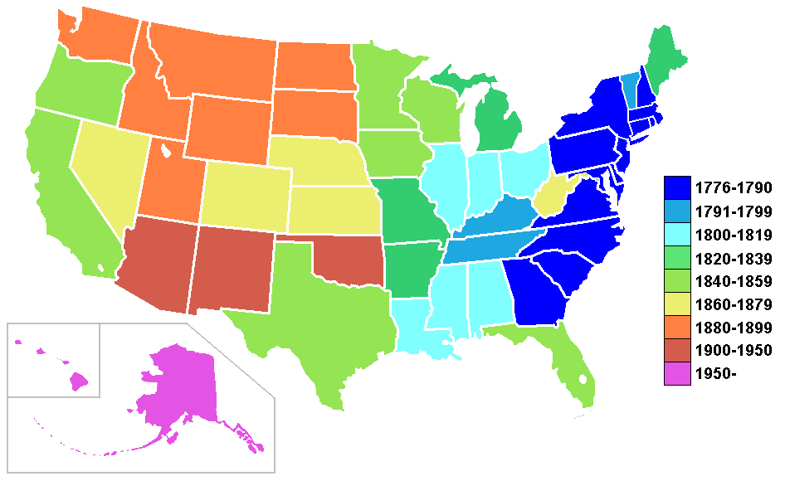
The United States
Third most populous country in the world
Made up of 50 states and the District of Columbia
48 states lie between Canada, which is north of the U.S., and Mexico, which is to the south
Alaska, northwest of Canada
Hawaii, group of islands in the Pacific Ocean
Notes:
Teaching notes
Suggested Pacing: 1 minute
Directions:
Say, “The United States is the third most populous country in the world.
The United States is made up of 50 states and the District of Columbia.
Forty-eight of the states lie between Canada, which is north of the U.S., and Mexico, which is to the south. Alaska is the 49th state and it is northwest of Canada.
Hawaii, the 50th state, is a group of islands in the Pacific Ocean.”
Attribution:
CC BY-SA 3.0

Slide 3
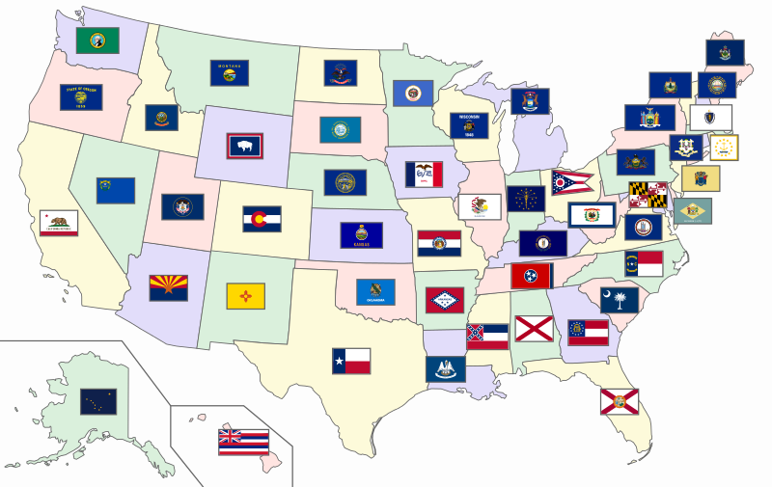
Statehood
Have governments elected by the people of that state
Are represented by voting in the U.S. Congress
Have the power to create their own laws
Enforce laws
Vote on their budget based on their needs
Notes:
Teaching notes
Suggested Pacing: 2 minutes
Directions:
Say, “Each of our 50 states has achieved statehood. Each state holds their own elections to decide who they best think will govern them and represent them.
Elected representatives from each state work in Washington, D.C. as members of Congress.
In the United States, each state has voting representation. That means each state has the opportunity to vote on important issues and determine how our national government works too.
On a state level, the elected representatives work to govern and make decisions for the people in their states.
Each state has the power to create their own laws. States enforce, or make sure people follow these laws and then decide what happens when the laws are broken.
States also vote on their budget, or their plan for spending money to run the government, according to their needs.”
Attribution:
SiBr4 and respective authors of base files / CC BY-SA

Slide 4
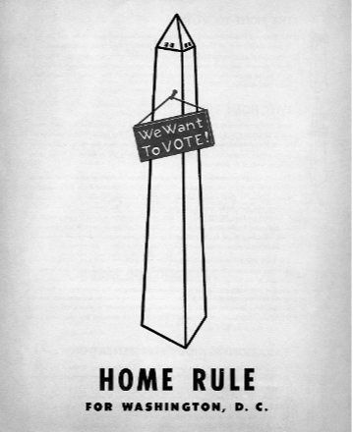
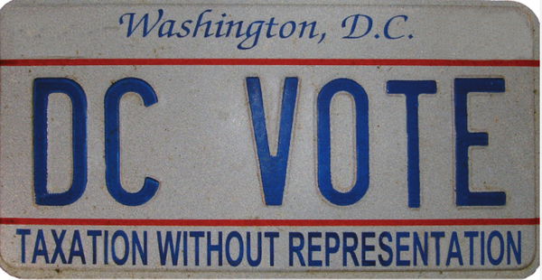
The Home Rule Act of 1973
Power to elect a Mayor and a District Council
District Council can pass local laws
New laws need approval of Congress
Budget needs approval of Congress
Represented in U.S. Congress by a non-voting representative
Notes:
Teaching notes
Suggested Pacing: 2 minutes
Directions:
Say, “Washington, D.C. serves a special role in the United States as the Nation’s Capital.
According to the Constitution, the Nation's Capital city must be in a district, not a state. It also allows Congress to govern the capital city, the District of Columbia. This means that self-governance did not exist in Washington, D.C. before 1973.
With the Home Rule Act of 1973, the citizens of Washington, D.C. gained certain powers. Washington, D.C. citizens now had the right to elect a mayor.
The citizens also had the right to elect a district council. A council is a group of people elected to manage a city or district. This council had the ability to pass laws. These were all steps in the right direction for self-governance.
Despite the new freedoms the Home Rule Act of 1973 gave Washington, D.C., they still did not gain complete independence.
Their budget still needs approval by Congress. Also, D.C. gained a representative in Congress, but that representative can not actually vote.”
Attributions:
Home rule for Washington, D.C. poster. Washingtoniana Ephemera Collection. DC Public Library.
DC VOTE license plate. District of Columbia. Department of Motor Vehicles. Washingtoniana Ephemera Collection. DC Public Library.

Slide 5
Turn and Talk
Compare and contrast Statehood and D.C. Home Rule using the Venn diagram.
Notes:
Teaching notes
Suggested Pacing: 5 minutes
Directions:
Hand out copies of Statehood and Home Rule Venn diagram.
Say, “Let’s compare and contrast Statehood and D.C. Home Rule using the Venn diagram. What is the same? What is different?"
Use an established classroom routine to pair students or use elbow partners.
Prompt students to turn and talk to their partners and record ideas on the Venn diagram.
Conduct a whole class discussion calling on a few students to share their thinking.
Student Look-fors:
Statehood:
Power to elect local officials
State governments elected by the people of that state
Represented by voting in the U.S. Congress
Power to create their own laws
Vote on their budget based on their needs
Home Rule:
Represented in U.S. Congress but no vote
Laws need approval of Congress
Budget needs approval of Congress
Same
Attribution:
Conversation Clipart

Slide 6
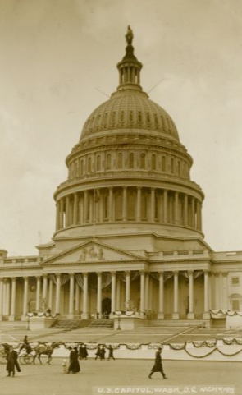
How Statehood Becomes a Law
Laws begin as ideas that are written down and explained
This written down idea becomes a bill
Senators or representatives introduce bills in Congress
Bills are voted on by the Congress
If Congress passes a bill, it goes to the President to be signed into law
Notes:
Teaching notes
Suggested Pacing: 2 minutes
Directions:
Say, “When people in the United States have ideas about something they want to see happen across the country, they send those ideas to the House of Representatives or the Senate, which are the two parts of the US Congress.
These ideas come from people in different states across the country, and the ideas are turned into Bills.
Bills are then voted on by the Congress. If Congress passes a bill, it goes to the President to be signed into law.
The only way for the District of Columbia to become a state is if a new law is passed by the US Congress."
Attribution:
U.S. Capitol, Washington, D.C., March 4, 1913. Ross, Willard R., 1860-1948, Willard R. Ross Postcard Collection. DC Public Library.

Slide 7
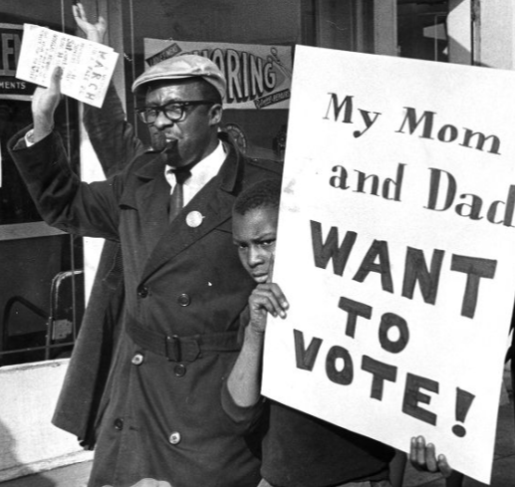
Attempts at Statehood
Bills for D.C. Statehood have been introduced to Congress more than 12 times
Only two bills have made it to a vote, in 1993 and 2020
The 1993 bill did not pass
The 2020 bill passed the House of Representatives
Notes:
Teaching notes
Suggested Pacing: 1 minute
Directions:
Say, “Since the Home Rule Act of 1973, bills for D.C. Statehood have been introduced to Congress more than 12 times.
Only two bills have made it to a vote, in 1993 and 2020. The 1993 bills did not pass. The 2020 bill passed the House of Representatives."
Attribution:
Man and child in Free D.C. march. Evening Star (Washington, D.C.). Washington Star Photograph Collection. DC Public Library.

Slide 8
Delegate Eleanor Holmes
Delegate to United States House of Representatives since 1991
Introduced the D.C. Statehood Bill in January 2019
First time since 1993 that Congress will vote on D.C. becoming the 51st state
Notes:
Teaching notes
Suggested Pacing: 1 minute
Directions:
Say, “Eleanor Holmes Norton has been Washington, D.C.’s delegate to the United States House of Representatives since 1991.
She introduced H.R. 51, the D.C. Statehood Bill, in January of 2019. The Statehood Bill was passed in the House on June 26, 2020.
This will be the first time since 1993 that Congress will vote on D.C. becoming the 51st state.”
Attribution:
US House Office of Photography / Public domain

Slide 9
D.C. Statehood Bill
Residential and commercial parts of the District of Columbia would become a new state
Called Washington, Douglass Commonwealth
Named for Frederick Douglass
Douglass was a resident of D.C. and strong civil rights advocate
Notes:
Teaching notes
Suggested Pacing: 1 minute
Directions:
Say, “According to the D.C. Statehood Bill, the residential and commercial parts of the District of Columbia would become the new state.
The state would be called Washington, Douglass Commonwealth, named for Frederick Douglass.
Douglass was a famous abolitionist, resident of D.C. and a strong civil rights advocate.”
Attribution:
Community Archives, DC Public Library.

Slide 10
D.C. Statehood Bill
A smaller District of Columbia is left and includes federal buildings:
Capitol
Supreme Court
White House
Senate and House Buildings
Monuments on the National Mall
Revision to the 23rd Amendment
Notes:
Teaching notes
Suggested Pacing: 1 minute
Directions:
Say, “The D.C Statehood Bill leaves a smaller District of Columbia. This includes federal buildings such as the Capitol, the Supreme Court, the White House, the Senate and House Buildings and the Monuments on the National Mall.
Changing the size of District of Columbia would also require an adjustment to the 23rd Amendment.
Currently, the amendment gives D.C. 3 electoral votes. Because no one would be residing in this smaller, federal land version of D.C., the number of electoral votes provided by the 23rd Amendment would need revision."
Attribution:
Community Archives, DC Public Library.

Slide 11
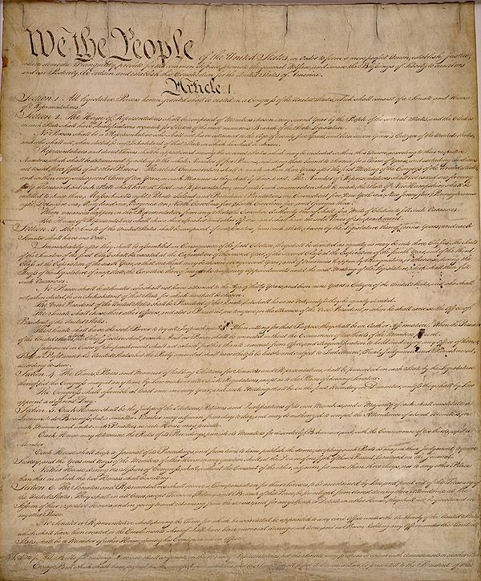
Abiding by the Constitution
Leaving the District of Columbia intact keeps the federal seat of government required by the Constitution
Residents of Washington, Douglass Commonwealth earn equal rights
Notes:
Teaching notes
Suggested Pacing: 2 minutes
Directions:
Say, "Article 1, Section 8, Clause 17 of the Constitution is about the Powers of Congress.
It states that our country's capital city must be in a district, not a state. It also allows Congress to govern the capital, the District of Columbia.”
The D.C. Statehood Bill abides by the Constitution by leaving the District of Columbia intact. This keeps the federal seat of government required by the Constitution.
Additionally, by having federal representation in Congress, the residents of Washington, Douglass Commonwealth would earn the equal rights that are guaranteed by the Constitution.”
Attribution:
Constitutional Convention / Public domain

Slide 12
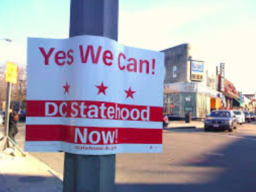
Express Your Understanding
Summarize the changes that would take place if Washington, D.C. became a state. Be sure to consider the differences between Home Rule and Statehood.
If Washington D.C. becomes a state, what potential hurdles would it need to overcome?
Notes:
Teaching notes
Suggested Pacing: 5 minutes
Directions:
Hand out the Exit Ticket.
As a formative assessment, students summarize the changes that would take place if Washington, D.C. become a state.
Remind students to think about the differences between Home Rule and Statehood by referring to their Statehood and Home Rule Venn Diagram.
Additionally, remind students to incorporate the new information they learned during the lesson.
Student Look-fors:
Refer to completed handout.
Attributions:
D.C. Wants To Become The 51st State. And Here’s How It Plans On Going About It.
DC Statehood Now. Michelle Kinsey Bruns.

