Slide 1
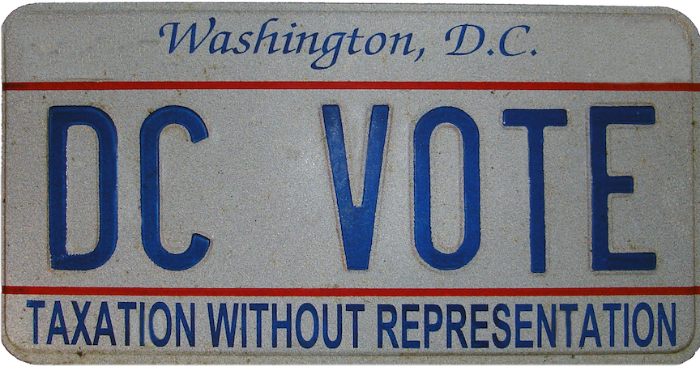
What makes Washington, D.C. unique?
Home Rule: Grade 3, Lesson 1
Notes:
About this lesson
This lesson focuses on the differences between states and a district. Students will be able to explain what makes D.C. unique as a district, specifically in how D.C. lacks representation in the national political system.
Students . . .
track their thinking about new terms on a vocabulary log.
analyze photographs in order to determine that despite the passing of time, the issue of voting rights in Washington, D.C. is significant and remains unresolved.
express their understanding with a formative exit ticket.
Materials:
Vocabulary Log (Blank)
Vocabulary Log (Completed)
Exit Ticket (Blank)
Exit Ticket (Completed)
ELA Standards:
SL.3.1.d: Explain their own ideas and understanding in light of the discussion.
SL.3.1: Engage effectively in a range of collaborative discussions (one-on-one, in groups, and teacher-led) with diverse partners on grade 3 topics and texts, building on others' ideas and expressing their own clearly.
W.3.2.d: Provide a concluding statement or section.
W.3.2.b: Develop the topic with facts, definitions, and details.
RI.3.7: Use information gained from illustrations (e.g., maps, photographs) and the words in a text to demonstrate understanding of the text (e.g., where, when, why, and how key events occur).
RI.3.3: Describe the relationship between a series of historical events, scientific ideas or concepts, or steps in technical procedures in a text, using language that pertains to time, sequence, and cause/effect.
DC Content Power Standards:
3.2: Students understand the basic structure of the Washington, D.C. government.
3.2.4: Describe the distinctions between local, state, and national government.
C3 Framework Indicators and Common Core Standards for Literacy in History/Social Studies:
D2.Civ.3.3-5: Examine the origins and purposes of rules, laws, and key U.S. constitutional provisions.
D2.Civ.4.3-5: Explain how groups of people make rules to create responsibilities and protect freedoms.
D2.Civ.5.3-5: Explain the origins, functions, and structure of different systems of government, including those created by the U.S. and state constitutions.
D2.Civ.12.3-5: Explain how rules and laws change society and how people change rules and laws.
D2.Civ.14.3-5: Illustrate historical and contemporary means of changing society.
Attribution:
DC VOTE license plate. District of Columbia. Department of Motor Vehicles. Washingtoniana Ephemera Collection. DC Public Library.

Slide 2
Let's Discuss!
What does it mean to be a citizen?
Citizenship comes from the Latin word for "city."
It’s important to be a good citizen.
Notes:
Teaching notes
Suggested Pacing: 2 minutes
Directions:
Use an established classroom routine to pair students or use elbow partners.
Say, “Think about this question. What does it mean to be a citizen? Turn to your partner and discuss your thinking.”
Prompt students to turn and talk to their partners about the question.
Conduct a whole class discussion calling on a few students to share their thinking.

Slide 3
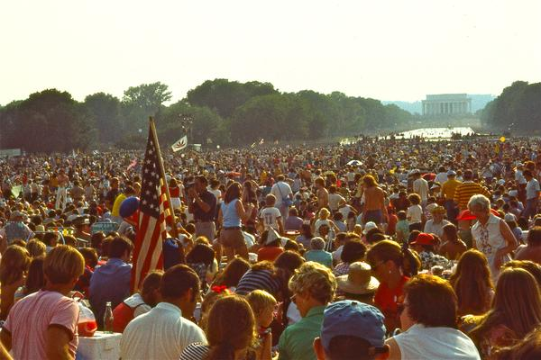
What does it mean to be a citizen?
Citizen: a full member of a country with rights that are given by the country’s government
Notes:
Teaching notes
Suggested Pacing: 2 minutes
Directions:
Say, “A citizen is a full member of a country. Citizens have rights that are given by the country’s government. If you have citizenship in a country, you have the right to live, work, vote, and pay taxes there!
Citizens also have the right to be protected by a country’s laws. In return, citizens have duties that they owe to the country.
One of the most important duties is being loyal to the country."
Ask students to record the following definition on the Vocabulary Log next to the term.
Citizen: a full member of a country with rights that are given by the country’s government
Attribution:
Bicentennial crowd in front of Lincoln Memorial. Crain, Darrell C., 1910-1995. Darrell C. Crain, Jr. Photograph Collection. DC Public Library.

Slide 4
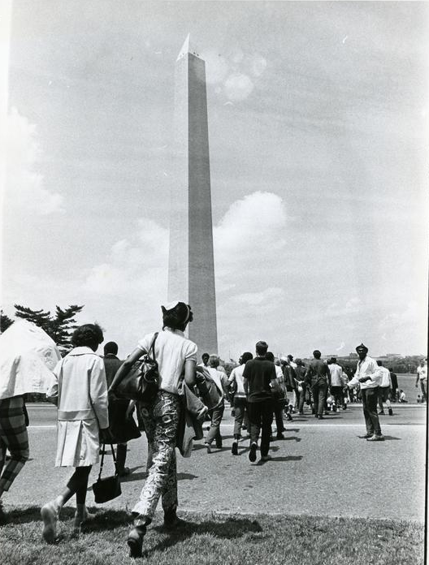
What makes Washington, D.C. different?
Congress is the branch of government that makes the laws of the United States and controls all of the money.
Only states have representatives in Congress.
The residents of Washington, D.C. do not have a vote in Congress.
Notes:
Teaching notes
Suggested Pacing: 2 minutes
Directions:
Say, “Washington is not part of a state. It is actually in a separate district called the District of Columbia. That is where the D.C. comes from. The city and the district take up the same space.
D.C. residents do not have the same rights that American citizens in the 50 states do. Because representatives to Congress are elected only by Americans living in the 50 states, residents of Washington, D.C. do not have a vote in Congress.”
Ask students to record the following definition on the Vocabulary Log next to the term.
Congress: the branch of government that makes the laws of the United States and controls all of the money
Additional Note:
Washington, D.C. has a delegate to the House of Representatives, who can introduce legislation but is unable to vote.
Washington, D.C. has also two shadow Congress persons.
Attribution:
Protestors walk toward the Washington Monument. Evening Star (Washington, D.C.) Boston, Bernie, 1933-. Washington Star Photograph Collection. DC Public Library.

Slide 5
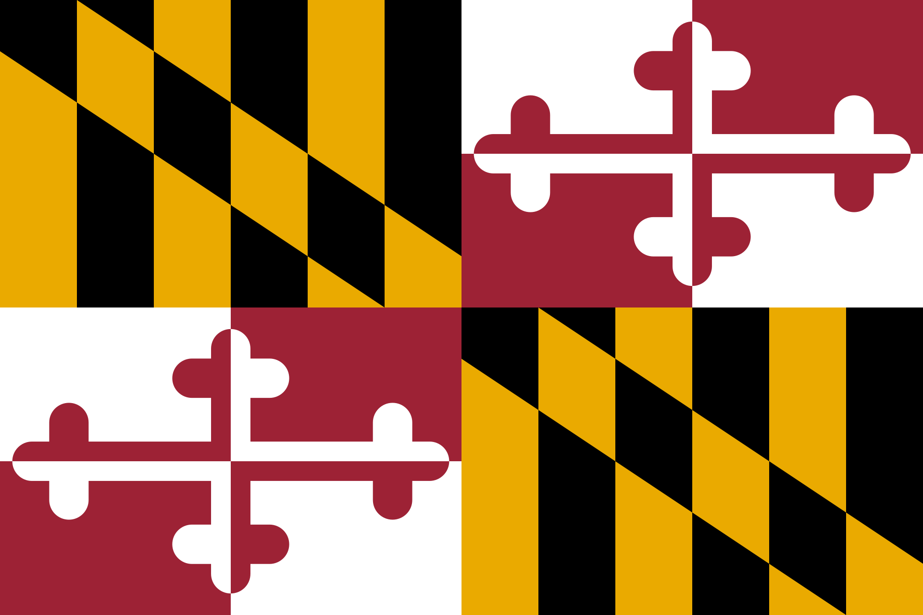
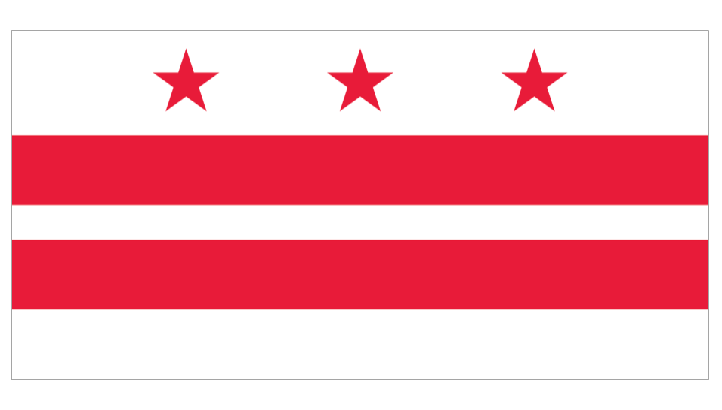
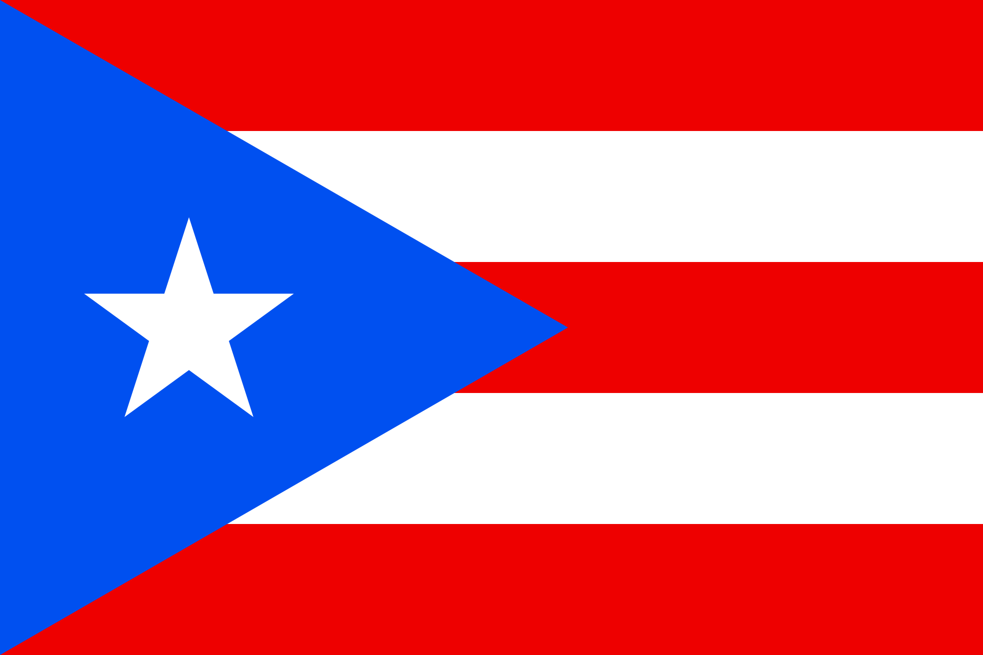
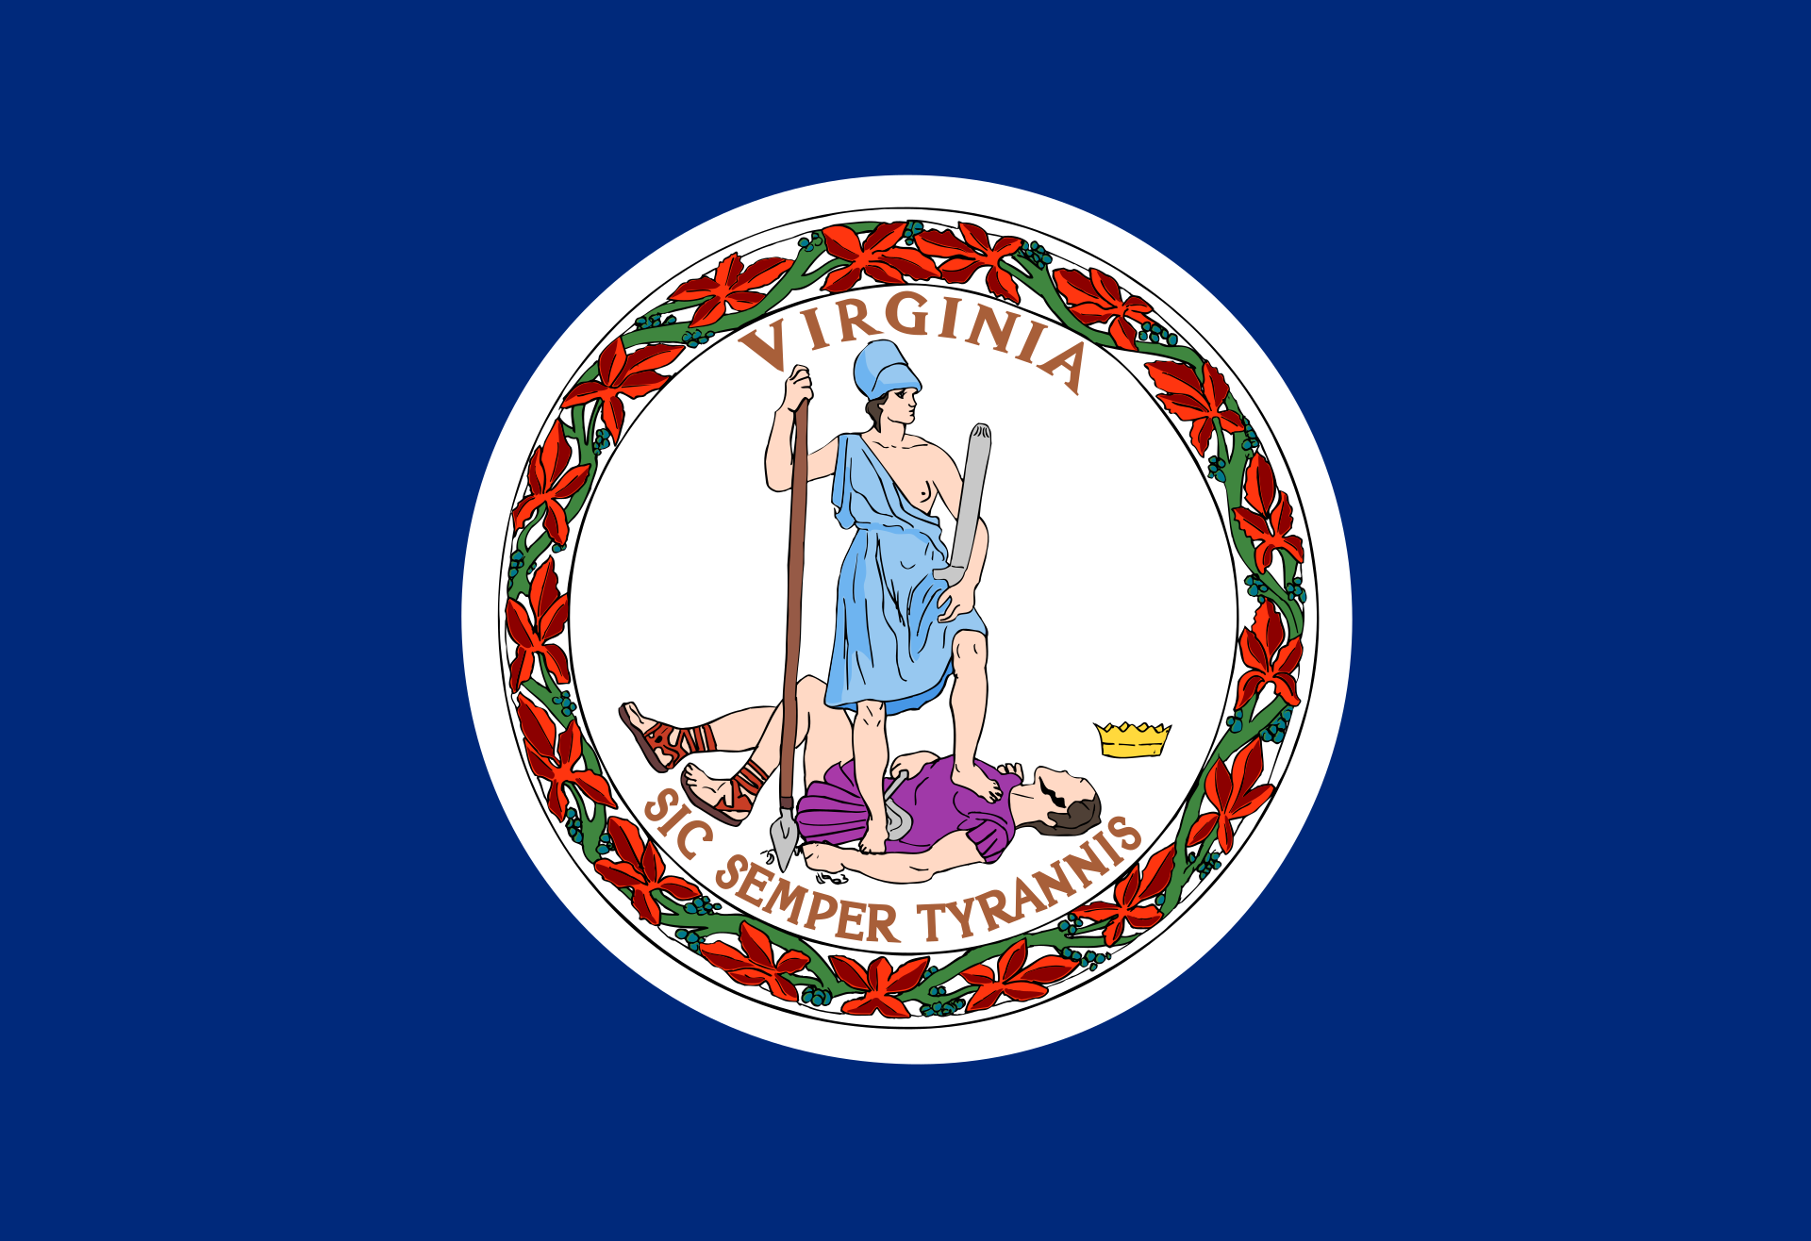
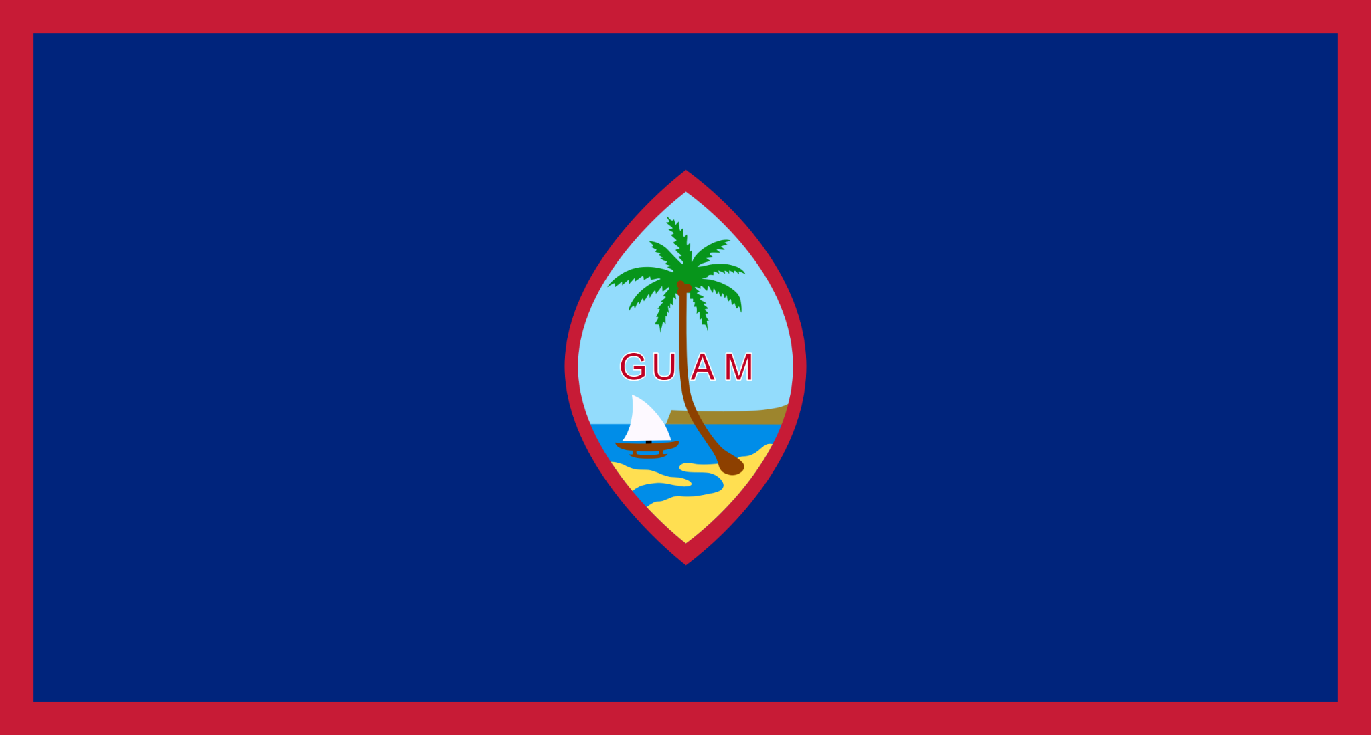
Where do citizens live in the United States?
State
District
Territory
Maryland
Washington, D.C.
Puerto Rico
Virginia
Guam
Notes:
Teaching notes
Suggested Pacing: 2 minutes
Directions:
Say, “United States citizens live in different places. Citizens can live in states like Maryland and Virginia.
Citizens can also live in territories like Puerto Rico and Guam.
Citizens can also live in a district like Washington, D.C."
Ask students to record the following examples next to the terms on the Vocabulary Log next to the term.
States: Maryland, Virginia
Territories: Puerto Rico, Guam
District: Washington, D.C.

Slide 6
Turn and Talk
Why is representation in Congress important?
Discuss with your partner:
Notes:
Teaching notes
Suggested Pacing: 2 minutes
Directions:
Use an established classroom routine to pair students or use elbow partners.
Say, “Why is representation in Congress important? Turn to your partner and discuss your thinking.”
Prompt students to turn and talk to their partners about the question.
Conduct a whole class discussion calling on a few students to share their thinking.
Say, “It's important every citizen votes so the individual's voice can be heard. This is important for democracy and for the United States.
When a group of Americans is not represented in Congress, our country loses balance. This impacts everyone.
The people who do not have a vote in Congress shape this country just as much as the people who do have a vote.”
Attribution:
DC VOTE license plate. District of Columbia. Department of Motor Vehicles. Washingtoniana Ephemera Collection. DC Public Library.

Slide 7
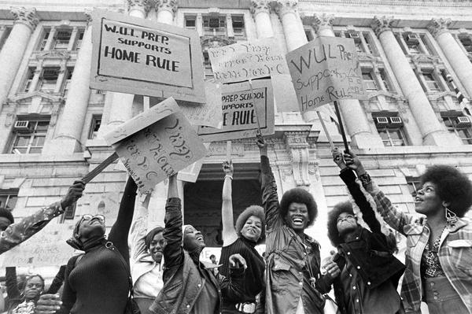
What is a protest?
Protest: A protest is an event where people gather to show disapproval.
A community or individual may protest if they feel that something is unfair.
Notes:
Teaching notes
Suggested Pacing: 2 minutes
Directions:
Say, “Many people do not believe that Washington, D.C. is treated fairly in the United States' political system. They think that the citizens of Washington, D.C. should be treated fairly by having the same rights as other United States citizens.
A protest is an event in which people gather to show disapproval. There have been many protests in Washington, D.C. about issues that people feel are unfair.”
Ask students to record the following definition on the Vocabulary Log next to the term.
Protest: A protest is an event in which people gather to show disapproval.
Attribution:
WUL Prep students at a home rule rally. Evening Star (Washington, D.C.). Washington Star Photograph Collection. DC Public Library.

Slide 8
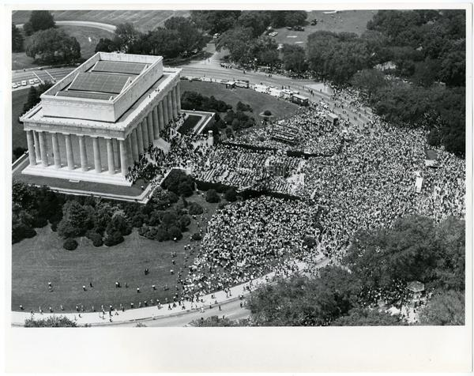
Turn and Talk
Discuss with your partner:
Why do people come from all over the country to Washington, D.C. in order to protest?
Notes:
Teaching notes
Suggested Pacing: 2 minutes
Directions:
Say, “Now that we understand what a protest is and why people protest, why do you think people come from all over the country to Washington, D.C. in order to protest? Turn to your partner and share your thinking.”
Prompt students to turn and talk to their partners about the question.
Conduct a whole class discussion calling on a few students to share their thinking.
Say, “Protestors come to Washington, D.C. because it is the nation’s capital and where our government is located. People come to Washington, D.C. to march and protest because it is the heart of our country’s government.
People who want to help make a change come in large numbers for a cause they believe in."
Attribution:
View of the crowd at the Lincoln Memorial during the Solidarity Day rally. Evening Star (Washington, D.C.). Washington Star Photograph Collection. DC Public Library.

Slide 9
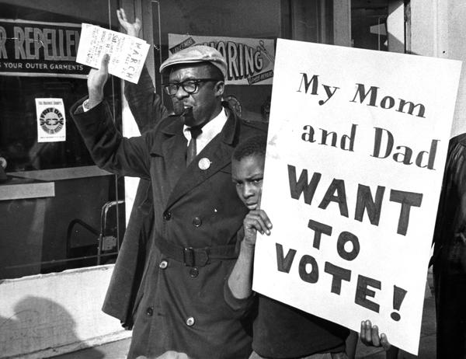
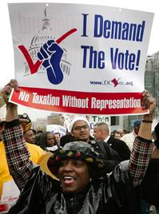
Let’s Compare
What is the same about the pictures? What is different about them?
1966
2007
Notes:
Teaching notes
Suggested Pacing: 2 minutes
Directions:
Say, “Let’s compare these two photographs of people protesting in Washington, D.C. What do the pictures have in common? What is different about them?"
Share student suggestions, acknowledging appropriate responses.
Student Look-Fors:
Students will notice that both pictures are of protestors holding signs about voting. The young boy is holding a sign about his parents voting. The woman is holding a sign about demanding the right to vote. The commonality is that both protestors are protesting for the same right.
Students will notice that the pictures are from the past (1966) and from modern day (2007). The time periods are very different. Students should infer that despite the passing of time, the issue of voting rights in Washington, D.C. is significant and remains unresolved.
Attributions:
Man and child in Free D.C. march. Evening Star (Washington, D.C.). Washington Star Photograph Collection. DC Public Library.
Demonstrators demand voting representation in Congress for Washington's 580,000 residents during a protest on Capitol Hill on April 17, 2007. (Getty ImagesAlex Wong)

Slide 10
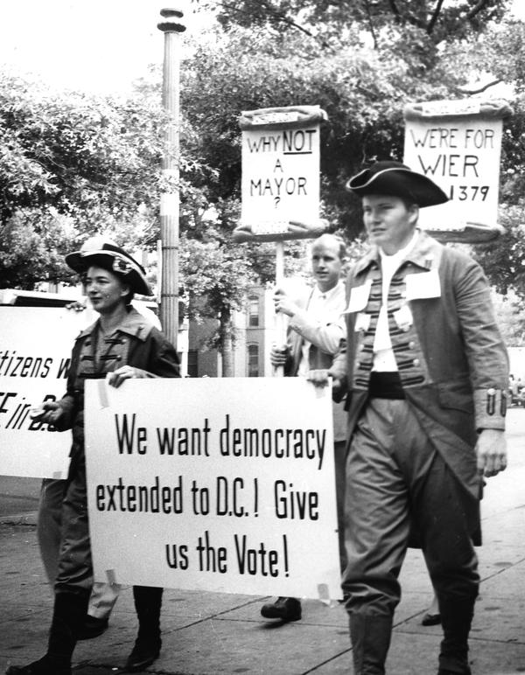
Express Your Understanding!
What makes Washington, D.C. unique?
Notes:
Teaching notes
Suggested Pacing: 3 minutes
Directions:
Hand out a copy of the exit ticket.
As a formative assessment, students are asked to complete a quick-write to the following question: “What makes Washington, D.C. unique?
Collect exit tickets as formative assessment.
Student Look-fors:
Student responses will vary.
See completed example.
Attribution:
D.C. residents march for home rule in colonial costumes. Evening Star (Washington, D.C.). Washington Star Photograph Collection. DC Public Library.

