Slide 1
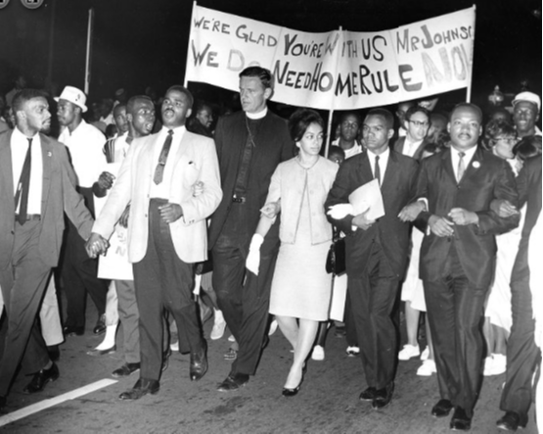
Dr. Martin Luther King Jr. and Washington, D.C. Home Rule History
Home Rule: Grade 3, Lesson 6
Notes:
About this lesson
This lesson asks students to consider how Dr. Martin Luther King Jr. used his political voice to target the lack of freedom and democracy in the District of Columbia.
Students . . .
learn about Dr. King's involvement in the Home Rule movement.
explain how Dr. Martin Luther King Jr. inspired change in Washington, D.C.’s Home Rule struggle.
Materials:
Entrance Ticket (blank)
Entrance Ticket (completed)
Dr. Martin Luther King Jr. and Washington, D.C. Home Rule Handout (blank)
Dr. Martin Luther King Jr. and Washington, D.C. Home Rule Handout (completed)
Exit Ticket (blank)
Exit Ticket (completed)
ELA Standards:
SL.3.1.d: Explain their own ideas and understanding in light of the discussion.
SL.3.1: Engage effectively in a range of collaborative discussions (one-on-one, in groups, and teacher-led) with diverse partners on grade 3 topics and texts, building on others' ideas and expressing their own clearly.
W.3.2.d: Provide a concluding statement or section.
W.3.2.b: Develop the topic with facts, definitions, and details.
RI.3.7: Use information gained from illustrations (e.g., maps, photographs) and the words in a text to demonstrate understanding of the text (e.g., where, when, why, and how key events occur).
RI.3.4: Determine the meaning of general academic and domain-specific words and phrases in a text relevant to a grade 3 topic or subject area.
RI.3.3: Describe the relationship between a series of historical events, scientific ideas or concepts, or steps in technical procedures in a text, using language that pertains to time, sequence, and cause/effect.
DC Content Power Standards:
D2.His.3.3-5. Generate questions about individuals and groups who have shaped significant historical changes and continuities.
D2.His.2: Compare life in specific historical time periods to life today.
C3 Framework Indicators and Common Core Standards for Literacy in History/Social Studies:
3.4.2: Construct a chronological explanation of key people and events that were important in shaping the character of Washington, D.C. during the 18th, 19th, and 20th centuries.
3.4.5 Identify and research outstanding statements of moral and civic principles made in Washington, D.C., as well as the leaders who delivered them, that contributed to the struggle to extend equal rights to all Americans (e.g., Lincoln and his second inaugural address, Frederick Douglass and his speech against lynching at the Metropolitan AME Church, Martin Luther King Jr. and his speeches at the Lincoln Memorial in 1957 and 1963, and Rodolfo “Corky” Gonzales at the Poor People’s March).

Slide 2
Let's Discuss
What does the word "inspire" mean to you?
The word “inspiration” comes from the word inspire.
Different types of protests have different meanings.
Notes:
Teaching notes
Suggested Pacing: 4 minutes
Directions:
Use an established classroom routine to pair students or use elbow partners.
Say, “What does the word inspire mean to you?”
Prompt students to turn and talk to their partners about the question.
Conduct a whole class discussion calling on a few students to share their thinking.
Student Look-Fors:
Student responses will vary.
Attribution:
INSPIRE

Slide 3
Let's Discuss
Think about people who inspire change in your community and world.
Who are these people? How do they inspire change?
Notes:
Teaching notes
Suggested Pacing: 4 minutes
Directions:
Hand out the Entrance Ticket.
Say, “Think about people who inspire change in your community and world.
Who are these people? How do they inspire change?”
Students should record their answers on the Entrance Ticket.
Use an established classroom routine to pair students or use elbow partners.
Prompt students to turn and talk to their partners about the question.
Conduct a whole class discussion calling on a few students to share their thinking.
Student Look-Fors:
Student responses will vary.
See completed example.
Attributions:
Writing Hand Silhouette
Conversation Clipart

Slide 4
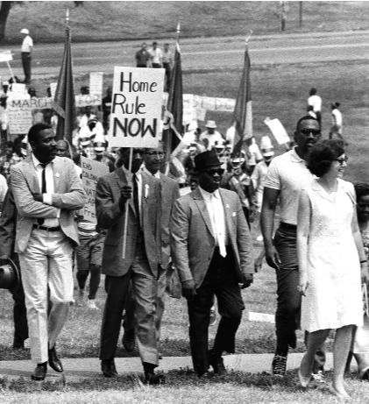
What is an activist?
Brings about change in politics or society through support and actions
Learns more about an issue
Raises awareness among others
Notes:
Teaching notes
Suggested Pacing: 3 minutes
Directions:
Say, “Many people who have inspired change are known as activists. An activist is a person who uses or supports strong actions, such as public protests, to help make changes in politics or society."
An activist is someone who does not let a problem or concerning situation go unnoticed.
An activist is a person who feels very strongly about an issue.
Because they feel so strongly, they choose to learn more about an issue, to raise awareness among others, and to bring about change through their actions like the protesters in this image.”
Attribution:
Marchers in the Home Rule Day rally. Evening Star (Washington, D.C.). Washington Star Photograph Collection. DC Public Library.

Slide 5
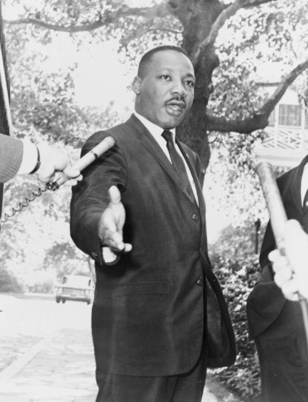
Who was Dr. Martin Luther King, Jr.?
Civil rights leader in the 1950s and 1960s
Minister and often referred to as Reverend King
Worked for the equal rights of all American people
Wanted to change America so that race or income would not impact a person's civil rights
Notes:
Teaching notes
Suggested Pacing: 1 minute
Directions:
Say, "Martin Luther King Jr. was a civil rights leader in the 1950s and 1960s.
Civil rights are the political and social freedoms that ensure equality to all citizens.
Dr. King was also a minister and often referred to as Reverend King.
Dr. King worked for the equal rights of all American people and wanted to change America so that race or income would not impact a person's civil rights.
He wanted America to be a country where all people have access to opportunities."
Attribution:
New York World-Telegram and the Sun staff photographer: DeMarsico, Dick, photographer. / Public domain

Slide 6
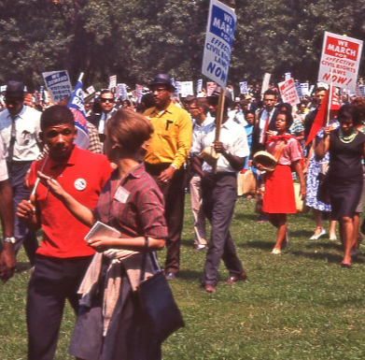
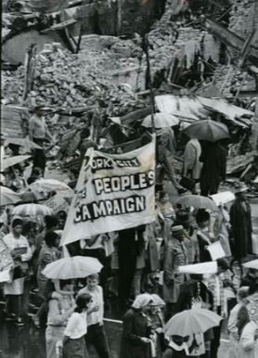
Dr. King and Protests
Led many protests
Two protests took place in Washington, D.C.
March on Washington for Jobs and Freedom, 1963
Poor People’s Campaign, 1968
Notes:
Teaching notes
Suggested Pacing: 1 minute
Directions:
Say, “Remember that a protest is an event at which people gather to call for a change.
A community or an individual may protest if they feel that something is unfair.
Dr. King led many successful protests. Several of these protests took place in Washington, D.C.
One of these protests was the March on Washington for Jobs and Freedom, 1963.
This march was the largest protest ever in the United States, and it is where Dr. King gave his famous “I Have a Dream” speech on the Lincoln Memorial steps.
Another one of Dr. King’s protests was the Poor People's Campaign.
The protestors demanded that the government create a plan to improve the jobs and housing problems of the poor throughout the United States.
Dr King was the original organizer of the Poor People's Campaign, although the protest took place after his assassination on April 4th, 1968.”
Attributions:
March on Washington at the Mall. Crain, Darrell C., 1910-1995. Darrell C. Crain, Jr. Photograph Collection. DC Public Library.
Poor People's Campaign marchers head for a rally at Cardozo High School. Heinen, Ken. Evening Star (Washington, D.C.). Washington Star Photograph Collection. DC Public Library.

Slide 7
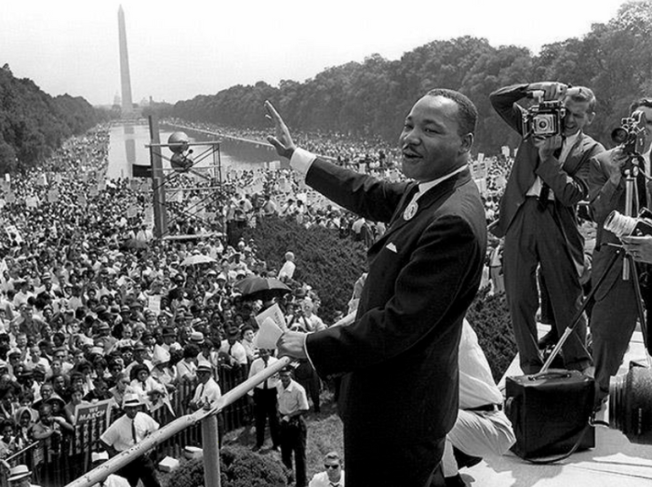
Turn and Talk
Why do you think Dr. King supported Home Rule for Washington, D.C.?
Notes:
Teaching notes
Suggested Pacing: 2 minutes
Directions:
Say, “Dr. King believed that all people should be treated with political and social equality.
He believed it was unfair when certain groups of people were treated differently than others, especially because of their race or how much money they had.
Now that you know some background information about Dr. King, why do you think he supported Home Rule for Washington, D.C.? Turn to your partner and discuss your thinking."
Prompt students to turn and talk to their partners about the question.
Conduct a whole class discussion calling on a few students to share their thinking.
Student Look-Fors:
Dr. King wanted to change equal rights for all American people.
The citizens of Washington, D.C. did not have equal rights because they did not have federal representation.
Attribution:
National Park Service (CC BY 2.0)

Slide 8
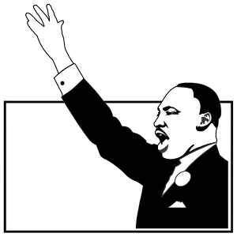
Dr. King and D.C. Home Rule
Supporter of D.C. Home Rule
Believed D.C. should have full voting representation in Congress
Worked with D.C. residents to gain their right to self-governance
Notes:
Teaching notes
Suggested Pacing: 2 minutes
Directions:
Hand out the Dr. King and D.C. Home Rule handout.
Say, “Dr. King saw that the citizens of Washington, D.C. were treated differently than other citizens in the United States and he knew this was unfair.
Dr. King was a strong supporter of D.C. Home Rule. Dr. King worked with D.C. residents in their struggle to gain the right to self-governance.”
Students record the information on the Dr. King and D.C. Home Rule handout.
Refer to Dr. King and D.C. Home Rule (completed) as needed.
Attribution:
Martin Luther King image

Slide 9
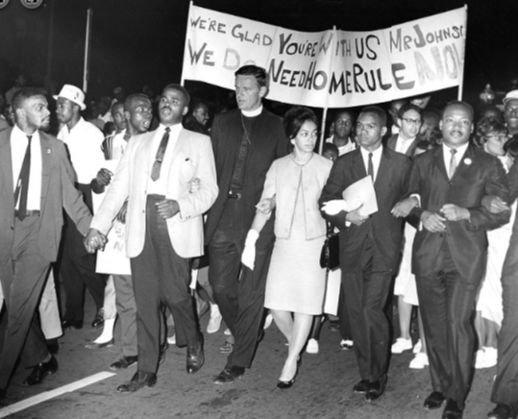
August 1965 March and Vigil
Dr. King led a march for Home Rule in D.C.
Activists marched in order to thank President Johnson for his support
5,000 Home Rule activists marched
Notes:
Teaching notes
Suggested Pacing: 3 minutes
Directions:
Say, “In August of 1965, Dr. King showed his support for Home Rule by leading a march in Washington, D.C."
The activists marched in order to thank President Johnson for supporting Home Rule.
Dr. King marched with about 5,000 Home Rule activists.
The march ended with a vigil.
A vigil is an event or period of time when a person or group assembles quietly to call attention to an issue, especially at night.”
Attribution:
Reverend Martin Luther King Jr., Reverend Walter Fauntroy, Right Reverend Paul Moore Jr., Reverend Ralph David Abernathy, and Reverend Andrew Young at the March for Home Rule. Evening Star (Washington, D.C.). Washington Star Photograph Collection. DC Public Library.

Slide 10
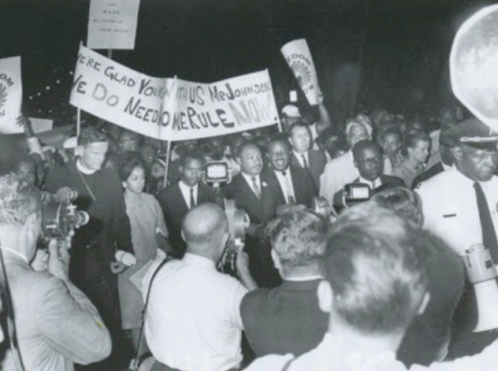
Turn and Talk
What was MLK’s role in the D.C. struggle for Home Rule? Think about Dr. King's beliefs.
Notes:
Teaching notes
Suggested Pacing: 2 minutes
Directions:
Say, "Think about what you have learned about Dr. Martin Luther King, Jr. and Washington D.C.'s struggle for Home Rule.
What was MLK’s role in D.C. struggle for Home Rule? Think about Dr. King's beliefs."
Prompt students to turn and talk to their partners about the question.
Conduct a whole class discussion calling on a few students to share their thinking.
Student Look-Fors:
Dr. King was a well known activist and effective organizer across the country so he had a large following of people.
This ensured that Dr. King’s support of D.C. Home Rule was important.
Attribution:
Community Archives, DC Public Library

Slide 11
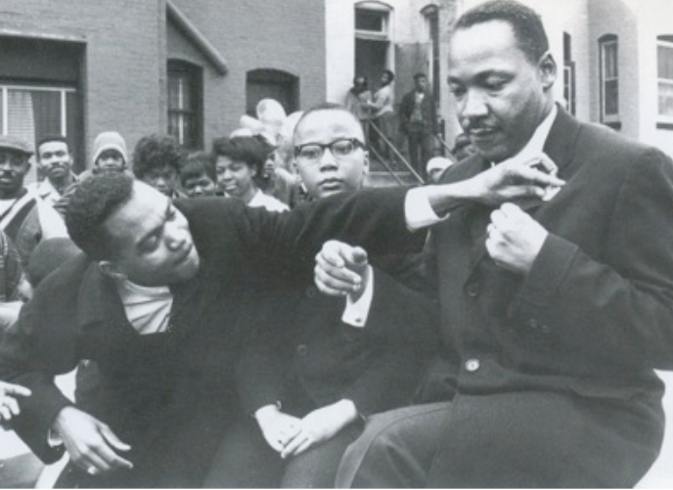
Express Your Understanding!
As an activist, how did Dr. Martin Luther King Jr. inspire change in Washington, D.C.’s Home Rule struggle? Write your response.
Notes:
Teaching notes
Suggested Pacing: 3 minutes
Directions:
Hand out a copy of the exit ticket.
As a formative assessment, students are asked to complete a quick-write to the following question: "As an activist, how did Dr. Martin Luther King Jr. inspire change in Washington, D.C.’s Home Rule struggle?"
Collect exit tickets as formative
Student Look-Fors:
Student responses will vary.
See completed example.
Attribution:
Community Archives, DC Public Library

