Slide 1
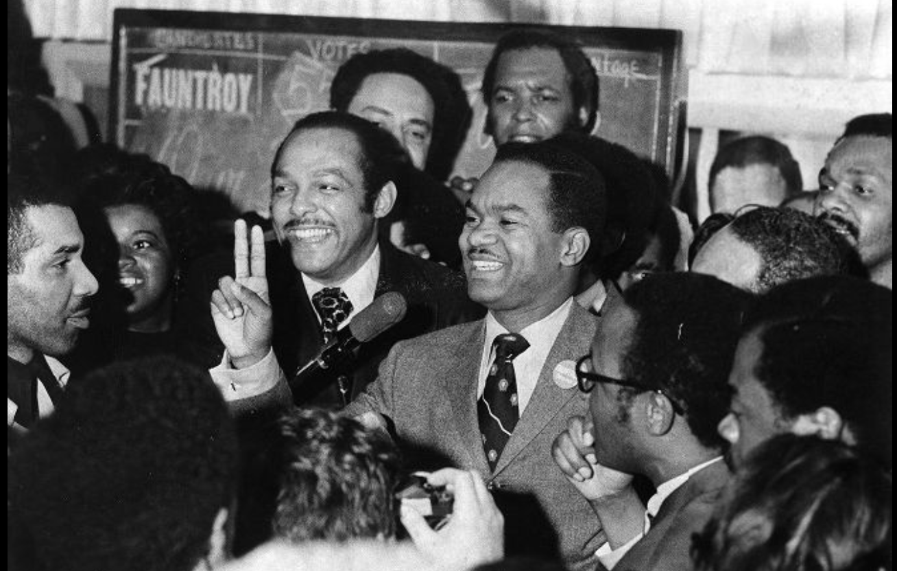
Leaders in Washington, D.C.'s Home Rule History
Home Rule: Grade 3, Lesson 8
Notes:
About this lesson
In this lesson, students consider why Walter Fauntroy, Walter Washington, and Marion Barry were important leaders in Washington, D.C.’s fight for Home Rule and discuss why we need leaders to make change.
Students . . .
track their learning with a Leaders in Washington, D.C.'s Home Rule History organizer.
express their understanding with an exit ticket.
Materials:
Leaders in Washington, D.C. Home Rule History organizer (blank)
Leaders in Washington, D.C. Home Rule History organizer (completed)
Exit Ticket (blank)
Exit Ticket (completed)
ELA Standards:
SL.3.1.d: Explain their own ideas and understanding in light of the discussion.
SL.3.1: Engage effectively in a range of collaborative discussions (one-on-one, in groups, and teacher-led) with diverse partners on grade 3 topics and texts, building on others' ideas and expressing their own clearly.
W.3.2.d: Provide a concluding statement or section.
W.3.2.b: Develop the topic with facts, definitions, and details.
RI.3.7: Use information gained from illustrations (e.g., maps, photographs) and the words in a text to demonstrate understanding of the text (e.g., where, when, why, and how key events occur).
RI.3.4: Determine the meaning of general academic and domain-specific words and phrases in a text relevant to a grade 3 topic or subject area.
RI.3.3: Describe the relationship between a series of historical events, scientific ideas or concepts, or steps in technical procedures in a text, using language that pertains to time, sequence, and cause/effect.
DC Content Power Standards:
3.2.3: Identify the different ways people in a community can influence their local government (e.g., by voting, running for office, testifying at hearings, or participating in meetings).
3.4.2: Construct a chronological explanation of key people and events that were important in shaping the character of Washington, D.C., during the 18th, 19th, and 20th centuries.
3.4.5: Identify and research outstanding statements of moral and civic principles made in Washington, D.C., as well as the leaders who delivered them, that contributed to the struggle to extend equal rights to all Americans (e.g., Lincoln and his second inaugural address, Frederick Douglass and his speech against lynching at the Metropolitan AME Church, Martin Luther King Jr. and his speeches at the Lincoln Memorial in 1957 and 1963, and Rodolfo “Corky” Gonzales at the Poor People’s March).
C3 Framework Indicators and Common Core Standards for Literacy in History/Social Studies:
D2.Civ.14: Illustrate historical and contemporary means of changing society.
D2.His.2: Compare life in specific historical time periods to life today.
D2.His.3.3-5. Generate questions about individuals and groups who have shaped significant historical changes and continuities.

Slide 2
Let's Discuss!
Why is it important for a group to have a leader?
A leader sees how to improve upon a problem and unites people to move toward that better vision.
People listen to and respect leaders.
Notes:
Teaching notes
Suggested Pacing: 3 minutes
Directions:
Use an established classroom routine to pair students or use elbow partners.
Say, "Think about the organizations and groups in your life that have leaders. Why is it important for a group to have a leader?"
Prompt students to turn and talk to their partners about the question.
Conduct a whole class discussion, calling on a few students to share their thinking.
Record student responses on a teacher-created anchor chart, "Why is it important for a group to have a leader?"
Student Look-Fors:
Leaders keep groups organized.
Leaders keep groups united and focused on a goal.
Leaders motivate and influence groups to reach a goal.

Slide 3
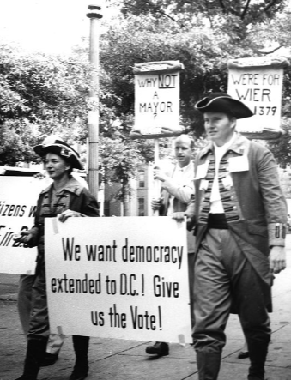
Let's Review
Congress and Washington, D.C.
Washington, D.C. was founded as a district.
The Constitution said Washington, D.C. must be governed by Congress.
The citizens of Washington, D.C. did not have the freedom of self-governance.
Notes:
Teaching notes
Suggested Pacing: 2 minutes
Directions:
Say, “Since 1790, Washington, D.C. has served a special role in the United States as the nation’s capital.
According to the Constitution, the nation's capital city must be in a district, not a state.
The Constitution states that Congress must govern the capital city.
This means that Washington, D.C. could not govern itself.
Washingtonians wanted the right to govern themselves instead of allowing Congress to make decisions for them.
They wanted home rule. Home rule is the government of a region by its own citizens.”
Attribution:
D.C. residents march for home rule in colonial costumes. Evening Star (Washington, D.C.). Washington Star Photograph Collection. DC Public Library.

Slide 4
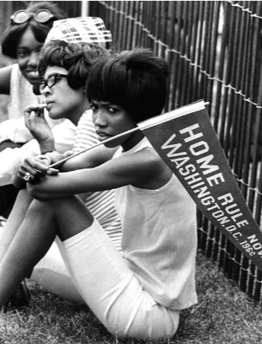
Let's Review
Home Rule in Washington, DC.
The District of Columbia Home Rule Act became a United States federal law on December 24, 1973.
Notes:
Teaching notes
Suggested Pacing: 2 minutes
Directions:
Say, “On December 24, 1973, the District of Columbia Home Rule Act became a federal law. With this law, the citizens of Washington, D.C. gained certain powers.
Washington, D.C. has the right to elect a mayor.
The citizens also have the right to elect a district council. A council is a group of people elected to manage a city or district. This council has the ability to pass laws.
Home Rule did not come easily for Washington, D.C. The passing of the District of Columbia Home Rule Act was the result of hard work and leadership of several important people.
This lesson will explore Leaders in Washington, D.C.'s Home Rule History.”
Attribution:
Supporters at the Home Rule Day rally. Evening Star (Washington, D.C.). Washington Star Photograph Collection. DC Public Library.

Slide 5
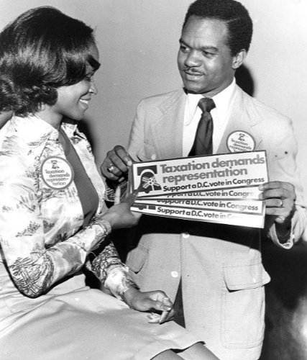
Who was Walter Fauntroy?
MLK’s representative in D.C.
Led 1963 March on Washington
D.C.’s first non-voting delegate to Congress
Notes:
Teaching notes
Suggested Pacing: 2 minutes
Directions:
Provide students with a Leaders in Washington, D.C.'s Home Rule History organizer.
Say, “Walter Fauntroy was a politician from Washington, D.C. who worked closely with Martin Luther King, Jr.
He led a protest march called the 1963 March on Washington. This was a march for the rights of African Americans.
In 1971, he became D.C.’s first ever non-voting delegate to Congress. That means he represented Washington, D.C. in Congress, but he could not vote.”
Refer to Leaders in Washington, D.C.'s Home Rule History organizer (completed) as needed.
Attribution:
Walter Fauntroy and a woman with voting rights bumper stickers. Evening Star (Washington, D.C.). Washington Star Photograph Collection. DC Public Library.

Slide 6
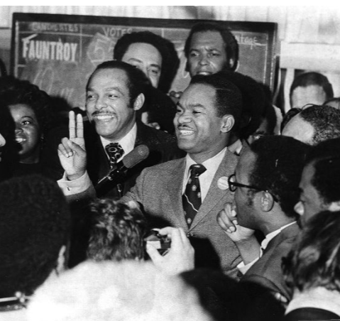
Walter Fauntroy’s Role in D.C. Home Rule History
Fought for the Voting Rights Act of 1965
Encouraged African American voters to support Home Rule
Led the citizens of D.C. in protesting and fighting for Home Rule
Notes:
Teaching notes
Suggested Pacing: 2 minutes
Directions:
Say, “Walter Fauntroy was a strong supporter of the right to vote for all Americans. He fought for the Voting Rights Act of 1965, which gave African Americans the right to vote.
After the Voting Rights Act of 1965 passed, Fauntroy encouraged African American voters to support Home Rule in D.C.
Their votes helped Home Rule efforts gain attention and eventually helped to pass the District of Columbia Home Rule Act in 1973.
Walter Fauntroy led citizens of D.C. in protesting and fighting for Home Rule.”
Direct students to fill in what they learned about the leadership of Fauntroy on their Leaders in Washington, D.C.'s Home Rule History organizer.
Fought for the Voting Rights Act of 1965
Encouraged African American voters support Home Rule
Led the citizens of D.C. in protesting and fighting for Home Rule
Attribution:
Reverend Walter Fauntroy flashes V for victory. Evening Star (Washington, D.C.). Washington Star Photograph Collection. DC Public Library.

Slide 7
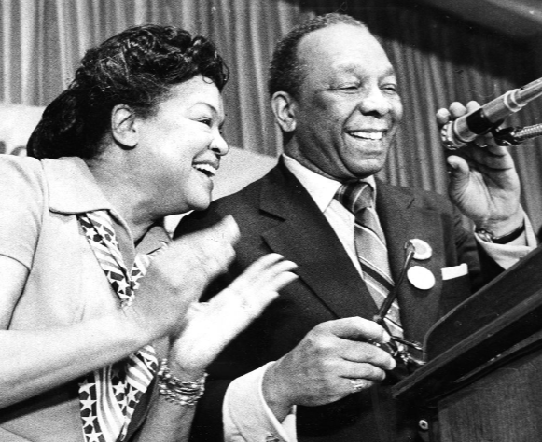
Who was Walter Washington?
American politician
1967: Mayor-Commissioner of D.C.
1975: Home Rule Mayor of D.C.
Notes:
Teaching notes
Suggested Pacing: 2 minutes
Directions:
Say, “Walter Washington was an American politician who played several important roles in the history of Washington, D.C. Home Rule.
In 1967, President Johnson appointed Walter Washington Mayor-Commissioner.
In 1975, after the passing of the District of Columbia Home Rule Act, Walter Washington became the first Home Rule Mayor of Washington, D.C.”
Attribution:
​​​​​​​Walter and Bennetta Washington celebrate on election night. Evening Star (Washington, D.C.). Washington Star Photograph Collection. DC Public Library.

Slide 8
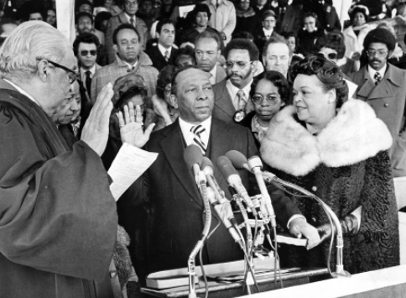
Walter Washington’s Role in D.C. Home Rule History
Shaped the role of mayor in country's only district
Created home rule governance
Strong leadership and service to the residents of Washington, D.C.
Paved the way for future leaders of D.C.
Notes:
Teaching notes
Suggested Pacing: 1 minute
Directions:
Say, “As the first mayor of Washington, D.C., Walter Washington created home rule governance, which meant that he had to make decisions and choices that impacted impacted citizens as well as future mayors.
His strong leadership and service to the residents of Washington, D.C. also paved the way for future leaders of D.C.”
Students should add the following information to their Leaders in Washington, D.C.'s Home Rule History organizer.
Shaped the role of mayor
Created home rule governance
Paved the way for future leaders of D.C.
Attribution:
Community Archives, DC Public Library

Slide 9
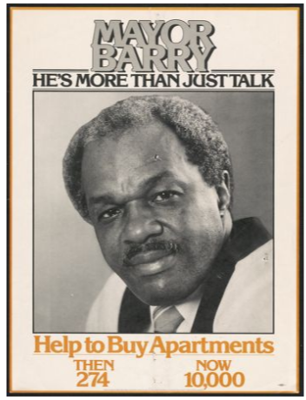
Who was Marion Barry?
American politician and activist
Member of D.C. School Board in 1971
2nd and 4th mayor of Washington, D.C.
Notes:
Teaching notes
Suggested Pacing: 1 minute
Directions:
Say, “Marion Barry was an American activist and politician. He was elected as a member of the Washington, D.C. school board in 1971.
This was important because the school board was a form of governance that D.C. did control before the Home Rule Act was passed in 1973.
He was the second and the fourth mayor of Washington, D.C.”
Attribution:
Marion Barry campaign poster. District of Columbia. Department of Motor Vehicles. Washingtoniana Ephemera Collection. DC Public Library.

Slide 10
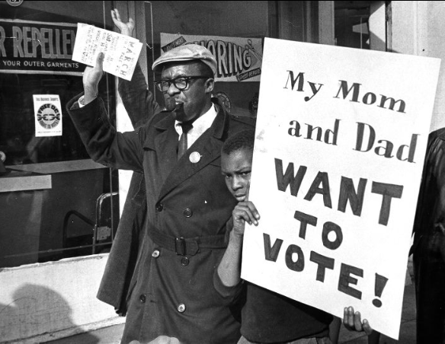
Marion Barry’s Role in D.C. Home Rule History
Led the Free D.C. Movement
Supported Home Rule by encouraging residents to only shop at businesses that supported Home Rule
Pushed businesses to support Home Rule for D.C.
Notes:
Teaching notes
Suggested Pacing: 2 minutes
Directions:
Say, “Marion Barry organized and led the Free D.C. Movement. It encouraged residents to only support businesses that supported Home Rule.
The businesses that supported Home Rule put Free DC stickers in the windows, which let residents know they should shop there.
As the movement continued, more businesses started to support the Home Rule for D.C.
By the end of the Free D.C. movement, 225 out of 260 businesses signed the pledge to support D.C. Home Rule.
Students should add the following information to their Leaders in Washington, D.C.'s Home Rule History organizer:
Supported Home Rule
Encouraged residents to only support businesses that supported Home Rule
Made businesses start to support Home Rule for D.C.
Attribution:
Man and child in Free D.C. march. Evening Star (Washington, D.C.). Washington Star Photograph Collection. DC Public Library.

Slide 11
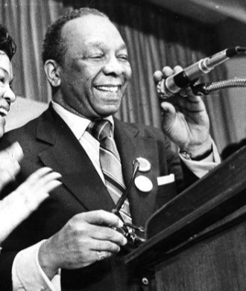
Express Your Understanding!
How did the leadership of Walter Washington, Walter Fauntroy and Marion Barry come together in the fight for Home Rule in D.C.? Think about their roles as leaders.
Notes:
Teaching notes
Suggested Pacing: 4 minutes
Directions:
Distribute the Leaders of the Poor People's Campaign Exit Ticket.
As a formative assessment, students complete an exit ticket.
Read the question, “How were Walter Washington, Walter Fauntroy and Marion Barry important leaders in Washington, D.C. 's Home Rule history?”
Provide students with an opportunity to turn and talk about the question with an elbow partner prior to handing out the Exit Ticket.
Hand out the Leaders of the Poor People's Campaign Exit Ticket.
Say, "Write the answer to the question on your exit ticket."
Collect exit tickets as formative assessment.
Student Look-Fors:
Student responses will vary.
See completed example.
Attributions:
Walter and Bennetta Washington celebrate on election night. Evening Star (Washington, D.C.). Washington Star Photograph Collection. DC Public Library.
Walter Fauntroy and a woman with voting rights bumper stickers. Evening Star (Washington, D.C.). Washington Star Photograph Collection. DC Public Library.
Marion Barry campaign poster. District of Columbia. Department of Motor Vehicles. Washingtoniana Ephemera Collection. DC Public Library.

