Slide 1
Leaders in Washington, D.C.'s Campaign for Statehood
Home Rule: Grade 3, Lesson 9
Notes:
About this lesson
In this lesson, students will identify political leaders who strongly supported or currently support statehood for Washington, D.C., including Muriel Bowser, Tom Carper, and Eleanor Holmes Norton.
Students . . .
track their learning on a Leaders in Washington, D.C.'s Campaign for Statehood organizer.
write a quote that one of the political leaders could use in their campaign for D.C. Statehood.
Materials:
Leaders in Washington, D.C.’s Campaign for Statehood organizer (blank)
Leaders in Washington, D.C.’s Campaign for Statehood organizer (completed)
Campaign Quote Exit Ticket (blank)
ELA Standards:
SL.3.1.d: Explain their own ideas and understanding in light of the discussion.
SL.3.1: Engage effectively in a range of collaborative discussions (one-on-one, in groups, and teacher-led) with diverse partners on grade 3 topics and texts, building on others' ideas and expressing their own clearly.
W.3.2.d: Provide a concluding statement or section.
W.3.2.b: Develop the topic with facts, definitions, and details.
RI.3.7: Use information gained from illustrations (e.g., maps, photographs) and the words in a text to demonstrate understanding of the text (e.g., where, when, why, and how key events occur).
RI.3.4: Determine the meaning of general academic and domain-specific words and phrases in a text relevant to a grade 3 topic or subject area.
RI.3.3: Describe the relationship between a series of historical events, scientific ideas or concepts, or steps in technical procedures in a text, using language that pertains to time, sequence, and cause/effect.
DC Content Power Standards:
D2.Civ.14: Illustrate historical and contemporary means of changing society.
D2.His.2: Compare life in specific historical time periods to life today.
D2.His.3.3-5. Generate questions about individuals and groups who have shaped significant historical changes and continuities.
C3 Framework Indicators and Common Core Standards for Literacy in History/Social Studies:
3.2.3: Identify the different ways people in a community can influence their local government (e.g., by voting, running for office, testifying at hearings, or participating in meetings).
3.4.2: Construct a chronological explanation of key people and events that were important in shaping the character of Washington, D.C. during the 18th, 19th, and 20th centuries.
3.4.5: Identify and research outstanding statements of moral and civic principles made in Washington, D.C., as well as the leaders who delivered them, that contributed to the struggle to extend equal rights to all Americans (e.g., Lincoln and his second inaugural address, Frederick Douglass and his speech against lynching at the Metropolitan AME Church, Martin Luther King Jr. and his speeches at the Lincoln Memorial in 1957 and 1963, and Rodolfo “Corky” Gonzales at the Poor People’s March).

Slide 2
Let's Discuss
Why is statehood an important issue for the citizens of Washington, D.C.?
Think about the differences between home rule and statehood.
Notes:
Teaching notes
Suggested Pacing: 3 minutes
Directions:
Use an established classroom routine to pair students or use elbow partners.
Say, “It took hundreds of years for Washington, D.C. to earn the right to home rule. The next step toward an independent government is statehood. Why is statehood an important issue for the citizens of Washington, D.C.?”
Prompt students to turn and talk to their partners about the question.
Conduct a whole class discussion calling on a few students to share their thinking.
Record student responses on co-created anchor chart.
Remind students to think about the differences between home rule and statehood.
Student Look-Fors:
Statehood is important to the citizens of Washington, D.C. because:
Congress will no longer have the ability to overrule D.C.’s laws.
Washington, D.C. will have a say in how its federal tax money is spent.
D.C. will have federal representation with the power to vote in the U.S. Congress.
Attribution:
Community Archives, DC Public Library

Slide 3
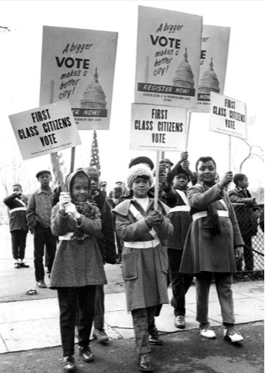
What is a Campaign?
Campaign:
an organized effort around making a change in society
citizens let the government know they want to see a change
Notes:
Teaching notes
Suggested Pacing: 1 minute
Directions:
Say, “Let's talk about the word 'campaign.'
A campaign is an organized effort around making a change in society by letting the government know citizens want to see a change.”
Attribution:
Yvonne Brock, Yolanda Wade, and Deborah Powell in the Get Out to Register parade. Historic Image Collection. DC Public Library.

Slide 4
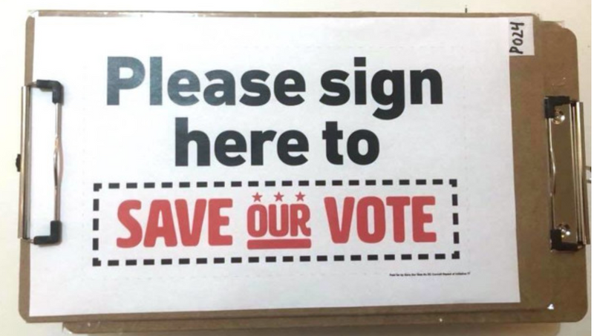
Campaign for Change
People choose to campaign when they feel strongly about an issue and want to change it
People might campaign to:
encourage politicians
change opinions
stop bad decisions
Campaigns organize to build movements that pressure the government to make a change
Notes:
Teaching notes
Suggested Pacing: 2 minutes
Directions:
Say, “Campaigning is about creating a change.
People may choose to campaign when they feel strongly about an issue and want to change it.
People might campaign to encourage politicians to support something, to change opinions on an issue, or to stop bad decisions from being made.
In society, campaigns build movements to pressure the government to make a change.”
Attribution:
DC Judge allows save our vote campaigners to collect petition signatures despite suit

Slide 5
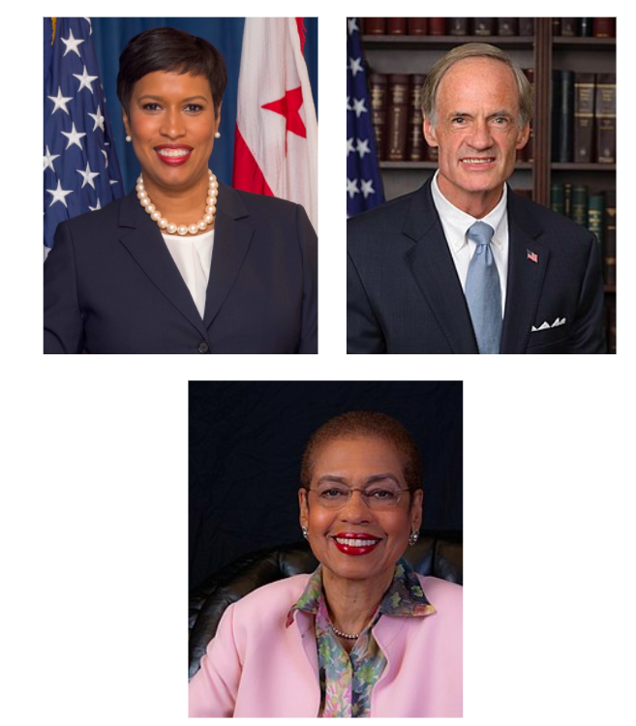
Campaign for D.C. Statehood
Political leaders in the campaign for D.C. Statehood:
Muriel Bowser
Tom Carper
Eleanor Holmes Norton
Notes:
Teaching notes
Suggested Pacing: 1 minute
Directions:
Say, “The campaign for D.C. statehood grows stronger as time passes.
Since the Home Rule Act of 1973, bills for D.C. Statehood have been introduced to Congress more than 12 times, but the U.S. Congress has voted against D.C. statehood every time.
In this lesson, you will learn about three people who have become political leaders in the campaign for D.C. Statehood: Muriel Bowser, Tom Carper and Eleanor Holmes Norton.”
Provide students with a copy of Leaders in Washington, D.C.'s Campaign for Statehood organizer (blank).
Refer to Leaders in Washington, D.C.'s Campaign for Statehood (for teacher reference) as needed.
Attributions:
District of Columbia Government / Public domain
United States Senate / Public domain
US House Office of Photography / Public domain

Slide 6
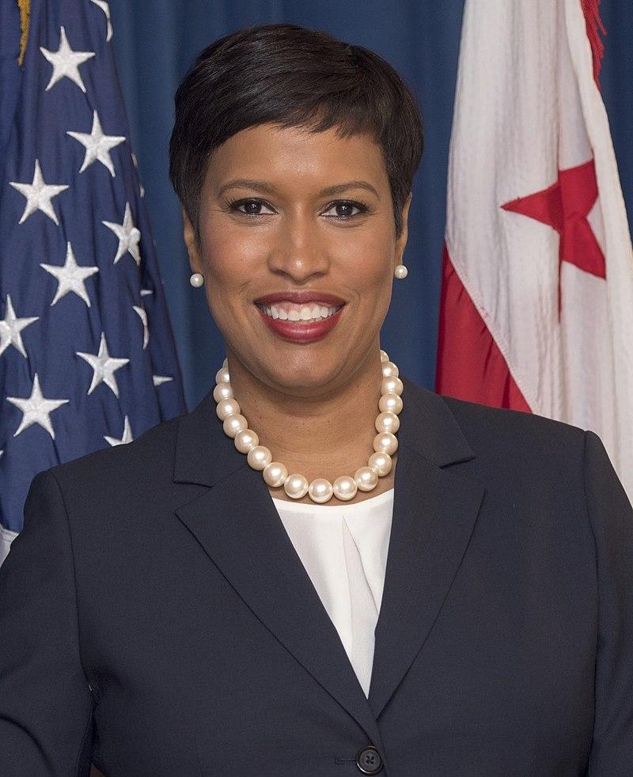
Muriel Bowser: Mayor of Washington, D.C.
Member of the Washington, D.C. Council from 2007 to 2015
Became Mayor of Washington D.C. in 2015
Wants justice for the people of Washington, D.C.
Notes:
Teaching notes
Suggested Pacing: 2 minutes
Directions:
Say, “One political leader who is working for D.C. statehood is Muriel Bowser. She became the mayor of Washington, D.C. in 2015. Before becoming the mayor, she served as a member of the Washington, D.C. Council from 2007 to 2015.
Mayor Bowser campaigns for D.C. statehood because she wants justice for the people of Washington, D.C. when it comes to representation in Congress.”
Ask students to record Muriel Bowser: Mayor of Washington, D.C. on their Leaders in Washington, D.C.'s Campaign for Statehood organizer.
Attribution:
District of Columbia Government / Public domain

Slide 7
Mayor Bowser and the Campaign for D.C. Statehood
“I was born without representation, but I will not die without representation.”
Mayor Muriel Bowser
What is Mayor Bowser saying about D.C. statehood in this quotation?
How does it represent her campaign for D.C. statehood?
Notes:
Teaching notes
Suggested Pacing: 2 minutes
Directions:
Say, “This is a quote from Mayor Bowser. Let’s read the quotation together.”
Read the quote aloud.
Say, “What is Mayor Bowser saying about D.C. statehood in this quotation? How does it represent her campaign for D.C. statehood?”
Prompt students to turn and talk to their partners about the question.
Conduct a whole class discussion calling on a few students to share their thinking.
Student Look-fors:
Mayor Bowser is determined to see a change in D.C.’s status during her lifetime.
This means that she feels strongly about the need for Washington, D.C. to be recognized as a state.
D.C. was born without representation in Congress, and she wants to see that change.
Attribution:
Bowser Uses Holidays to Advocate for Statehood

Slide 8
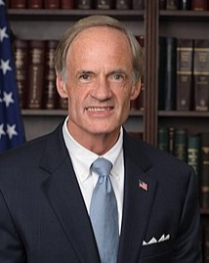
Senator Tom Carper: New Columbia Admission Act
Senator from Delaware
Introduced the New Columbia Admission Act in 2019
Would make Washington, D.C. the 51st State
Notes:
Teaching notes
Suggested Pacing: 2 minutes
Directions:
Say, “Another political leader who stands out for supporting D. C. statehood is Tom Carper. He is a Senator from the state of Delaware.
Senator Carper led a group of senators in introducing a bill called the New Columbia Admission Act.
This act would grant full statehood to Washington, D.C. and make it the 51st state. This would give D.C. citizens full representation in Congress.”
Ask students to record Senator Tom Carper on their Leaders in Washington, D.C.'s Campaign for Statehood organizer.
Attribution:
United States Senate / Public domain

Slide 9
Senator Carper and the Campaign for D.C. Statehood
”Washington, D.C. is not just a collection of government offices, monuments and museums; it is home to more than 600,000 people who work, study, raise families, and start businesses.”
Senator Tom Carper
What is Senator Carper’s saying about the people of Washington, D.C.?
How does this relate to his campaign for D.C. Statehood?
Notes:
Teaching notes
Suggested Pacing: 2 minutes
Directions:
Say, “This next quote is Senator Carper. Let’s read the quotation together."
Read the quote aloud.
Say, “What is Senator Carper’s saying about the people of Washington, D.C.? How does this relate to his campaign for D.C. Statehood?”
Prompt students to turn and talk to their partners about the question.
Conduct a whole class discussion calling on students to share their thinking.
Student Look-Fors:
Senator Carper believes that the people of D.C. deserve a change.
Senator Carper believes that the people who live in Washington, D.C. deserve representation in Congress, just like people who live in States have.
In order to gain representation in Congress, Washington, D.C. needs to become a state.
Attribution:
Senator Carper’s Statement on DC Statehood

Slide 10
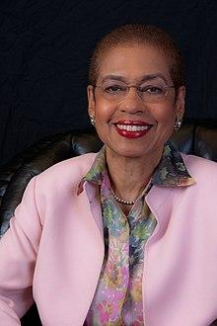
Congresswoman Eleanor Holmes Norton: Washington, DC Admission Act
D.C. Delegate to United States House of Representatives
Has been fighting for D.C. Statehood since 1991
Introduced the Washington, D.C. Admission Act in 2019 that would make Washington, D.C. the 51st State
Notes:
Teaching notes
Suggested Pacing: 2 minutes
Directions:
Say, “A third political leader with a strong commitment to statehood for D.C. is Congresswoman Eleanor Holmes Norton. Congresswoman Norton is the Delegate to the United States House of Representatives. She has been fighting for D.C. Statehood since 1991.
Congresswoman Norton introduced the Washington, D.C. Admission Act in 2019 which would make Washington, D.C. the 51st State if passed.”
Ask students to record Congresswoman Eleanor Holmes Norton and the Washington, D.C. Admission Act on their Leaders in Washington, D.C.'s Campaign for Statehood organizer.
Attribution:
US House Office of Photography / Public domain

Slide 11
Congresswoman Norton and the Campaign for D.C. Statehood
“My greatest disappointment is that most Americans believe we already have all the rights of those living in the states. We have work to do.”
Congresswoman Eleanor Holmes Norton
Why is Congresswoman Norton disappointed?
What is the work that needs to be done?
Notes:
Teaching notes
Suggested Pacing: 2 minutes
Directions:
Say, “Let’s read a final quotation together from Congresswoman Norton.”
Read the quote aloud.
Say, “Why is Congresswoman Norton disappointed? What is the work that needs to be done?”
Prompt students to turn and talk to their partners about the question.
Conduct a whole class discussion calling on a few students to share their thinking.
Student Look-fors:
Congresswoman Norton is disappointed because most Americans do not realize that citizens of D.C. do not have the same rights as citizens of states.
Making all Americans aware of the difference between D.C. and a state is the work that needs to be done.
Attribution:
Norton Says D.C. Statehood Cosponsors Represent Over Half of All Americans

Slide 12
Campaigning for D.C. Statehood
Notes:
Teaching notes
Suggested Pacing: 4 minutes
Directions:
Say, “Watch this campaign video for D.C. Statehood, which was created by Mayor Bowser’s office.
As you watch the video, think about what it means to campaign for change.
How could this video inspire people to make a change?
How could this video impact the work of leaders like Mayor Bowser, Senator Carper and Representative Holmes?"
Student Look-fors:
Student answers will vary.
Listening to the veteran in this video may inspire people to join in or support the campaign for D.C. Statehood.
If more Americans support the campaign for D.C. Statehood, it could help political leaders like Mayor Bowser, Senator Carper and Representative Holmes achieve their goal of making Washington, D.C. a state.
Attribution:
DC Statehood. DC Mayor's Office.

Slide 13
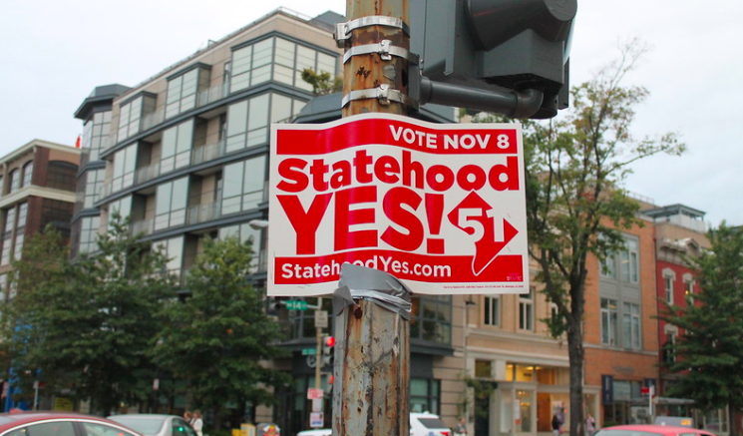
Express Your Understanding
Choose one of the political leaders from this lesson. Write a quote that they could use in their campaign for D.C. Statehood.
Be sure that the quote relates to the leader’s belief.
Notes:
Teaching notes
Suggested Pacing: 4 minutes
Directions:
Provide each student with a Campaign Quote Exit Ticket.
Say, “Choose one of the political leaders from this lesson. Write a quote that they could use in their campaign for D.C. Statehood. Be sure that the quote relates to the leader’s beliefs.”
Collect exit tickets as formative assessment.
Student Look-Fors:
Student answers will vary.
Student-generated quotes should refer back to the idea that statehood is an important issue for the citizens of Washington, D.C.
Attributions:
23.FourteenthStreet.WDC.26September2016.
Elvert Barnes.

