Slide 1
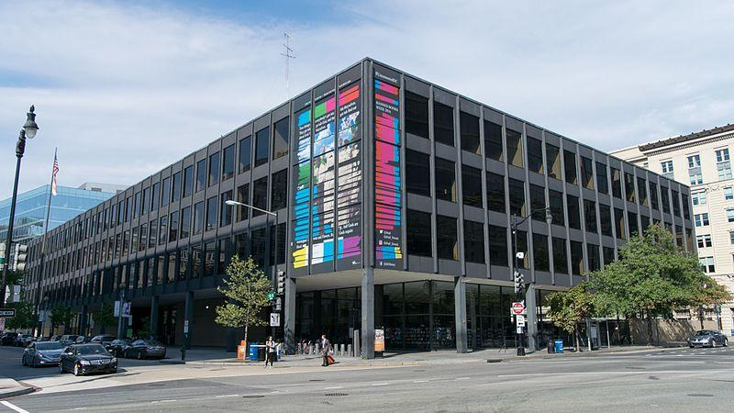
Accessing DC Public Library Resources
How to Use Library: Elementary, Lesson 7
Notes:
About this lesson
In this lesson, students will learn to navigate the DCPL website in order to access free research databases using their DC Public Library card. Students are introduced to the online library's main page and how to access databases through the Research toolbar. Students learn to use the database filter tool to narrow choices for specific research. Finally, students independently begin research on a specific question, using the filter tool to choose appropriate databases.
Materials:
Database (handout)
Suggested Topics List
ELA Standards:
1.G.A.1: Distinguish between defining attributes (e.g., triangles are closed and three-sided) versus non-defining attributes (e.g., color, orientation, overall size); build and draw shapes to possess defining attributes.
W.5.8: Recall relevant information from experiences or gather relevant information from print and digital sources; summarize or paraphrase information in notes and finished work, and provide a list of sources.
W.5.9: Draw evidence from literary or informational texts to support analysis, reflection, and research.
W.4.8: Recall relevant information from experiences or gather relevant information from print and digital sources; take notes and categorize information, and provide a list of sources.
W.4.9: Draw evidence from literary or informational texts to support analysis, reflection, and research.
W.3.8: Recall information from experiences or gather information from print and digital sources; take brief notes on sources and sort evidence into provided categories.
Prepare in Advance:
Have your DC Public Library card number ready to access lesson materials throughout the lesson.
List of grade-appropriate research questions that align with what you are currently studying in class or the Suggested Research Topics list.
Devices for students to use in order to access the DCPL website: www.dclibrary.org
DC Content Power Standards (3):
3.DC.4.4 - Explain how Washington, D.C., was selected and named as our capital city.
3.DC.4.5 - Identify and research outstanding statements of moral and civic principles made in Washington, DC, as well as the leaders who delivered them, that contributed to the struggle to extend equal rights to all Americans (e.g., Lincoln and his second inaugural address, Frederick Douglass and his speech against lynching at the Metropolitan AME Church, Martin Luther King Jr. and his speeches at the Lincoln Memorial in 1957 and 1963, and Rodolfo “Corky” Gonzales at the Poor People’s March).
DC Content Power Standards (4):
4.DC.6.6 - Identify the influence and achievements of significant leaders of the time (e.g., John Marshall, Andrew Jackson, Chief Tecumseh, Chief Logan, Chief John Ross, and Sequoyah).
4.DC.8.2 - Explain how political, religious, and economic ideas and interests brought about the Revolution
DC Content Power Standards (5):
5.DC.5.1 - Describe the extension of and controversy about slavery into the territories, including popular sovereignty, the Dred Scott decision, and the Kansas-Nebraska Act.

Slide 2
Guiding Question
How can I access DCPL resources to do research?
Notes:
Teaching notes
Suggested Pacing: 1 minute
Directions:
Explain that in this lesson, students will learn how to access resources from the DCPL.

Slide 3
Let's Review
How can I use the library to find true and relevant information?
Notes:
Teaching notes
Suggested Pacing: 2 minutes
Directions:
Use established classroom routine to divide the class into small groups of 2-3 and give each group a piece of paper to write on.
Say, "Turn and talk with your groups to answer the question on the slide in as many ways as you can. Write your ideas on your paper."
Call on groups to share out their ideas.
Attribution:
"Martin Luther King Jr. Memorial Library." Wikimedia Commons. Accessed Sept. 23, 2018

Slide 4
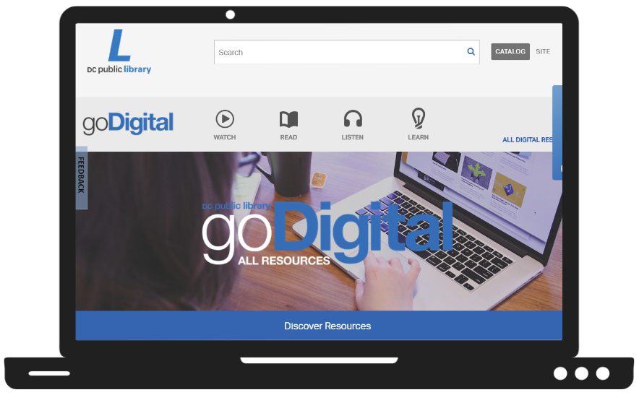
Introduction
I will need my library card number to get started!
Notes:
Teaching notes
Suggested Pacing: 2 minutes
Directions:
Explain that one way to use the library for research is to access its online resources.
Inform students that today they will be using several resources on the DC Public Library website.
Depending on the number of devices and your students' needs, either distribute a device to each student to use or divide students into groups to use a shared device.
Have a library card number ready in order to access all the resources on the DCPL website.
Direct students to go to www.dclibrary.org.
Attribution:
"goDigital" DC Public Library. Sept. 23, 2018.

Slide 5
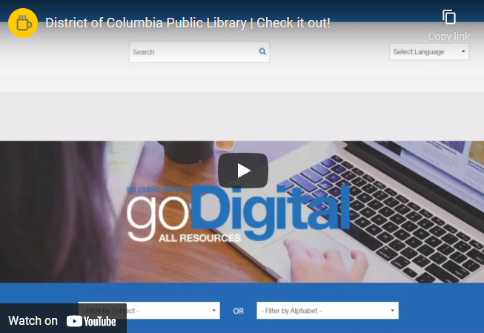
Finding the Research Databases
Notes:
Teaching notes
Suggested Pacing: 2 minutes
Directions:
Direct students to go to www.dclibrary.org on their devices.
Once there, watch the video and have students navigate to the research databases by hovering over the "Research" tab at the top of the page and selecting "Databases".
Student Look-Fors:
Students can navigate to the Databases page of the DCPL website.
Attribution:
District of Columbia Public Library l Check it Out!

Slide 6
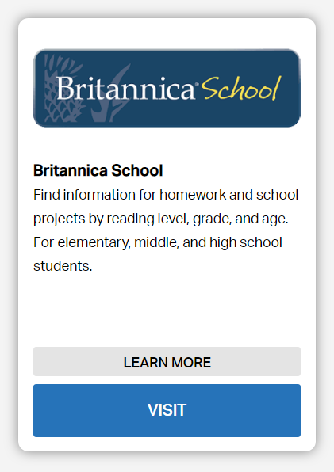
What is a Database?
Notes:
Teaching notes
Suggested Pacing: 1 minute
Directions:
Explain that a "database" is a collection. Just like a librarian might collect books and magazines for a student to use for research, a database is a collection of articles, videos, pictures, or audio recordings that can be used for research.
Note that while not every book in a library is useful for all students or all research projects, not all databases are the same. Some databases are more useful for different grades or different topics.
Student Look-Fors:
Students understand that a database is a collection of resources that can be used in research.
Students understand that not all databases are the same.
Attribution:
"goDigital" DC Public Library. Sept. 23, 2018.

Slide 7
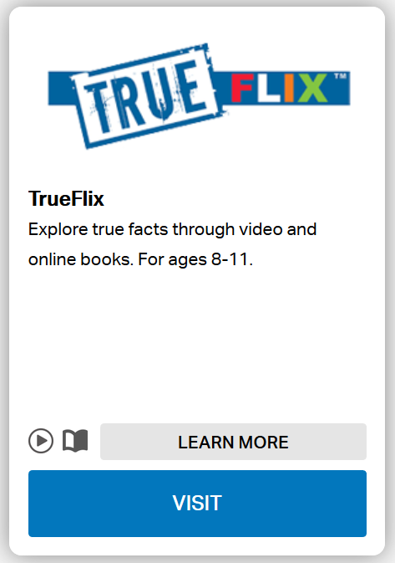
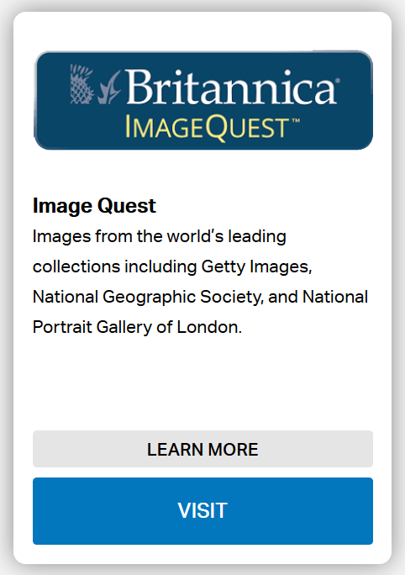
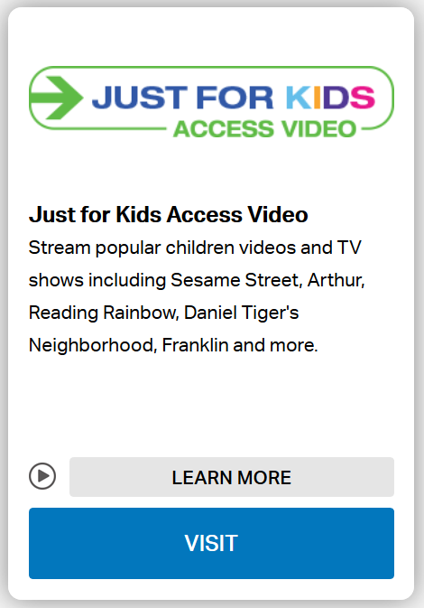
How are Databases Different?
How are these databases different?
Notes:
Teaching notes
Suggested Pacing: 3 minutes
Directions:
Draw student attention to the slide.
Say, "These are three databases available from DCPL, True Flix, Britannica ImageQuest and Just For Kids Access Video."
Say, "Each database has a descriptor below its title. Read the three database descriptors."
Say, "Turn and talk within your groups, how are these databases different?"
Give groups time to discuss, then call on several groups or individual students to share out their ideas.
Ask, "Which of these databases would be best to use to find an image?"
Ask, "Which of these databases would be best to find information about the American History?"
Ask, "Which of these databases would be best to use to find a video?"
If needed, model reading the descriptors on each database in order to learn more about each database.
Student Look-Fors:
Some databases have information about a certain topic, like history or music. Other databases have certain types of resources, like images or videos.
Britannica ImageQuest would be the best database to find images.
True Flix would be the best database to find information about the American History.
Just for Kids: Access Video and True Flix would both be good databases to find a video.
Attributions:
goDigital
Filter databases by "Homework Help for Middle School"

Slide 8
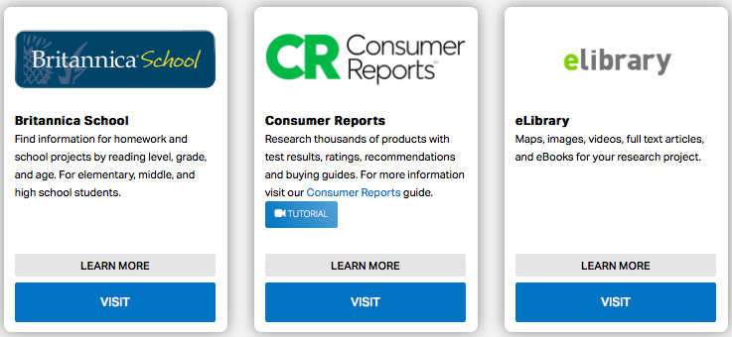
Are All Databases Useful?
Are all databases useful?
Notes:
Teaching notes
Suggested Pacing: 2 minutes
Directions:
Draw student attention to the slide.
Say, "Here are three more choices for databases available from the library. Read the descriptor for each."
Say, "Turn and talk, would these databases be useful for researching how Washington D.C. became the capital of the United States?"
Note that not all databases are useful for all research questions. Researchers need to look carefully at which databases they want to search in order to find true and relevant information.
If needed, model reading the descriptors on each database in order to learn more about each database.
Student Look-Fors:
Not all databases are useful for research on a specific question or topic.
Attribution:
GoDigital "Research" DC Public Library. March 31, 2020.

Slide 9
Finding the Right Database
Notes:
Teaching notes
Suggested Pacing: 1 minute
Directions:
Explain that one way to narrow the choices to more appropriate databases is to "Filter by Subject".
Watch the video, and explain that by selecting the subject, "Children," students can see databases that are made for students. Not all of the sources will have relevant information, but they will be written for elementary students to use instead of for high school students or adults.
Have students use their devices to navigate to the "Children" page using the "Filter by Subject" drop-down menu.
Student Look-Fors:
Students can navigate to the "Children" collection using the "Filter by Subject" drop-down menu.
Attribution:
- All Digital Resources l District of Columbia Public Library

Slide 10
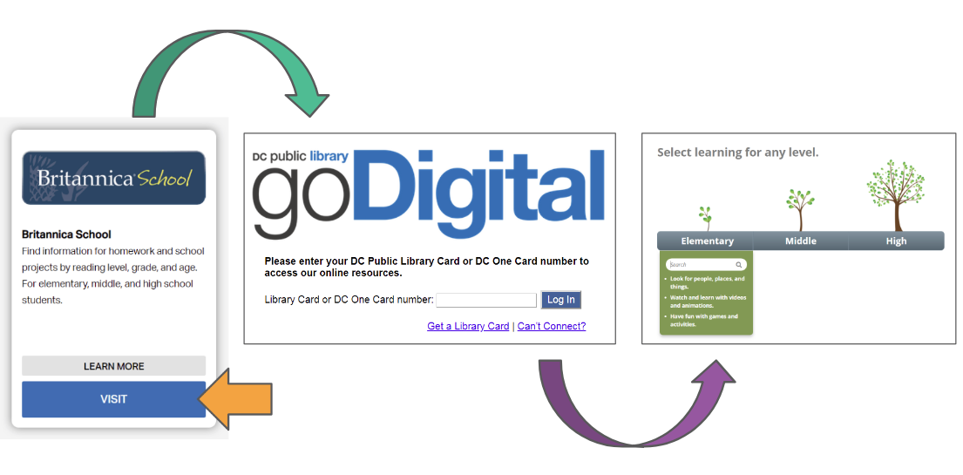
Using a Database
I'm ready!
Notes:
Teaching notes
Suggested Pacing: 1 minute
Directions:
Explain that once students have chosen a database to use, they can access it by clicking on the blue "Visit" button. This will open a new tab asking for their DC Public Library card number. After students enter the card number, they will be taken to that database and can start their research.
Have each student or group practice this process by clicking on the "Britannica School" database and logging in with their DC Public Library card.
Student Look-Fors:
Students can successfully log into a database using their DC Public Library card.

Slide 11
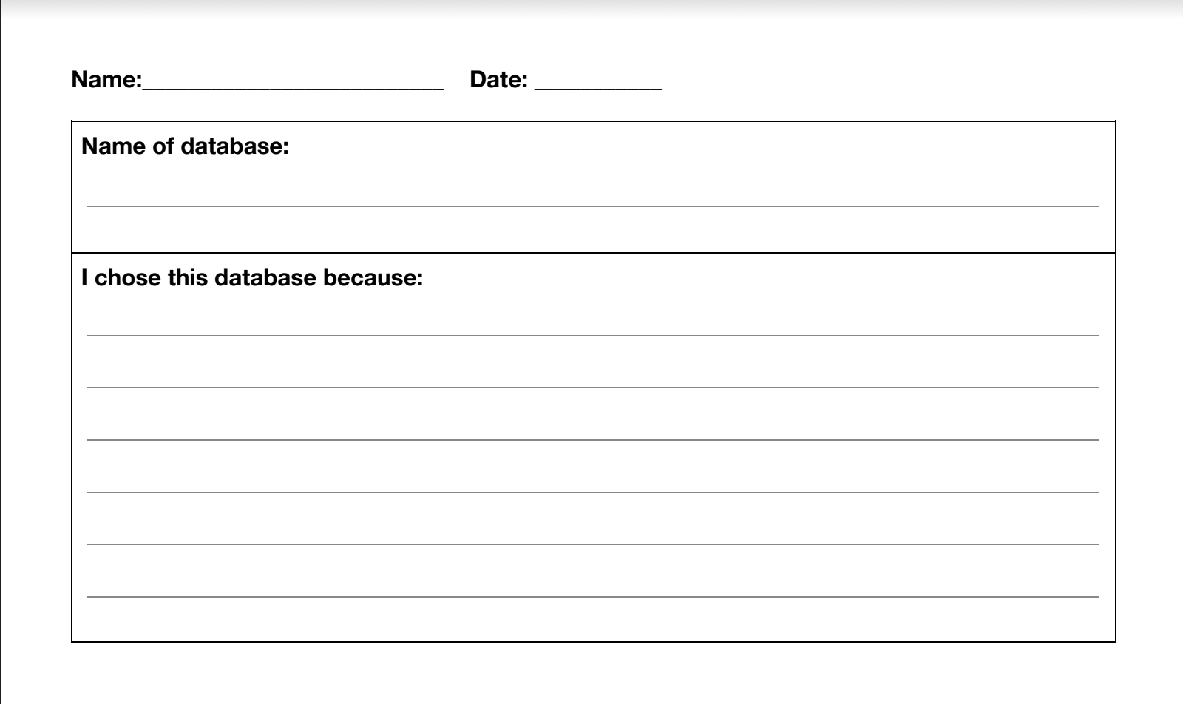
Express Your Understanding
Notes:
Teaching notes
Suggested Pacing: 5 minutes
Directions:
Have all students close all tabs and return to the original web page: https://www.dclibrary.org
Inform students that they will be using what they have learned to find the best database to use in order to research a given topic.
The topic itself is secondary but can be aligned with what students have been studying in social studies. If needed, teachers can use a research question from the Suggested Topics List.
Distribute the Database handout and allow students to begin work using their devices.
Explain that students will use this handout to:
record which database they chose to use for their research.
state why they decided to use that particular database.
Note that the goal of this activity is for students to justify their choice of a database, not to take notes on a topic.
Monitor the class and provide assistance and redirection as needed to struggling students.
Student Look-Fors:
Students can use the DCPL website to navigate to an appropriate database to use in research.

