Slide 1
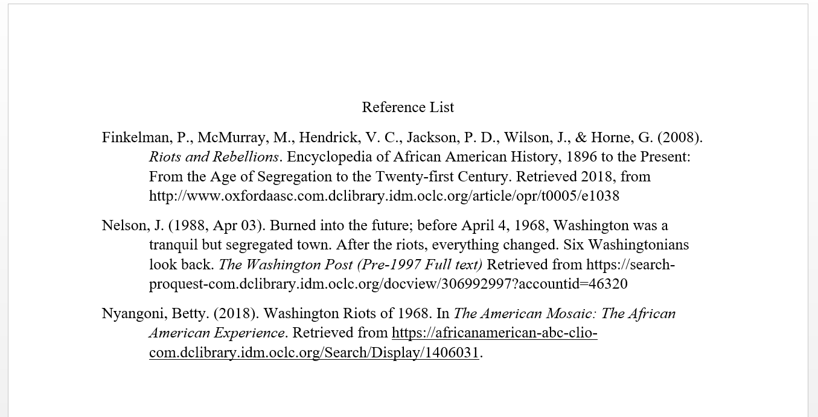
How can I cite where I found information using a standard format?
How to Use Library: High, Lesson 5
Notes:
About this lesson
This lesson explains how to cite research sources, through in-text citations and a reference list. It references items and research topics from the 12-grade cornerstone project, When should people fight for change?
Materials:
Summarizing Information
ELA Standards:
W.11-12.8: Gather relevant information from multiple authoritative print and digital sources, using advanced searches effectively; assess the strengths and limitations of each source in terms of the task, purpose, and audience; integrate information into the text selectively to maintain the flow of ideas, avoiding plagiarism and overreliance on any one source and following a standard format for citation.
Prepare in Advance:
Ensure that technology is in place for individual research. Students should have access to their research sources (books, articles, websites, etc.). Both the teacher and students will also need a DCPL library card number to login to databases.
If a student does not have a library card, he/she can apply here.
DC Content Power Standards:
12.DC.10.2: Describe disturbances resulting from racial tensions.
12.DC.10.3: Explain how African American leaders resisted discrimination.
C3 Framework Indicators and Common Core Standards for Literacy in History/Social Studies:
D2.His.1.9-12: Evaluate how historical events and developments were shaped by unique circumstances of time and place as well as broader historical contexts.
D2.His.14.9-12: Analyze multiple and complex causes and effects in the past.

Slide 2
Guiding Questions
How do I cite using a standard format?
Why do I need to cite the sources where I find my information?
Notes:
Teaching notes
Suggested Pacing: 2 minutes
Directions:
Ask, "Why do I need to cite the source where I find my information?"
Say, "In order to avoid plagiarism, you need to give authors and speakers the credit they deserve. Any information you include that is another author's words or ideas, must be attributed to the author."
Say, "For the majority of academic writing purposes, you will be required to use APA standard format. According to the Purdue OWL website, 'APA (American Psychological Association) style is most commonly used to cite sources within the social sciences. This resource, revised according to the 6th edition, second printing of the APA manual, offers examples for the general format of APA research papers, in-text citations, endnotes/footnotes, and the reference page. For more information, please consult the Publication Manual of the American Psychological Association, (6th ed., 2nd printing).' We will use this resource later on in this lesson to learn how to cite sources correctly.
Attribution:
Previous slide - The Purdue Online Writing Lab

Slide 3
Research Vocabulary
Extensive information about a source is listed in a Reference List at the end of a research paper.
Where do I cite information in my research?
Throughout your paper, in-text citation is used after you quote, summarize, or paraphrase from a source, to direct your reader to the source in your Reference List.
Notes:
Teaching notes
Suggested Pacing: 2 minutes
Directions:
Say, "You will provide citation for your sources in two places: in a reference list at the end of your paper, and throughout your paper, using in-text citations. If you paraphrase, summarize, or quote from a source in your research, you must provide in-text citation for the source and it must be included in your reference list. In this lesson, we will learn how to do both types of citation, using APA format.
Ask, "What kind of information do you need to collect about your source in order to cite properly?" Invite 2-3 students to share out loud with the class.
Student Look Fors:
Students will have experience citing sources. They may suggest the following:
Author name, publishing information, page numbers where information was found
If it is an online source, website and retrieval date

Slide 4
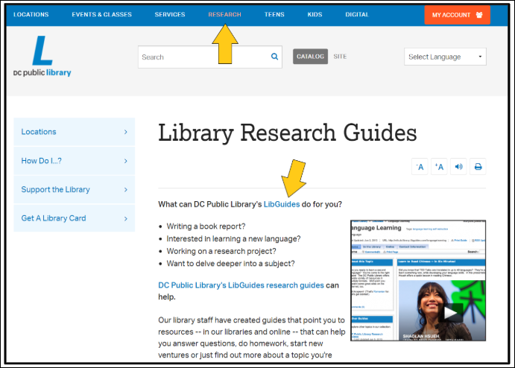
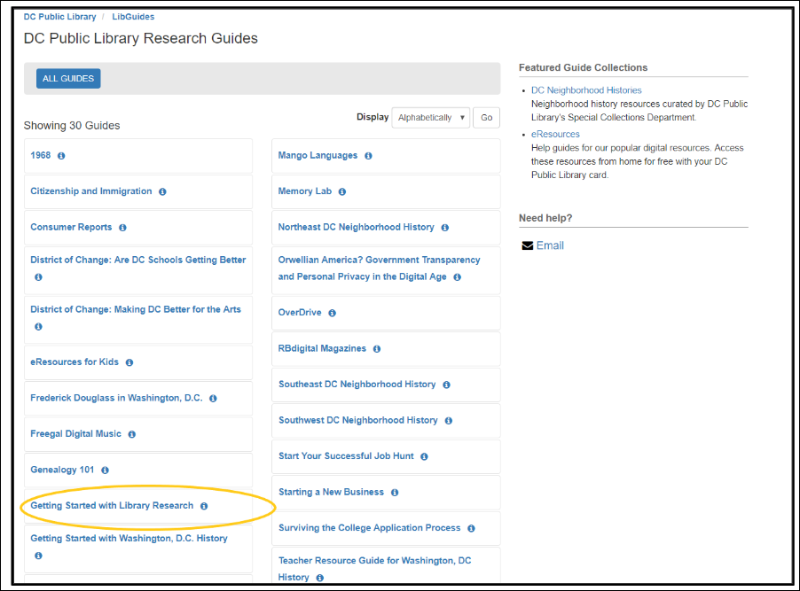
Standard Format Resources
Use the D.C. Public Library Research Guides to get help with sources!
Click on Research on the tool bar.
Choose Research Guides from the drop down list.
Select Getting Started with Library Research.
Notes:
Teaching notes
Suggested Pacing: 1 minute
Directions:
Using an established classroom routine, distribute electronic devices to each student, or to small groups. You and each student will need access to a D.C. One library card number.
Say, "On your own device, follow along with me as I direct you to some helpful resources."
Direct students to the D.C. Public Library homepage.
Say, "The D.C. Library website provides all kinds of resources to help you find and cite sources. One of their most helpful online tools are their Research Guides. These are compilations of sources and information on popular topics. There is even a whole guide devoted to 1968, which is bound to be full of helpful sources as I explore the Washington Riots of 1968. However, today I want to show you a guide that will be helpful anytime you need to do research. First, you can find the Library Research Guides by clicking Research on the main tool bar at the top of the website. Select "Research Guides" on the drop down list. Let's look at the Getting Started with Library Research Guide."
Attribution:
D.C. Public Library Research Guides, courtesy of the D.C. Public Library

Slide 5
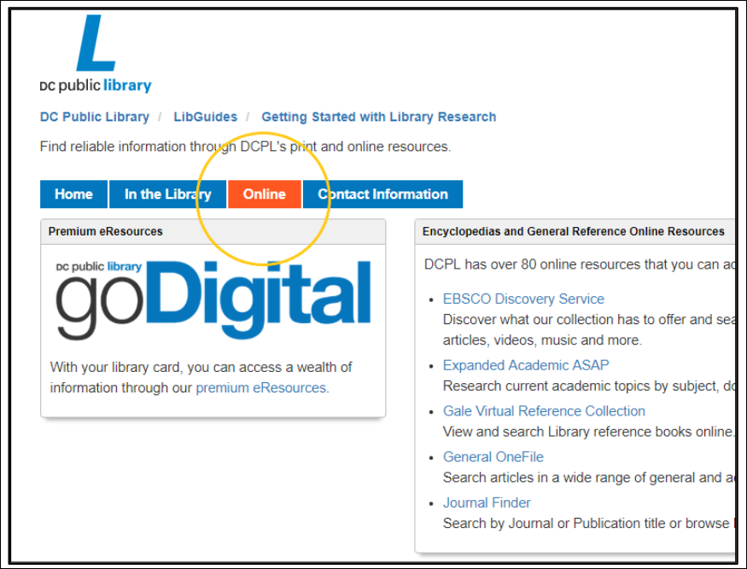
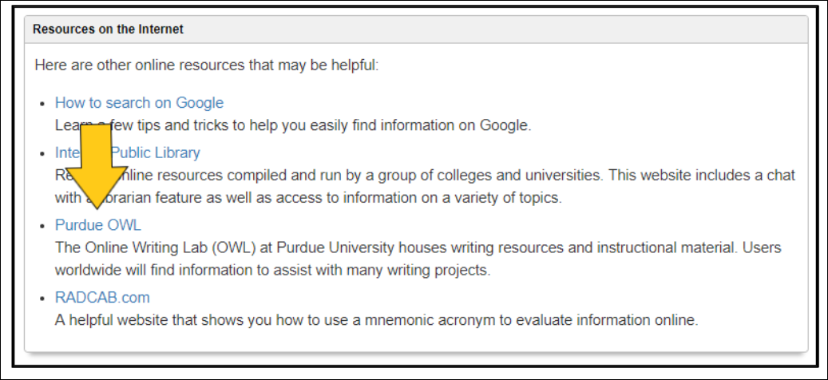
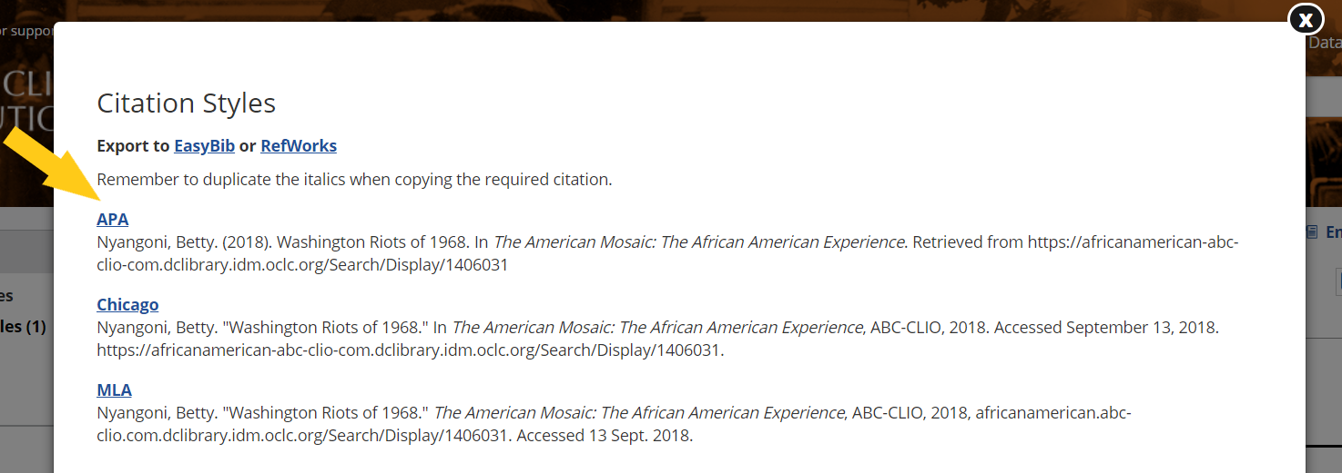
Standard Format Resources
Notes:
Teaching notes
Suggested Pacing: 4 minutes
Directions:
Say, "Now that you are on the page for the guide, choose the tab that says 'Online.' Take a few minutes exploring the resources on this page."
Circulate and make sure students are exploring the resources on this page.
After a few minutes, ask, "What are some of the resources you discovered? How can this page be helpful to you in your research?" Invite a few students to share out loud with the class.
Say, "When it comes to sources, this page can be a great "jumping off" place for getting started. The tips on beginning your search and the links to reference sources are great places to start. At the bottom of the page, you will find a link to the Purdue OWL website. I want to draw your attention to this, as it will be very helpful in citing your sources."
Say, "Keep in mind, that most of the sources in the DCPL online databases provides a link to automatically generate the citation information you need in APA format. Look at the top of the source's page for a link that says "cite." Once you click on it, you will see a window pop up like this (point to the bottom image). You can copy/paste the APA citation information you need from here."
Say, "If there isn't an option to generate the citation information, you can use the Purdue OWL website to find directions on citing your source, using APA format."
Say, "Even if you use an automatically generated citation, it is important to double check it with the standard format, using an APA guide, such as the Purdue OWL website."
Student Look Fors:
Students will share information about some of the tools they find on the Library Guides Getting Started with Library Research page. Some of the tools they might reference include:
Links to Online Reference Materials
Tips on beginning an online search, using Google or the library database
Online resource collections
Writing guides, such as the Purdue OWL site
Attributions:
D.C. Public Library Research Guides, courtesy of the D.C. Public Library
Purdue Online Writing Lab
The African American Experience, courtesy of the D.C. Public Library

Slide 6
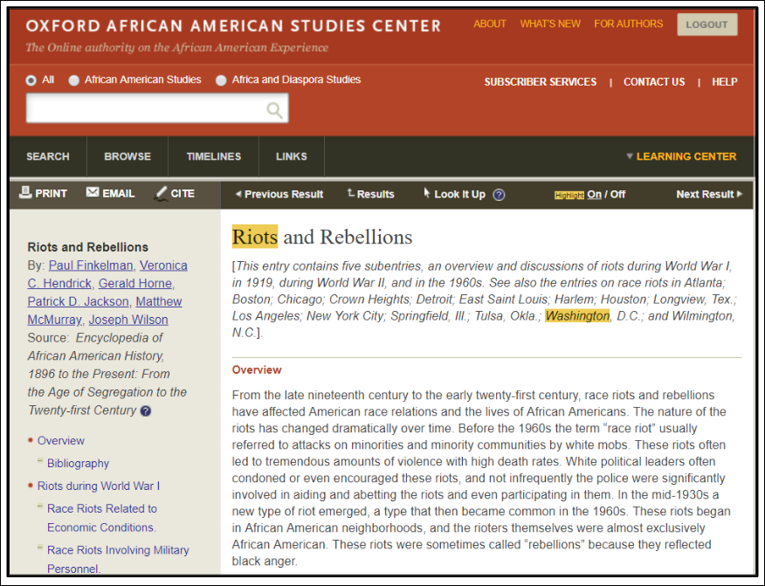
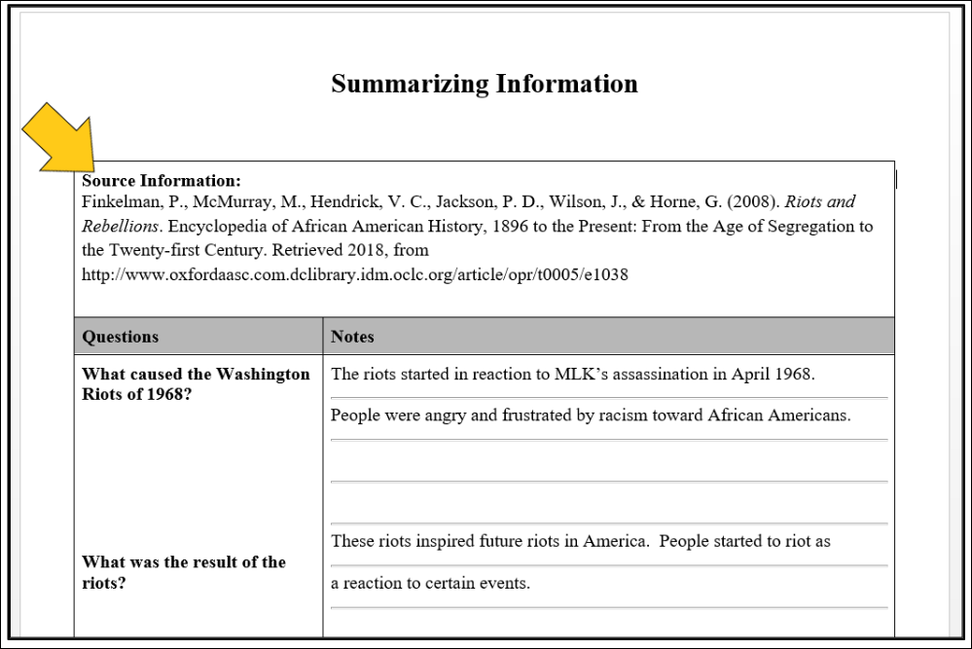
Keeping Sources Organized
Record your source information at the top of your note-catcher.
Record page numbers next to your notes, if your source has any.
Notes:
Teaching notes
Suggested Pacing: 2 minutes
Directions:
Using a previously established classroom routine, distribute or invite students to take out their Summarizing Information note-catcher.
Say, "Before we begin collecting source information, let's get organized. This will keep you from losing track of a source. Here's an example of some notes I took from the Oxford African American Studies Center. This database only generates MLA formatted citations, so I used the Purdue OWL website to record the information from this source at the top of my note-catcher."
Say, "As you collect notes from each source, keep all of your notes from one source on the same page(s). Record this information as you go, so it is not hard to find later."
Attribution:
"Riots and Rebellions," Oxford African American Studies Center, courtesy of the D.C. Public Library

Slide 7
Keeping Sources Organized
In-text citations provide:
author's last name
publishing date
page number (if applicable)
How do I write an in-text citation?
The Washington Riots of 1968 began at Fourteenth and U Streets in Washington, D.C. This area was the center of many civil rights organizations. The group started out as a small group of young adults. When black activist, Stokely Carmichael joined the group and started to take the lead, the crowd grew louder and angrier (Nyangoni, 2018).
Notes:
Teaching notes
Suggested Pacing: 4 minutes
Directions:
Ask, "What is an 'in-text citation' and what information does it include?" Invite a student to share out loud with the class.
Say, "In-text citations will direct your reader to find the original source of your ideas and quotes. The in-text citation will always include the author's last name and publishing date. If there are page numbers in your source, such as in a physical book, you will also include the page numbers where you found your information in your in-text citation. If there aren't page numbers, you may need to refer to headings or paragraph numbers. The Purdue Online Writing Lab gives guidelines for all types of sources and trickier citation scenarios. Using your device, take a look at the Purdue OWL's APA Formatting and Style Guide. Look at the In-Text Citations: Basics guide."
Invite students to read through the basic guidelines and then say, "Take a look at this example of in-text citation from my research paper on the Washington Riots of 1968. (Read aloud the paragraph.) After reading through the basics, are there other ways I could have structured this citation? What other information is sometimes included in in-text citations?"
Say, "In your research you will come across sources that do not fit into the guidelines for the basics. For example, you may come across sources that have many authors, or the author is unknown. The APA Formatting and Style guide has information for many different citation scenarios. In this case, if you scroll down the side bar, click on 'In-Text Citations: Author/Authors.' Here you will find guidelines for many different author scenarios." Click on the link to show the website page to the class.
Student Look-Fors:
The author and publishing date could have been stated before the paraphrased information.
The page number, headings, or paragraph numbers.
If there are multiple authors, other authors will be listed, or the phrase "et al." depending on the number of authors.
Attributions:
"The Washington Riots of 1968," The African American Experience, courtesy of the D.C. Public Library
"In-Text Citations: The Basics," Purdue Online Writing Lab

Slide 8
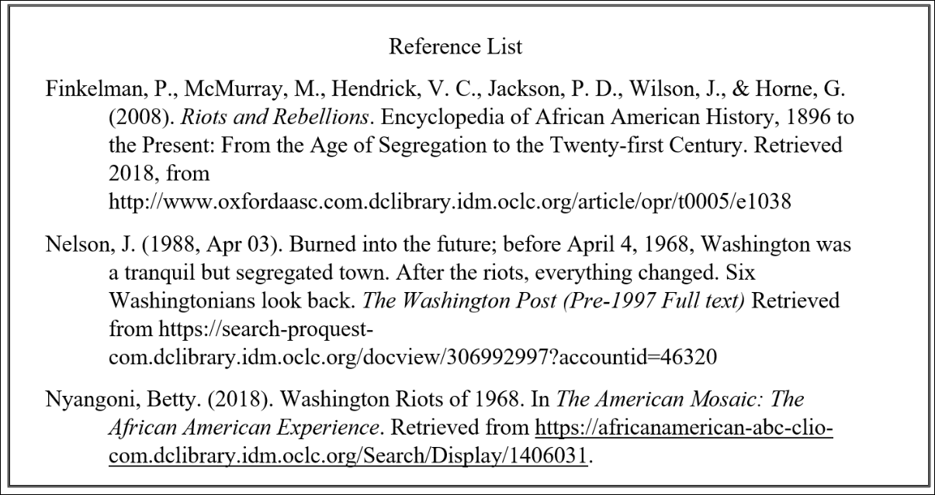
Keeping Sources Organized
A Reference List:
is created using standard format, usually APA
includes all sources you used in your research
author, publication, and retrieval information for each source
is alphabetized by author's last name, with all lines after first line of each source indented a half inch
How do I make a Reference List?
Notes:
Teaching notes
Suggested Pacing: 5 minutes
Directions:
Ask, "How do you make a reference list?"
Say, "Reference Lists provide all the information your reader will need to find the original source of your ideas and quotes. The reference list always includes author, publication, and retrieval information for each your sources. The Purdue Online Writing Lab gives basic guidelines for creating this list. A few other tips about a reference list includes:
It is created in standard format, in most cases APA.
It is alphabetized by author's last name.
All lines after the first line of each source are indented a half inch."
Say, "Using your device, take a look at the Purdue OWL's APA Formatting and Style Guide. Look at the Reference List: Basic Rules guide."
Invite students to read through the basic guidelines and then say, "Be sure to explore some of the other options on the sidebar. Just like the tips provided on in-text citations for sources with unknown author/multiple authors, there is a page that is specifically helpful for listing sources in your reference list that have an unknown author/multiple authors." Click on the link to show the website page to the class.
Say, "Additionally, there are many other pages that will guide you through adding sources with more challenging citation information to your reference list."
Attributions:
Purdue Online
"Reference List: Basic Rules," Purdue Online Writing Lab

Slide 9
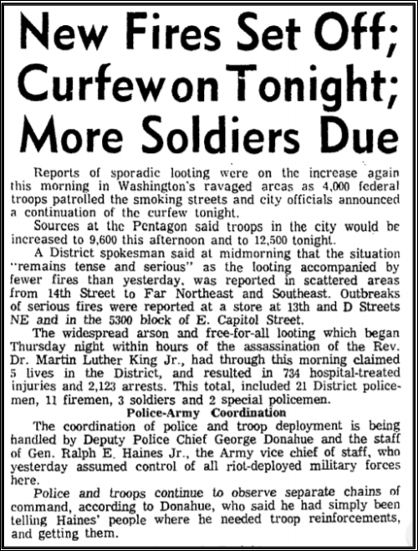
Express Your Understanding
Practice citing information about this article from The Evening Star newspaper.
On a note card....
Write an in-text citation for the quote from the article, included below.
Using the Purdue OWL site as a guide, create an APA Reference List entry for the article.
The widespread arson and free-for-all looting which began Thursday night within hours of the assassination of the Rev. Dr. Martin Luther King, Jr., had through this morning claimed 5 lives in the District, and resulted in 734 hospital-treated injuries and 2,123 arrests.
Notes:
Teaching notes
Suggested Pacing: 8 minutes
Directions:
Guide students to access the full article through the News Bank database on the DCPL website.
Distribute a blank note card to each student, using an establish classroom routine.
Say, "Using the online article source and the resources we have used today, record the quote from the article, using an in-text citation for the source. Then, on the other side of the card, create the full reference list entry for this source."
Collect note cards as a formative assessment.
Student Look-Fors:
In-text citation is written in one of the following ways:
According to the Evening Star (1968), "The widespread arson and free-for-all looting which began Thursday night within hours of the assassination of the Rev. Dr. Martin Luther King, Jr., had through this morning claimed 5 lives in the District, and resulted in 734 hospital-treated injuries and 2,123 arrests" (p. A-1)
"The widespread arson and free-for-all looting which began Thursday night within hours of the assassination of the Rev. Dr. Martin Luther King, Jr., had through this morning claimed 5 lives in the District, and resulted in 734 hospital-treated injuries and 2,123 arrests" (The Evening Star, 1968, p. A-1)
The reference list entry is written as follows:
The Evening Star. New Fires Set Off; Curfew on Tonight; More Soldiers Due. (1968, Apr 6). Evening Star, p. A-1. Retrieved from https://infoweb.newsbank.com/resources/doc/nb/image/page/v2:13D5DA85AE05A305@EANX-14DF46D34BBA6B02@2439953-14DEA10295534F7F@0?p=WORLDNEWS
Note: The author is unknown, so students may use the Purdue OWL website to determine the correct citation when an author is unknown.
Additional Note:
The full reference list entry contains a long URL, as it is from an online database. Teacher may elect to have students simply write "URL" after retrieval website, as in this entry:
The Evening Star. New Fires Set Off; Curfew on Tonight; More Soldiers Due. (1968, Apr 6). Evening Star, p. A-1. Retrieved from https://infoweb.newsbank.com/URL
Attribution:
"New Fires Set Off; Curfew on Tonight; More Soldiers Due," NewsBank Database, courtesy of D.C. Public Library

