Slide 1
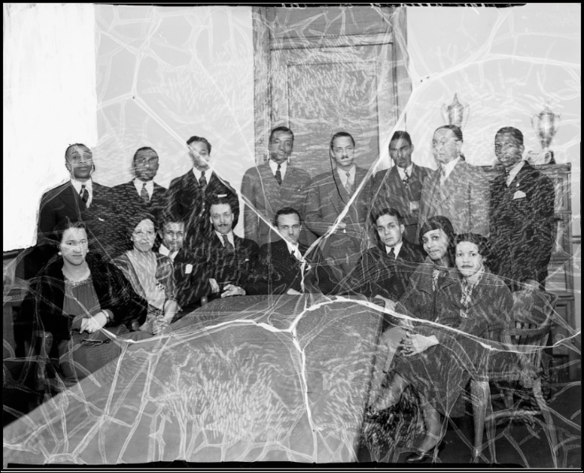
What type of source should I use?
How to Use Library: High School, Lesson 6
Notes:
About this lesson
This lesson describes different types of research sources, and explains how to select appropriate sources for a research topic. It references items and research topics from the 12-grade cornerstone project, When should people fight for change?
Materials:
Summarizing Information
ELA Standards:
W.11-12.2.b: Develop the topic thoroughly by selecting the most significant and relevant facts, extended definitions, concrete details, quotations, or other information and examples appropriate to the audience's knowledge of the topic.
W.11-12.7: Conduct short as well as more sustained research projects to answer a question (including a self-generated question) or solve a problem; narrow or broaden the inquiry when appropriate; synthesize multiple sources on the subject, demonstrating understanding of the subject under investigation.
W.11-12.2: Write informative/explanatory texts to examine and convey complex ideas, concepts, and information clearly and accurately through the effective selection, organization, and analysis of content.
Prepare in Advance:
Ensure that technology is in place for individual research. Students should have access to their research sources (books, articles, websites, etc.). Both the teacher and students will also need a DCPL library card number to login to databases.
If a student does not have a library card, he/she can apply here.
DC Content Power Standards:
12.DC.10.2: Describe disturbances resulting from racial tensions.
12.DC.10.3: Explain how African American leaders resisted discrimination.
C3 Framework Indicators and Common Core Standards for Literacy in History/Social Studies:
D2.His.1.9-12: Evaluate how historical events and developments were shaped by unique circumstances of time and place as well as broader historical contexts.
D2.His.14.9-12: Analyze multiple and complex causes and effects in the past.

Slide 2
Guiding Questions
How can I make sure I choose a variety of resources?
What type of source should I use?
Notes:
Teaching notes
Suggested Pacing: 1 minute
Directions:
Ask, "How do you pick the best resources for your research, and make sure you include a variety of sources?"
Invite 2-3 students to share responses out loud.
Student Look Fors:
Students might share the following:
The types of sources you need will depend on the type of research. For example, in the sciences, studies found in journals will be helpful, in history, primary sources will be useful.
Carefully select and refine your keywords according to your research questions.
Use a variety of databases to search.
Visit the library or museums to find primary sources.
Attribution:
Previous Slide:
Scurlock Studio Records, ca. 1905-1994, Archives Center, National Museum of American History

Slide 3
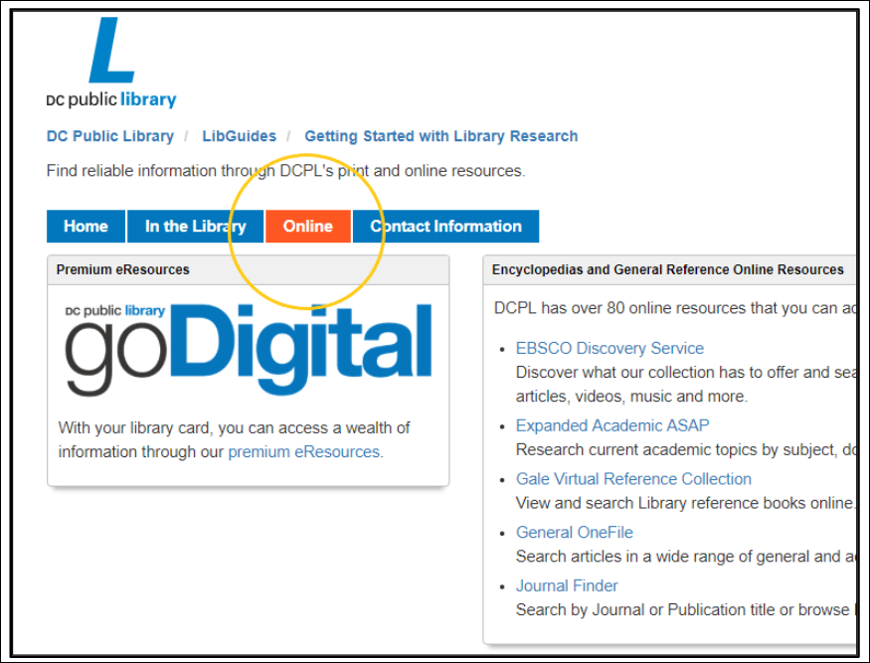
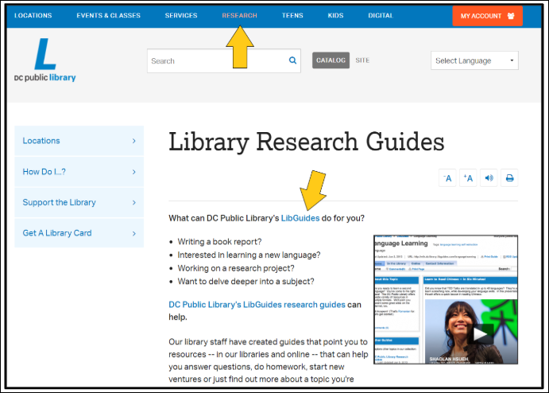
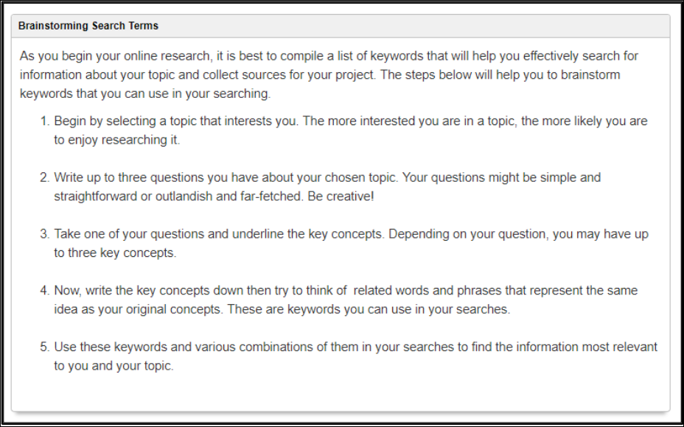
Brainstorming Search Terms
Notes:
Teaching notes
Suggested Pacing: 7 minutes
Directions:
Use an established classroom routine to arrange students in their research groups. Each student will need access to devices and research materials.
You and each student will need access to a D.C. One library card number.
Using an established classroom routine, distribute the Starting Research handout to each student.
Say, "In order to select the best resources, you need to narrow down your search to keywords that will give you the most relevant answers to your research questions."
Invite students to log in to the D.C. Public Library website and follow along with you.
Say, "The D.C. Public Library Research Guides offer tips on developing strong keywords. On the homepage, select 'Research' on the top tool bar, and then 'Research Guides' from the drop down menu. When you get to the list of guides, choose 'Getting Started with Library Research.' Select the 'Online' tab for tips on using the internet to begin your research process. Scroll down to the box that says, 'Brainstorming Search Terms.'"
Say, "In your research groups, develop keywords for your search by reading through these steps and completing your Starting Research handout."
Give students a few minutes to work through the steps and develop at least 2-3 keywords for their search.
Additional Note:
If students have already developed keywords for research, invite research groups to explore some of the other resources suggested on the "Getting Started with Library Research" pages, including those suggested on the "In the Library" tab.
Student Look Fors:
Students are working in groups, completing the Starting Research handout.
Each group needs at least 2-3 keywords for research.
As students finish, they are exploring the other resources on the "Getting Started with Library Research" page.
Attribution:
D.C. Public Library Research Guides, courtesy of the D.C. Public Library

Slide 4
Types of Sources
The following types of sources can be found in physical or online form, through D.C. Public Library:
reference materials
articles
primary sources
sources that reveal opinions for/against
What types of sources can I choose to use in my research?
Notes:
Teaching notes
Suggested Pacing: 2 minutes
Directions:
Say, "Now that you have keywords for your research, it is time to begin collecting sources."
Ask, "What types of sources have you used in past research?" Invite several students to share aloud with the class. Share the items on the slide if students do not mention them.
Use an established classroom routine to distribute Summarizing Information note-catchers to each student, or invite students to pull their notes out if they already have them. Each student will need several Summarizing Information note-catcher copies to track their sources and take notes.
Say, "As we begin our research, we want to be organized and ready to keep track of our notes and sources. We will use this Summarizing Information note-catcher to keep organized as we work."
Student Look Fors:
Students might share:
Different types of reference materials, such as encyclopedias, dictionaries, almanacs, atlases, etc.
Articles: newspaper, journal, etc.
Primary sources: journal entries, photographs, videos, artifacts, etc.
Opinion sources: op-eds, court case decisions, etc.

Slide 5
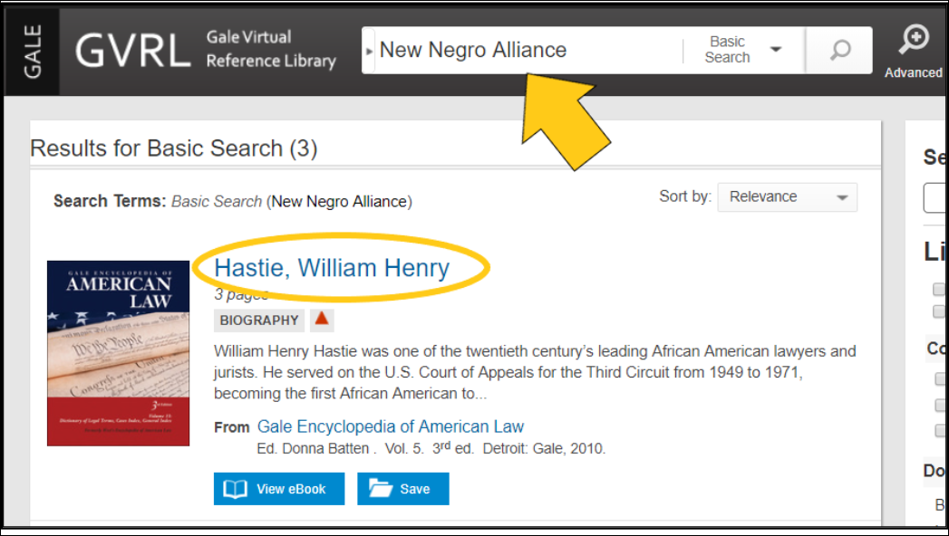
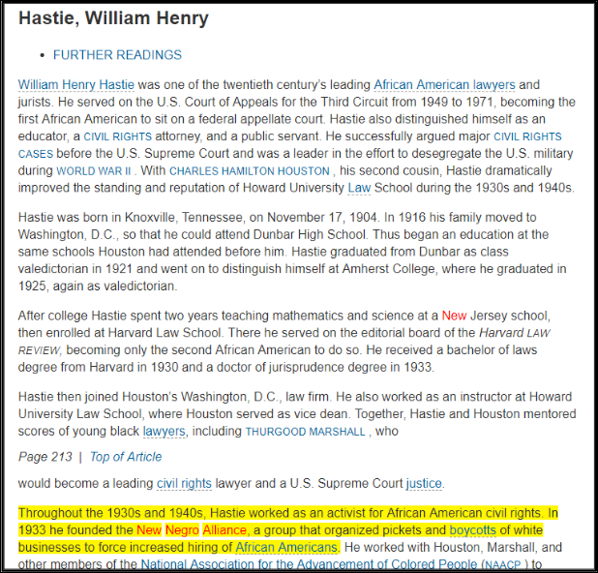
Using Reference Sources
Reference sources . . .
Provide background on topics
Include encyclopedias, dictionaries, atlases, almanacs, etc.
Can help you expand your keywords for research
-The New Negro Alliance was formed in 1933 by William Henry Hastie, an African American Civil RIghts Activist.
-The Alliance was formed to organized pickets and boycotts to demand white business owners hire more African American employees.
Notes:
Teaching notes
Suggested Pacing: 5 minutes
Directions:
Say, "Reference sources are great for obtaining background information about your topic, especially as you are getting started in your research."
Say, "On the DCPL online databases, there are many reference databases to choose from. Gale Virtual Reference Library and Britannica are two commonly-used reference resources. In these databases, use your key words in the search bar to generate lists of entries related to your topic."
Say, "Sometimes the entry title may not seem relevant, but if you look more closely, you may gather information you need. For example, I am gathering research about the New Negro Alliance to understand why it was organized and the effects of its advocacy tactics. When I searched 'New Negro Alliance,' the name William Henry Hastie came up in the results. Upon reading the article, I gained some important background information that will help me dive deeper into this topic."
Say, "One of the helpful features of this online reference tool is that you can save reference articles and highlight the relevant information for later use."
Say, "Here are some notes I will add to my Summarizing Information note-catcher.
The New Negro Alliance was formed in 1933 by William Henry Hastie, an African American Civil RIghts Activist.
The Alliance was formed to organize pickets and boycotts to demand white business owners hire more African American employees.
Say, "I paraphrased this information, so I will be sure to give this source attribution. I will place the citation information at the top of my Summarizing Information note-catcher, so I don't lose track of this source."
In research groups, invite students to use their keywords in the Gale Virtual Reference Library or Britannica to find background information on their topics.
Student Look Fors:
Students working in research groups, entering keywords into the Gale Virtual Reference Library and Britannica databases.
Groups are adding source information and notes, using the Summarizing Information note-catcher.
Attribution:
"Hastie, William Henry," Gale Virtual Reference Library, courtesy of the D.C. Public Library

Slide 6
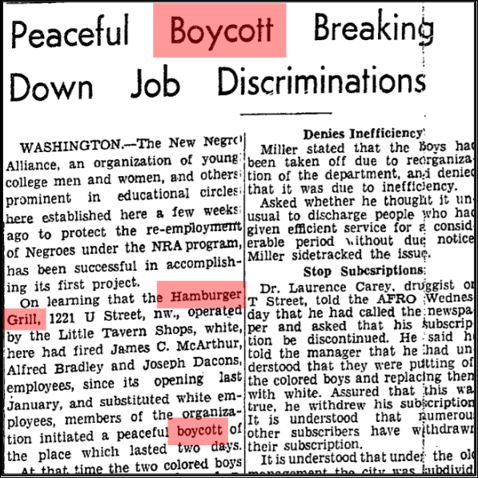
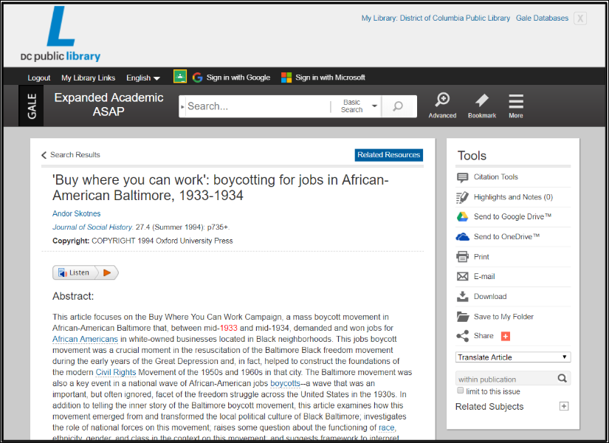
Articles
When should I use academic journal articles?
When does it make sense to use newspaper articles?
NewsBank
ProQuest: Historical Black Newspapers
Gale Expanded Academic, ASAP
EBSCO
Notes:
Teaching notes
Suggested Pacing: 10 minutes
Directions:
Using an established classroom routine, distribute a piece of chart paper and markers to each research group.
Say, "There are different types of articles that can be used in research. When people refer to articles, newspaper articles come to mind. Usually, when referring to articles for research, people are referring to academic journal articles."
Ask, "What is the difference between these types of articles? How are they structured differently and when would you choose to use each type?"
Say, "We are going to explore these questions in our research groups today. As I have been doing more research on The New Negro Alliance (NNA), I developed a few more keywords for my research. I learned that the Hamburger Grill Boycott in Washington, D.C. (August 1933) was the first boycott led by the NNA. Using these keywords, I found a newspaper article and an academic journal article. Each of your groups will be assigned one of these sources. Spend a few minutes skimming the articles. Pay attention to the kind of information it provides and how it is structured. On your chart paper, record the main features and type of information provided in the article."
Make sure each group has digital access or a printed copy of their article, which can be accessed at the links above.
After each group has completed their poster, invite groups to display their posters on the wall. Invite students to do a gallery walk, noting the differences between these types of articles.
Invite students to return to their seats and lead a whole class discussion, asking, "After exploring your article and seeing other groups' work, when does it make sense to use a newspaper article in your research? An academic journal article?" At least one student from each group should share an idea.
Student Look Fors:
Students working in research groups, reading either the newspaper article or journal article.
Groups are recording features of their source on their chart paper.
Newspaper articles:
Shorter in length, describes eye witness accounts of what happened during significant events, describes people and details of events, may be biased depending on the writer
Might be referenced when writing historical research, to offer the perspective of eye witnesses or the public perspective of events at the time of the event
Academic journal articles:
Includes an abstract, which is a summary of the research, journals are usually peer-reviewed to ensure research is credible and accurate
Content usually takes form of research presenting original research, review articles and/or book reviews
Academic journals often are specific to a particular scholarly field, such as sciences or the humanities
Historical journals may include an analysis of the long term impacts of an event
Attribution:
"Peaceful Boycott Breaking Down Job Discriminations," The Baltimore Afro-American, Accessed through ProQuest: Historical Black Newspapers, courtesy of D.C. Public Library
"Buy where you can work': boycotting for jobs in African American Baltimore, 1933-1934," The Journal of Social History, Accessed through Gale Expanded Academic ASAP, courtesy of D.C. Public Library.

Slide 7
Primary Sources
Primary sources include:
photographs
video
audio recording
interviews
journal entries
artifacts
Access:
Smithsonian Collections
DIGDC, courtesy of D.C. Public Library
Notes:
Teaching notes
Suggested Pacing: 3 Minutes
Directions:
Say, "One helpful place to find primary sources is through the Smithsonian Museum Archives and Special Collections. This photo was from the newspaper produced by the New Negro Alliance, called New Negro Opinion, in 1934. Here is a summary of the photo from the Smithsonian American Museum of American History collections: "The correct name apparently was New Negro Alliance. Members of the committee are seated in a row around a conference table, with another row standing behind them. Seated, left to right, are: Catherine Gray, Peggy Williston, Howard Fitzhugh, A.L. DeMond, Frank Thorne, Verdie Robinson, Bertha Lomack, Thelma D. Ackiss. Standing, left to right: Julian O. Branch, Jesse W. Lewis, John Mayo, Rudolph Renfrow, William H. Hastie, Granville Woodson, Col. Harry Atwood, L.J.W. Hayes.
Ask, "How could I include this photo in my research? What information is learned from this photo and summary?" Invite 3-4 students to share out loud with the class.
Say, "There are many types of primary sources to use in your research. Interviews, videos, photographs, journal entries, and artifacts can be helpful in understanding the historical context of your topic, as well as different perspectives at the time."
Say, "You can access the Smithsonian Collections online for primary sources. DCPL Online has many primary source databases. DIGDC is a helpful database, which focuses specifically on primary sources.
Student Look Fors:
Students might share that this summary reveals that the NNA published their own newspaper, called the New Negro Opinion.
Additionally, the summary provides more names of leaders in the Alliance, which we could research further.
Students might observe that several women were included in the NNA, which may be surprising given that the the date is 1930. This could lead towards further research on significant women in the early civil right's movement.
Attribution:
Scurlock Studio Records, ca. 1905-1994, Archives Center, National Museum of American History

Slide 8
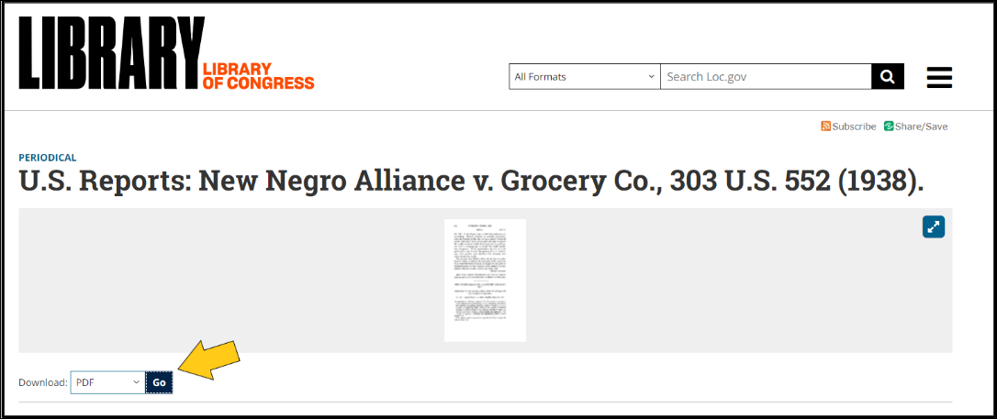
Opinion Sources
Court opinion: "those having a direct or indirect interest in the matters of employment have the freedom to take action against discrimination and peacefully persuade others."
Opinion Sources:
Court/dissenting opinions
Gale Opposing Viewpoints in Context
Op-eds in major newspapers
Notes:
Teaching notes
Suggested Pacing: 3 minutes
Directions:
Say, "Finding opposing viewpoints on your topic can help you develop a more objective perspective. Especially if you are studying current or historical events, it is important to understand all positions. There are several resources that are helpful for finding opinions on an issue. The Library of Congress and Supreme Court Database offer access to court decisions. After trials, the judge will record the details of the case and court opinions. These reports also include dissenting opinions. This is a great tool for understanding different perspectives on the case at hand."
Say, "Take a look at the court decision in the first major case involving the NNA. In your research groups, pull up the report and skim through, looking for major opinions/dissenting opinions. Discuss the potential impact of this report."
Invite students to access the report here. Give students a few minutes to explore the report and discuss.
Read aloud the court opinion on the screen. Ask, "What is the impact of this opinion?" Invite 2-3 students to share out oud with the class.
Say, "The DCPL database offers a great tool, called Gale Opposing Viewpoints in Context. This database allows you to search a topic and find a variety of relevant opinions. Op-eds in newspapers can also be helpful for finding public reaction to current events. The DCPL research database has several sites that allow you to search historical newspaper issues, such as the Washington Post, New York Times, or regional papers."
Student Look Fors:
Students might share that this ruling strengthened the NNA and gave them legal support in demanding other businesses implement fair hiring practices.
Attributions:
"New Negro Alliance v. Grocery Co., 303 U.S. 552 (1938), courtesy of The Library of Congress.
Gale Opposing Viewpoints in Context, courtesy of D.C. Public Library

Slide 9
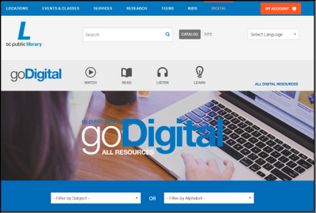
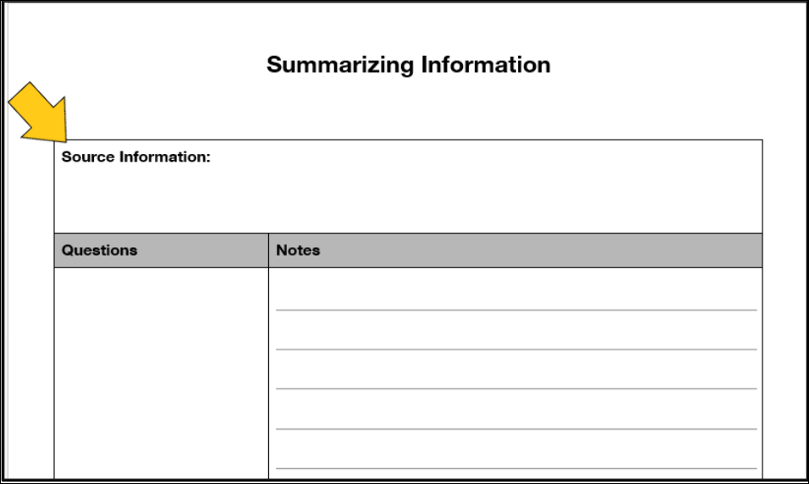
Express your Understanding
Using the D.C. Public Library's Online Database, and your key words, find at least three different types of sources for your research.
Court/dissenting opinions
Gale Opposing Viewpoints in Context
Op-eds in major newspapers
Choose from:
reference sources
articles
primary sources
opinion sources
*Record your source information on your note-catchers.
Notes:
Teaching notes
Suggested Pacing: 10 minutes
Directions:
Using an established classroom routine, distribute three Summarizing Information note-catchers to each student.
Say, "Now it's your turn to find appropriate sources for your research. Using the DCPL Online Database and your key words, find at least three different types of sources for your research. Keeping in mind all that we have learned about different types of sources, choose the best sources for your research purposes. Record your source information at the top of each Summarizing Information note-catcher."
Walk around, making sure each student is engaged in finding three sources and recording the information as they work. Collect the Summarizing Information note-catchers as a formative assessment.
Student Look Fors:
Responses will vary.
Student Summarizing Information note-catchers include:
at least three different sources
three sources are recorded in Source Information section
information from sources recorded on note-catcher
Attributions:
Online Digital Database, courtesy of D.C. Public Library

