Slide 1
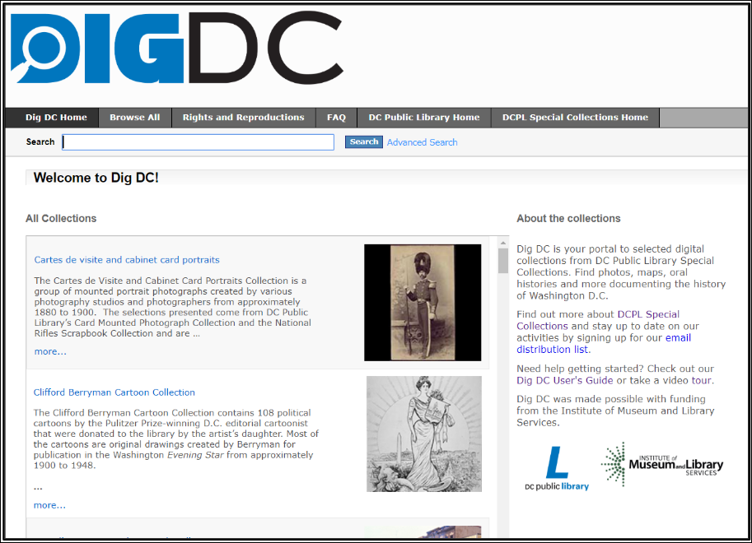
How can I use the collections on DigDC?
How to Use Library: High School, Lesson 9
Notes:
About this lesson
This lesson instructs students on using DCPL's digitized Special Collections for research, which can be accessed through the DIGDC database. It references items and research topics from the 12-grade cornerstone project, When should people fight for change?
Materials:
Summarizing Information
Police Report
ELA Standards:
RI.11-12.7: Integrate and evaluate multiple sources of information presented in different media or formats (e.g., visually, quantitatively) as well as in words in order to address a question or solve a problem.
RH.11-12.1: Cite specific textual evidence to support analysis of primary and secondary sources, connecting insights gained from specific details to an understanding of the text as a whole.
W.11-12.8: Gather relevant information from multiple authoritative print and digital sources, using advanced searches effectively; assess the strengths and limitations of each source in terms of the task, purpose, and audience; integrate information into the text selectively to maintain the flow of ideas, avoiding plagiarism and overreliance on any one source and following a standard format for citation.
Prepare in Advance:
Each student will need research questions and keywords, related to DC history.
Ensure that technology is in place for individual research. Both the teacher and students will also need a DCPL library card number to login to databases.
If a student does not have a library card, he/she can apply here.
DC Content Power Standards:
12.DC.10.2: Describe disturbances resulting from racial tensions.
12.DC.10.3: Explain how African American leaders resisted discrimination.
C3 Framework Indicators and Common Core Standards for Literacy in History/Social Studies:
D2.His.1.9-12: Evaluate how historical events and developments were shaped by unique circumstances of time and place as well as broader historical contexts.
D2.His.14.9-12: Analyze multiple and complex causes and effects in the past.
Attribution:
DigDC collections, courtesy of D.C. Public Library

Slide 2
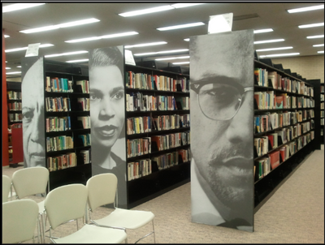
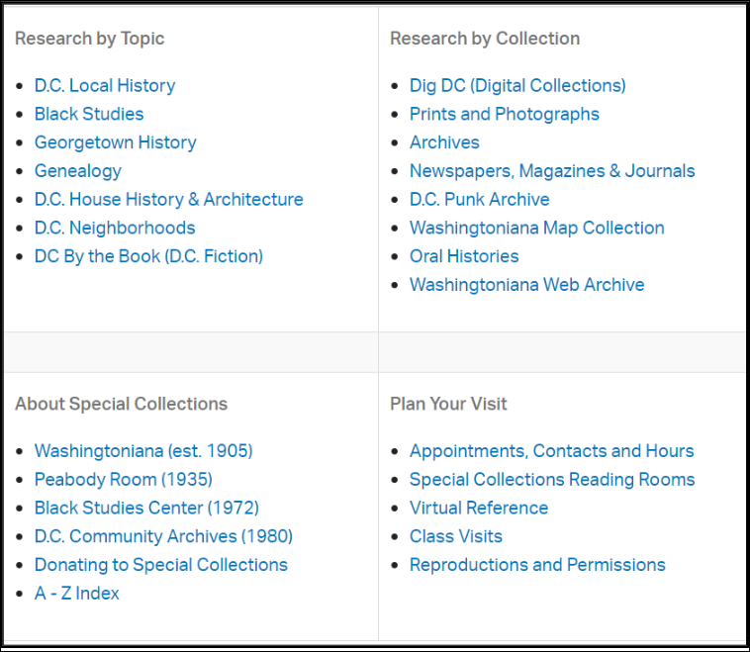
Guiding Questions
How can collections on DigDC help me with my research?
Notes:
Teaching notes
Suggested Pacing: 2 minutes
Directions:
Say, "What is DigDC? The DC Public Library has many archival collections, focused on specific aspects of DC's history. While you can find these collections physically at the library, you can access the digital copy through the DigDC database. (For example, the Peabody Room located at the Georgetown Neighborhood Library contains historical artifacts, photographs, articles, etc. related to Georgetown History, but you can also search for digitized versions of these items on DigDC)
Say, "DigDC is an excellent source for primary sources. Here, you will find photographs, artifacts, newspaper clippings, maps, oral histories, and much more. This is a great place to find eye-witness accounts of DC's historic events."
Attribution:
D.C. Library Special Collections, courtesy of D.C. Public Library

Slide 3
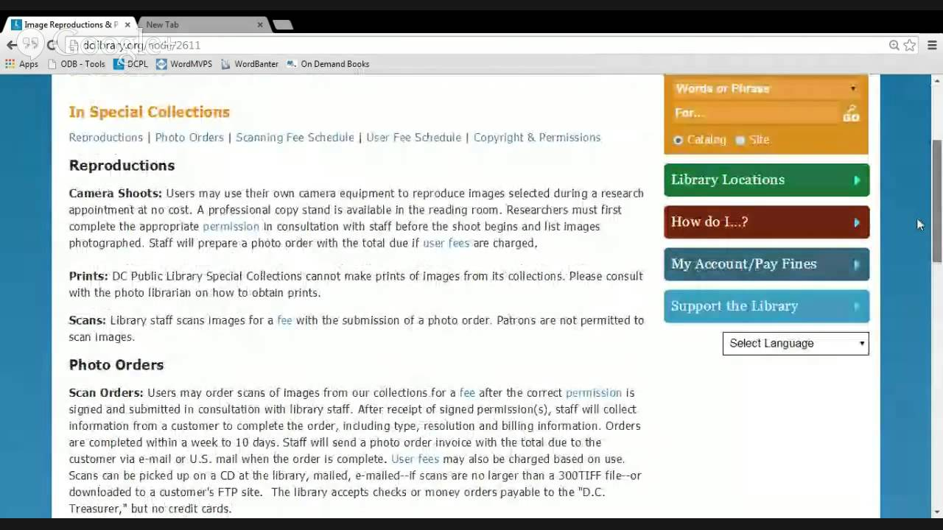
Getting Started with DIGDC
Notes:
Teaching notes
Suggested Pacing: 7 minutes
Directions:
Say, "The DIGDC website includes a video tour of the site, to help you use it most effectively. Let's watch together and learn how to use the database." Play the video and watch together as a class.
Using an established classroom routine, distribute electronic devices to each student, or to small groups. You and each student will need access to a D.C. One library card number.
Direct students to go to www.dclibrary.org on their devices.
Once there, have students navigate to the DIGDC database by hovering over the "Research" tab at the top of the page and selecting "DIGDC".
Student Look Fors:
Students exploring the DIGDC website
Attribution:
"Dig DC User Guide," DIGDC, courtesy of D.C. Public Library

Slide 4
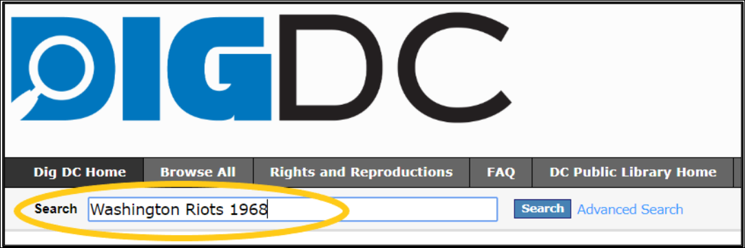
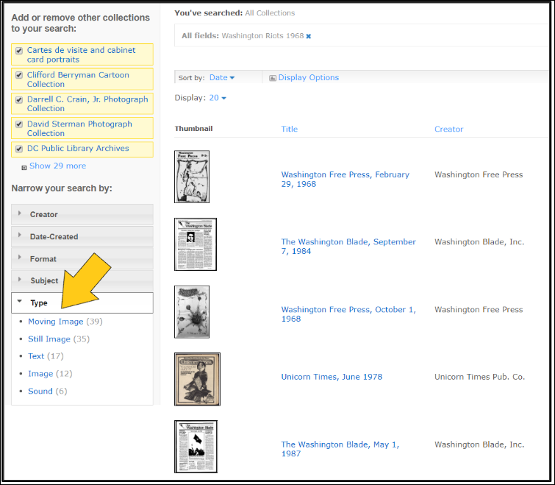
Getting Started: DigDC
To get started on DIGDC…
Use keywords from your research questions to search.
Scroll through your results:
Use the sidebar to narrow your search by source type or specific collections.
Notes:
Teaching notes
Suggested Pacing: 2 minutes
Directions:
Each student will need research questions and keywords, related to DC history, to begin exploring the DIGDC site.
Say, "Use your keywords from your research questions to begin your search. Enter these keywords into the search bar. Once your search results are generated, you can filter them further by selecting or omitting specific collections, or by choosing a specific type of source, such as image, or sound."
Say, "As you are collecting sources, remember to select a variety of types and to look for multiple perspectives about your topic."
Student Look Fors:
Students using keywords to explore the DIGDC website. Students might explore using different search filters.
Attribution:
DIGDC, courtesy of D.C. Public Library

Slide 5
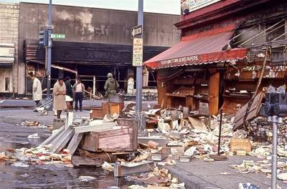
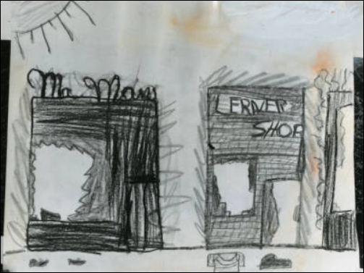
DIGDC Sources: Photos
What information do these photos add to my research?
Washington Riots of 1968 were highly destructive; businesses were completely destroyed.
Fires and smoke filled the city.
Children were exposed to the violence and damage.
Notes:
Teaching notes
Suggested Pacing: 2 minutes
Directions:
Say, "Using the DIGDC search tool, you can narrow your search down specifically to images."
Ask, "What kind of information can photos or other images add to research?" Invite 2-3 students to share out loud with the class.
"Say, "Let's look at these two images I found as I searched 'Washington Riots of 1968.' The top image is of a torn down newsstand in central DC during the riots. The bottom is a photograph of a drawing done by a child after the riots. Hmmm...what information do these images give me about my topic? Both images show the level of intense destruction in the city. They show how fire, violence, and rooting destroyed businesses. The bottom image shows that children were exposed to this destruction."
Student Look Fors:
Images help researchers understand the historical context of events, provides evidence from events.
Attributions:
"Torndown newsstand after rioting," DIGDC, courtesy of D.C. Public Library
"Child's Drawing of Uprising Destruction," DIGDC, courtesy of D.C. Public Library

Slide 6
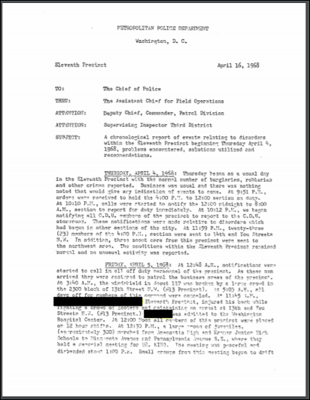
DIGDC Sources: Photos
What new information is learned from this document?
Notes:
Teaching notes
Suggested Pacing: 6 minutes
Directions:
Using an established classroom routine, distribute a paper copy of the police report, accessed from DIGDC.
Say, "DC Special Collections includes historical documents such as legal reports, newspaper clippings, journal entries, letters, etc. These documents are helpful in understanding various perspectives of eye-witnesses. Understanding the context and public perception of historical events can give us a more well-rounded understanding of events. Take a look at this police report, filed during the Washington Riots of 1968. Read this document independently, looking for new information about the riots. Highlight and annotate on your copy, noting new information."
Ask, "What new insight do we gain from reading this document? What bias may exist in this source?"
Student Look Fors:
Students identify the following important information:
The memorial held in honor of Dr. Martin Luther King, Jr, was calm. Rioting broke out gradually in the hours afterward.
Rioting lasted from April 4-April 16.
Description of the type of violence and destruction, including fire, looting, picketing, gun violence
Police force was used to detain rioters; there wasn't enough room on buses and in prisons to hold rioters.
Both police and rioters were killed by gunshot.
The report was written from the perspective of the police, which presents a biased view of the event. Finding sources that document the perspective of the rioters/community will help us form a better-rounded understanding of the event.
Additional Note:
The report contains detailed, graphic descriptions of the violence in the Washington Riots of 1968.
Attribution:
"Chronological report of events relating to disorders within the Eleventh Precinct beginning Thursday, April 4, 1968," DIGDC, courtesy of D.C. Public Library

Slide 7
DIGDC Sources: Audio/Video
Notes:
Teaching notes
Suggested Pacing: 5 minutes
Directions:
Say, "One of the most interesting resources you can find in the DC Special Collections are the oral histories. These have been digitized on DIGDC. Let's listen to this interview with DC native, Kenneth Tolliver. Mr. Tolliver offers his perspective as a member of the black community, during the riots."
Play Part 2 from beginning to 4:00 time stamp. (If time allows, the entire interview can be watched.)
Say, "As we watch, pay special attention to the effects of the riots on the city, from Mr.Tolliver's perspective." Click on the video image to follow the link.
Student Look Fors:
Students might share the following insights:
Mr. Tolliver reiterates the level of destruction in the city during the riots.
Businesses more than houses were destroyed, although some houses were burned.
A woman died from smoke inhalation from an adjacent burning house.
Most businesses destroyed in the riots never reopened.
Attribution:
South of U Oral History Project, DC Public Library

Slide 8
Express Your Understanding
Find three types of sources for your research using the DIGDC database. Include at least two of the following:
photographs
audio recordings
historic documents (legal reports, letters, journal entry, etc.)
artifacts
Record source information and notes for each one on your note-catcher.
Notes:
Teaching notes
Suggested Pacing: 8-10 minutes
Directions:
Using an established classroom routine, distribute three Summarizing Information note-catchers to each student.
Say, "Now that we have explored how to use the DIGDC website and the sources it offers, it is your turn to use it to conduct your own research. Using the database, find at least three sources for your research. In order to have a variety, be sure to include at least two of the following types of sources:
photographs
audio recordings
historic documents
artifacts"
Say, "Be sure to record your source information and relevant notes on your Summarizing Information note-catchers as you work."
Collect students' Summarizing Information note-catchers as a formative assessment.
Additional Note:
The DC Special Collections featured in DIGDC focus on DC History. Each student will need research questions and keywords specific to DC History.
Student Look Fors:
Students using DIGDC to find sources for DC History-related research topics.
Students recording source information and notes on their note-catchers.
Attribution:
DIGDC, courtesy of D.C. Public Library

